Slide 1
Measuring TCP RTT in the data plane
Xiaoqi Chen, Hyojoon Kim, Javed M Aman,
Willie Chang, Mack Lee, Jennifer Rexford

Slide 2
Why measure round-trip time?
Security
BGP hijack, inter-ISP path change
IP spoofing
Performance
Persistent link congestion
Infer user Quality of Experience (QoE)

Slide 3
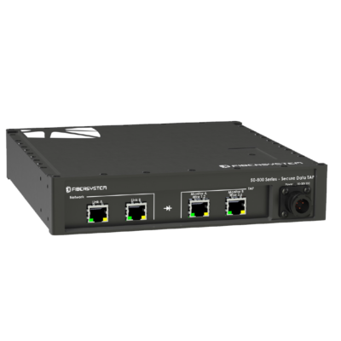
Monitoring at a vantage point
Internet
Passive monitoring: split client-server RTT into two legs¹
Run a programmable switch at the vantage point?
Line-rate traffic, multiple samples per flow
Directly in data plane, enabling real-time reroutes
External Leg
Vantage Point
Internal Leg
Client
¹Cziva et al. Ruru: High-speed, Flow-level Latency Measurement and Visualization of Live Internet Traffic. SIGCOMM 2017

Slide 4
TCP sequence numbers
Internet
External Leg
SYN
ACK
SEQ
ACK
SEQ
ACK
SYN/ACK
Vantage Point
Internal Leg
Client
External Leg RTT
Internal Leg RTT
External Leg RTT
Internal Leg RTT

Slide 5
A table with timestamps
expected ACK:
SEQ + Len
T=105
Outgoing Packet A->B, SEQ=1001, Len=3 (eACK=1004)
Flow id, eACK | Timestamp
(A->B, 1001) | T=101
(A->B, 1004) | T=105
(A->C, 1050) | T=122
(D->E, 1020) | T=107
Insert record
Match & erase
T=125
RTT = 3
Incoming Packet C->A, ACK=1050

Slide 6
Challenge: delayed ACK
Issue 1: ACK is not immediate, might be delayed for 50ms
Solution: heuristics
Look at ACKs for MTU-sized packets, likely not experiencing delay
Issue 2: Many packets never receive their ACK
Solution: lazy-expiration of entries
An entry is considered timed out when timestamp is too old
Upon table insertion, check timestamp and erase old entry

Slide 7
Multi-stage hash tables
h₂(fid, eACK)
h₄(fid, eACK)
h₁(fid, eACK)
h₃(fid, eACK)
Flow id: *
eACK: ***
Stage 1 |  | Stage 2 |  | Stage 3 |  | Stage 4
Occupied |  | Occupied
Expired |  |  |  | Expired |  | Occupied
Occupied |  | Occupied
Occupied |  | Expired |  | Occupied
 |  | Occupied |  | Occupied |  | Expired
Occupied
T=*
Outgoing Packet
Insert record
Inserted
Per-stage random hash functions
Multiple chances to sidestep hash collisions

Slide 8
Multi-stage hash tables
h₂(fid, ACK)
h₄(fid, ACK)
h₁(fid, ACK)
h₃(fid, ACK)
fid reversed
ACK: ***
Stage 1 |  | Stage 2 |  | Stage 3 |  | Stage 4
Occupied |  | Occupied
Expired |  |  |  | Expired |  | Occupied
Expired |  | Occupied
Expired |  | Expired |  | Expired
 |  | Occupied |  | Occupied
Occupied
T=*
Incoming Packet
Query record
Occupied
Matched RTT
Check every stage, until a match is found

Slide 9
Evaluation
Traffic: captured from 10Gbps campus border links
Metric: % of RTT samples matched
Parameters for multi-stage hash table:
Size per table (# of entries)
Total number of tables

Slide 10
Evaluation
100%
Better
75%
50%
Match rate
25%
0%
2¹²
2¹³
2¹⁴
2¹⁵
2¹⁶
(32KB)
Size per table (# entries)
(0.5MB)

Slide 11
Deployment
Internet
University campus deployment
Mirrored traffic, non-invasive
External leg: cloud service latency monitoring
Internal leg: Wi-Fi client latency diagnostics
External Leg
Mirrored
Vantage Point
Tofino
Internal Leg
Campus

Slide 12
Summary, Q&A
Match TCP SEQ/ACK numbers for RTT samples
Multi-stage hash table with lazy expiration of entries
Tested & deployed on 10Gbps campus border links
Our P4 code is open-source! github.com/Princeton-Cabernet/p4-projects

