Slide 1
Data-Driven Management of CDN Performance
Mojgan Ghasemi

Slide 2


Serving Content
Challenges of content providers:
  Performance (e.g., high latency)
  Availability (e.g., server down)
  Scalability (e.g., many requests)
  Security (e.g., DOS attacks)
Content Provider
Clients

Slide 3

Content Distribution Networks (CDNs)
CDN: distributed caching servers
  Akamai, Limelight, CloudFlare
Most web content is served through CDNs
  Akamai served 15-30% of all web traffic in 2016
Content Provider
(origin)
CDN
(edge servers)
Clients

Slide 4
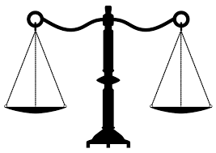
Goals of CDN
  Good performance (for clients)
  Low latency
  High throughput
Reasonable cost (for CDN)
    Bandwidth
    Disk capacity

Slide 5
Sources of Poor Performance
Edge server is too far from clients
  Not enough replicas
  Poor mapping
Poor edge server performance
Network path congestion
Client’s bad browser or rendering engine
Cache misses at the edge server
Edge server is too far from origin
Content Provider
(origin)
CDN
(edge servers)
Clients

Slide 6

Techniques For Managing CDN Performance
“Measurement” is key in achieving these goals.
Content Provider
(origin)
  Allocate resources efficiently across the platform
CAM (TE)
  Diagnose e2e performance problems
CDN
(edge servers)
  Diagnose TCP connection problems efficiently
Diva
(HTTP)
Dapper
(TCP)
Clients

Slide 7



Our Approach
Data sets at industry scale
100s of servers & billions of requests
Analyze
Edge server request logs
Optimize CDN config
Better system design
Trigger finer-grained measurement
Measure
Act
Performance logs
(both sides)
Fine-grained TCP metrics

Slide 8
The Three Pieces
TE
(CAM)
HTTP
(Diva)
TCP
(Dapper)
Project | Publication | Contribution | Real-world Deployment
CAM (Akamai) | In preparation | Large scale analysis of server request logs, Cache-aware post-mapping optimization | Approved to be deployed in a real cluster of servers in Akamai
Diva (Yahoo) | IMC’16 | Instrumentation of the Yahoo player and edge servers, first dataset with e2e metrics | In production, results were used to optimize CDN and player for NFL-Live
Dapper | SOSR’17 | P4 code for TCP analytics and diagnosis at line-rate at edge | Open sourced P4 prototype, ongoing discussions with Barefoot Networks

Slide 9
Part 1: Cache-Aware CDN Design
Cache-aware mapping (CAM), in collaboration with Akamai

Slide 10
How CDNs work
Mapper’s role:
  Assigns an edge server to client (DNS request)
Best performance at a reasonable cost:
  The edge server can handle it (load)
  The edge server is close by (proximity)
  Avoid going to origin (cache hit rate)
Content Provider
(origin)
CDN
(edge servers)
Mapper
DNS
Clients

Slide 11
Impact of Cache Misses
Costly for CDN:
  $ paid for every bit
  Make Content Provider (CP) unhappy
Impair end-user’s performance:
  Requests that re-buffer have higher cache miss rates
Our goal: Enhance performance and cost while including the impact of cache misses, based on real workloads

Slide 12
Decisions a CDN Makes
Placement: For a given CP which edge servers should be serving the content?
Mapping: For each client of a CP, which one of the replicas should serve it?
Disk Allocation: On an edge server, how should the disk be allocated across CPs?

Slide 13

Example
S1
S2
CP3
CP2
CP1
S3

Slide 14
Maximize Network Performance:
(Minimize Distance to Edge)
S1
S1
CP2
CP2
CP3
CP3
Clusters of clients
CP1
CP1
Mapping
S1
CP2
CP3
CP1

Slide 15
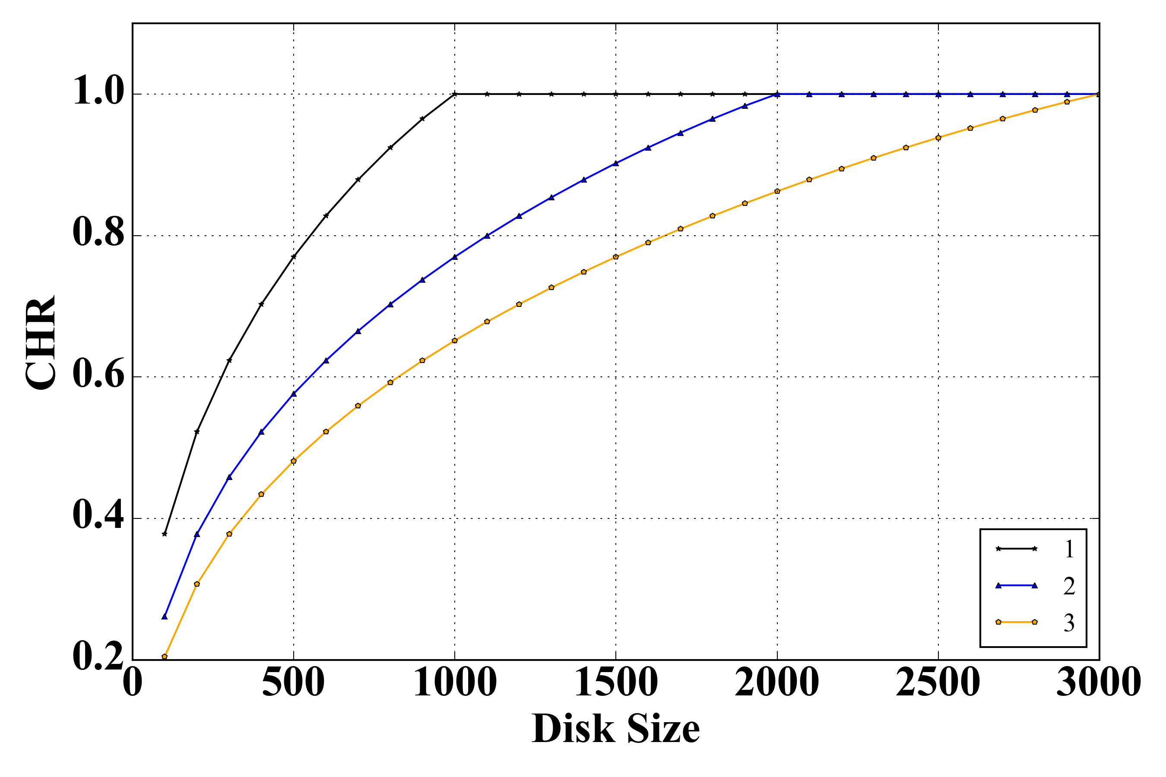
Impact on Cache Hit Rate (CHR)
1 CP
2 CP
3 CP

Slide 16
Maximize Cache Hit Rate
S1
m1
CP1
S2
m2
CP2
S3
m3
CP3

Slide 17
Goal: Optimize both (cost and performance)
Balance the goals
S1
S1
CP1
CP3
CP3
CP2
S1
CP1
CP2

Slide 18
Observation
Diminishing Returns in both aspects of optimization
1. One CP per edge-server:
Can fit the tail, but the tail is unpopular
2. Every CP everywhere:
Performance may already be adequate!

Slide 19
Disk Allocation
Goal: Minimize overall cache miss rate
  Shared cache
Goal: Minimize the impact of cache misses
  CP1’s cache misses are more costly than CP2’s
The ability to partition the cache is worth it!
CP1
CP2
S1
CP1
CP2

Slide 20
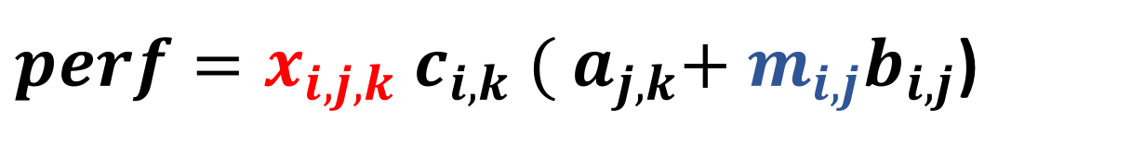
Unified Performance Model
i
Notations:
  x_{i,j,k} : portion of client_{k}’s demand for CP_{i} served by server_{j}
  m_{i,j} : miss rate of of CP_{i} on server_{j}
Content Provider
(origin)
b_{i,j}
CDN
(edge servers)
j
a_{j,k}
$perf=x_{i,j,k}{ c}_{i,k} ({ a}_{j,k}+{{ m}_{i,j}b}_{i,j}$)
Clients
k
  c_{i,k}: demand for CP_{i} from client_{k}

Slide 21
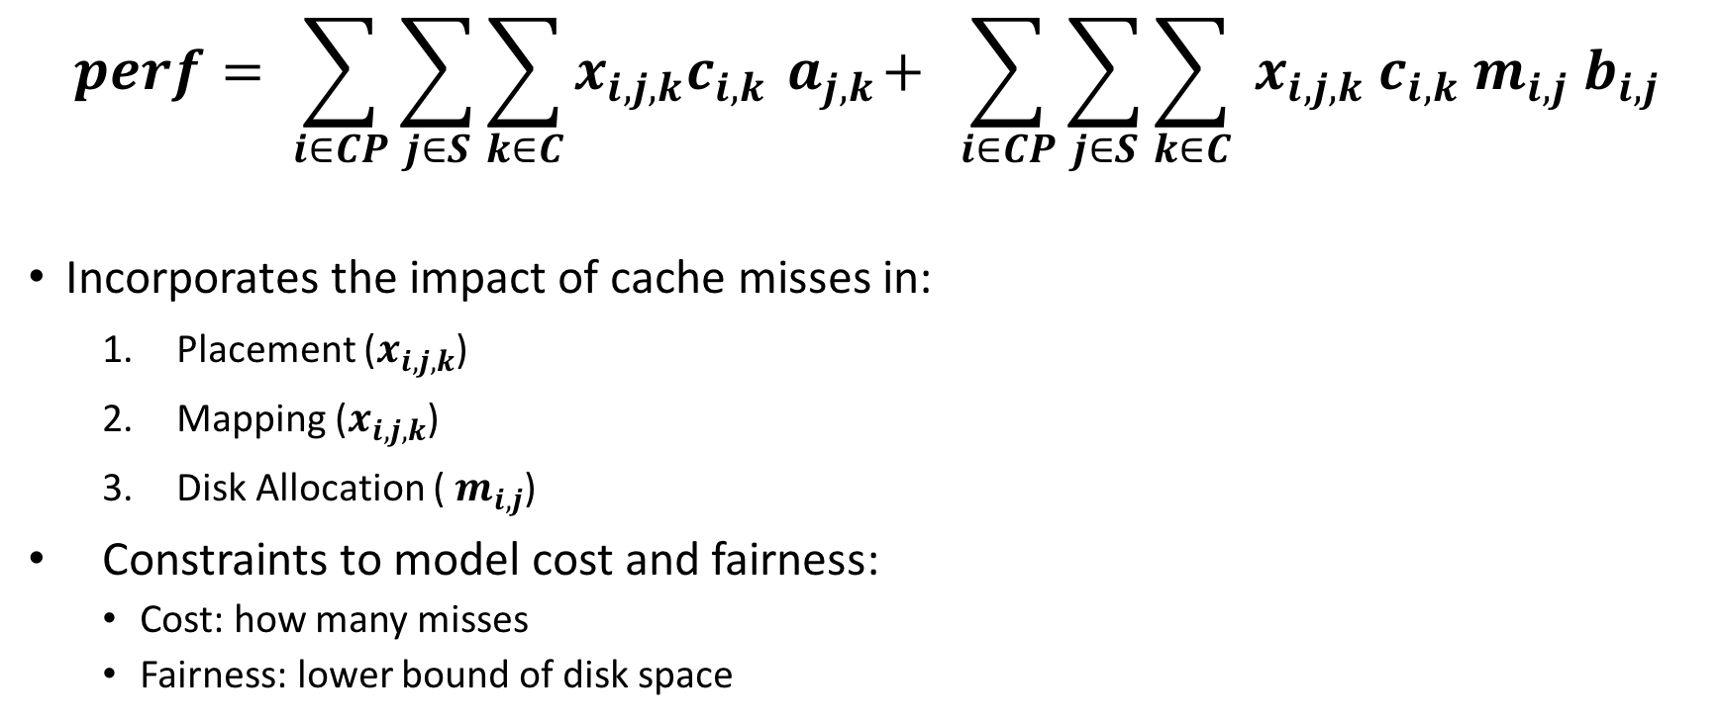
Unified Performance Model
Sum of distances (latency) from clients to edge
$$perf= \sum_{i∈CP}{\sum_{j∈S}{\sum_{k∈C}{x_{i,j,k}c_{i,k}{ a}_{j,k}+ }}}\sum_{i∈CP}{\sum_{j∈S}{\sum_{k∈C}{{{ x}_{i,j,k} c}_{i,k}{ m}_{i,j} b_{i,j}}}}$$
  Incorporates the impact of cache misses in:
    Placement ($x_{i,j,k}$)
    Mapping ($x_{i,j,k}$)
    Disk Allocation (${ m}_{i,j}$)
  Constraints to model cost and fairness:
  Cost: how many misses
  Fairness: lower bound of disk space
Sum of distances (latency) from edge to origin

Slide 22
Solving the Unified Model
Joint optimization is:
  Non Convex
  Non Linear
Choose one!
  Mapping and placement have been studied before!
  Disk Allocation: Can we improve the performance by only managing the disk, with the current mapping?

Slide 23
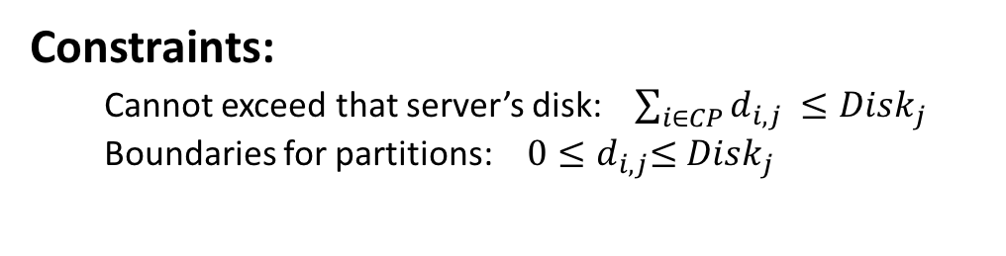


Optimizing Disk Allocation
$$perf= \sum_{i∈CP}{\sum_{j∈S}{\sum_{k∈C}{{x_{i,j,k}{×c}_{i,j,k}× a}_{j,k} + }}}$$
$$\sum_{i∈CP}{\sum_{j∈S}{l_{i,j}{×{ m}_{i,j}×b}_{i,j}}}$$
Sum over all clients to get
per-server demand for each CP
$$l_{i,j}=\sum_{k∈C}{{ x}_{i,j,k}×c_{i,k} }$$
But how can we model the miss rate now?
Constraints:
  Cannot exceed that server’s disk: $\sum_{i∈CP}{d_{i,j} ≤{Disk}_{j}}$
  Boundaries for partitions:$0{≤d}_{i,j}≤{Disk}_{j}$

Slide 24
Modeling Cache Miss Rate
Depends on:
  Cache replacement policy
  Allocated cache per CP
  Popularity laws of CPs
We need:
  Model: cache miss rate vs disk, per CP
  Cannot analytically derive the model (Not all workloads are zipfian)
?
miss-rate
disk

Slide 25
Modeling Cache Misses
Stack distance
DP
overhead
Che
LFU
accuracy
Che’s Approximation:
  Needs popularity distribution and the LRU cache size
  Extensive empirical verification against Akamai’s workload
  This analysis is still expensive
    Run it once
    Curve fit with an analytical expression to speed up optimization

Slide 26
Data Collection and Preparation
Dataset:
  2 days of data, two separate 24 hours worth of data
  26 edge server clusters, with over 300 servers located across the state of PA
  More than 4.5 billion requests
Data preparation:
  Construct popularity distribution per CP
  Fit the cache miss rate vs disk curves
  Latency costs (Time-to-first-byte)
  Per-CP demand

Slide 27
Inputs
50 CPs, on one edge server cluster
Requests: 4,457,590
Objects: 2,912,005
Average and median object size: 1MB
Cache size: 1TB
Popularity distribution of CPs

Slide 28
Results
 | Cache Miss Rate (cost) | Avg Latency (perf)
Shared LRU cache | 22.50% | 37.1 ms

Slide 29
Results
 | Cache Miss Rate (cost) | Avg Latency (perf)
Shared LRU cache | 22.50% | 37.1 ms
Partitioned cache | 22.75% | 31.6 ms
For a slight increase (0.25%) in the overall cache miss rate (i.e., cost), latency was reduced by 14.8%

Slide 30
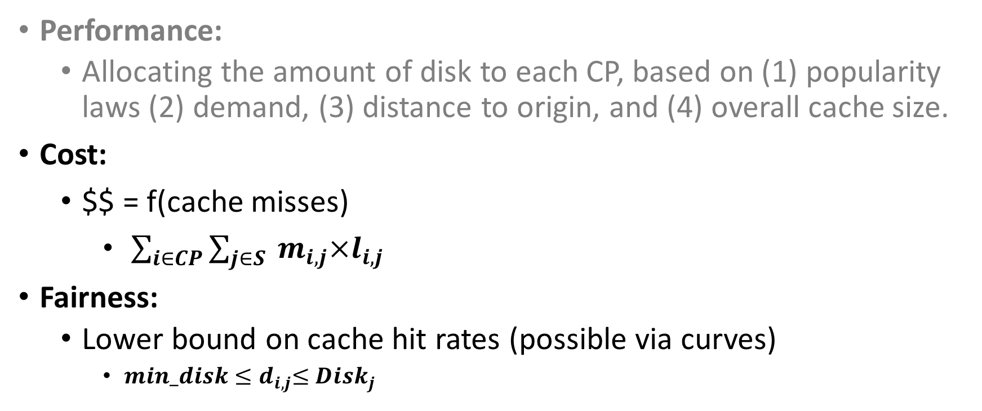
Metrics
Performance:
  Allocating the amount of disk to each CP, based on (1) popularity laws (2) demand, (3) distance to origin, and (4) overall cache size.
Cost:
    $$ = f(cache misses)
      $\sum_{i∈CP}{\sum_{j∈S}{{ m}_{i,j}×l_{i,j}}}$
Fairness:
  Lower bound on cache hit rates (possible via curves)
    $min_disk{≤d}_{i,j}≤{Disk}_{j}$

Slide 31
Conclusion
Characterization of workload
Unified performance model
  Explicitly models the impact of cache misses
  Non-convex, non-linear
Post-mapping disk optimization
  Improve the client-perceived performance at a reasonable cost
Stability analysis
  Workloads are stable enough to do this weekly

Slide 32
Limitation
Joint optimization
Cache re-allocation is expensive
Caching hierarchy is ignored in our simple model

Slide 33
Part 2: Diva
Diagnosis of Internet Video Anomalies, in Collaboration with Yahoo!

Slide 34
Content Provider
(origin)
CAM (TE)
  Diagnose e2e performance problems
CDN
(edge servers)
Diva
(HTTP)
Clients

Slide 35

Unique Dataset
Video makes up 70% of the traffic
First study to measure both sides

Slide 36
Yahoo’s Video Delivery System
Client receives the manifest
HTTP requests for chunks
  sharing a TCP connection
CDN servers use Apache Traffic Server (ATS) and LRU policy in cache
Chunks pass client’s download and rendering stack
Backend
CDN
Network
HTTP requests
manifest
Player

Slide 37
Our Dataset: Yahoo Videos
VoD Dataset:
  Over 18 days, Sept 2015
  85 CDN servers across the US
  65 million VoD sessions, 523m chunks

Slide 38
Our Goal
Identify performance problems that impact video
A content provider (e.g., Yahoo) controls “both sides”
Player
Network
CDN

Slide 39
Our Approach
End-to-end
  Instrumenting both sides (player, CDN servers)
Per-chunk
  Unit of decision making (e.g., bitrate, cache hit/miss)
  Sub-chunk is too expensive
TCP statistics
  Sampled from CDN host’s kernel
  Operational at scale

Slide 40
Our Approach: e2e Per-chunk Measurement
Player
OS
WAN
CDN
Backend
HTTP Get
Cache
miss
D_{FB}
D_{CDN} + D_{BE}
D_{DS}
D_{LB}

Slide 41
Findings
Location | Findings
CDN | 1. Asynchronous disk reads increase server-side delay.
 | 2. Cache misses increase CDN latency by order of magnitude.
 | 3. Persistent cache-miss and slow reads for unpopular videos.
 | 4. Higher server latency even on lightly loaded machines.
Network | 1. Persistent delay due to physical distance or enterprise paths.
 | 2. Higher latency variation for users in enterprise networks.
 | 3. Packet losses early in a session have a bigger impact.
 | 4. Bad performance caused more by throughput than latency.
Client | 1. Buffering in client download stack can cause re-buffering.
 | 2. First chunk of a session has higher download stack latency.
 | 3. Less popular browsers drop more frames while rendering.
 | 4. Avoiding frame drops needs min of 1.5 sec/sec download rate
 | 5. Videos at lower bitrates have more dropped frames

Slide 42
Server-side Performance Problems
Direct measurement
Player
CDN
Session ID
Chunk ID
Startup time
Re-buffering
Video quality
Session ID
Chunk ID
Server latency (D_{CDN} )
Backend latency (D_{BE})
Cache hit/miss

Slide 43
Cache Misses and ATS Configuration
Cache misses increase server latency
  40X median, 10X average
Server latency can be worse than network
  Caused by cache misses (40% miss rate)
ATS read timer: retry from memory to disk
Unpopular video titles are most affected in both cases
memory
disk
backend
request

Slide 44
Network Measurement
Challenges:
Smoothed average of RTT: SRTT
Infrequent network snapshots
Packet traces cannot be collected

Slide 45
Network Latency Problems
Persistent high latency:
  /24 IP prefixes, recurring in 90th percentile
  25% of prefixes are located in the US, with the majority close to CDN nodes
High latency variation:
  Enterprise networks have higher latency variation

Slide 46
Earlier Packet Losses Cause More Rebuffering
Packet loss is more common in the first chunk (4.5X)
Packet loss in the first chunk causes more rebuffering

Slide 47

Download Stack Latency
Cannot observe download stack latency (D_{DS} ) directly at scale
Detecting “outliers” :
  D_{FB} > μ_{DFB} +2· σ_{DFB}
  TP_{inst} > μ_{TPinst} + 2 ·σ _{TPinst}
  Similar network and server performance
Download Stack
Network
NIC
OS
Browser
Player
Player
OS
WAN
CDN
Backend
HTTP Get
Cache
miss
D_{FB}
D_{CDN} + D_{BE}
D_{DS}
D_{LB}

Slide 48
Download Stack Latency: Case Study

Slide 49
Rendering Stack
If CPU is busy, rendering quality drops (high frame drops)
If video tab is not visible, browser drops frames
Per-chunk data: vis (is player visible?), dropped frames
Rendering Stack
(CPU or GPU)
Player
Screen
Demux
(audio/video)
Decode
Render

Slide 50
Good Rendering Needs 1.5 sec/sec Download Rate
De-multiplexing, decoding, and rendering takes time.

Slide 51
Take-Aways
Problem | Take-away
Cache miss persistence | Pre-fetch subsequent chunks
Prefixes with persistent high latency or variation | Adjust ABR algorithm accordingly (more conservative bitrate, increase buffer size)
Packet loss more harmful in first chunk | Pacing, Loss rate does not necessarily correlate with QoE
Download stack latency | Can cause over-shooting or under-shooting by ABR, incorporate server-side TCP metrics
Rendering is resource-heavy | Use 1.5 sec/sec video arrival rate as a rule-of-thumb

Slide 52
Conclusion
Instrumenting both sides
Uncover range of problems for the first time
Per-chunk and per-session data
Uncover “persistent” vs. “transient” problems
Our findings have been used to enhance performance in Yahoo

Slide 53
Limitations
Limited snapshots of network statistics
Indirect measurement of network
Averaged statistics (e.g., SRTT) instead of individual samples
No access to the client’s download stack (inference)

Slide 54
Part 3: Dapper
Dataplane Performance Diagnosis of TCP Connections

Slide 55
Content Provider
(origin)
CAM (TE)
CDN
(edge servers)
  Diagnose TCP connection problems efficiently
Diva
(HTTP)
Dapper
(TCP)
Clients

Slide 56
Challenges of Efficient TCP Diagnosis
Collecting TCP logs at end-hosts:
  Patching kernels (e.g., Web10G)
  Frequently snapshotting TCP metrics from the kernel (e.g., tcp_info)
Insufficient Information
  Lack of flexibility (e.g., SRTT instead of individual RTT samples)
  Practicality (not enough for performance diagnosis)
Overhead
  Monitoring consumes the resources and slows down the servers
  Snapshots takes a lot of storage
  Can only monitor a few connections, or at low frequency

Slide 57

Sources of Poor TCP Performance
Segment size, MSS, App reaction time
Not backlogged!
Delayed ACK
Receive window, delayed ACK
App
App
Send buffer too small
Receive buffer is full
Congestion window,
RTT, loss
High RTT
High Loss
Low BW
Identifying the faulty component is the most time-consuming and expensive part
Our goal: quickly pinpoint the component impairing TCP performance

Slide 58
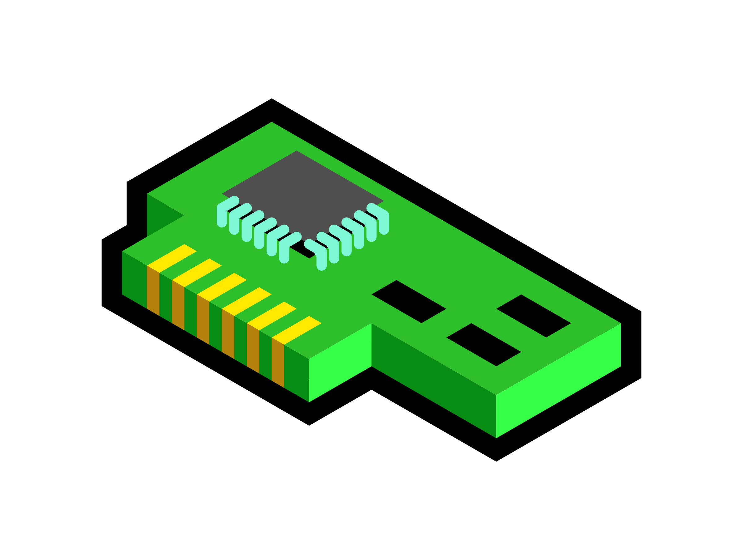
Location of Performance Monitoring
NIC
Edge
Switch
No visibility into e2e metrics,
Not owned by CDN
App
Infrequent network snapshots,
Packets cannot be collected
Application
Edge
Core
Efficient monitoring in hardware at linerate,
Sees both directions,
No need to poll metrics,
  Immediately actionable
Notes:
Now that we know what metrics to measure
we need to know where to monitor the performance of these connections
Instrument VMs directly, have e2e metrics, but violates trust
Monitoring at the core uses the monitoring functionality available at switches but
We think that The edge seems like the best viable option
By edge we mean Hypervisor, NIC, top-of-rack switch
The edge
(i) Is compatible with IaaS cloud
(i) sees all of a TCP connection’s packets in both directions,
(ii) can closely observe the application’s interactions with the network without the tenant’s cooperation
(iii) can measure end-to-end metrics from the end-host perspective (e.g., path loss rate) because it is only one hop away from the end-host.

Slide 59

Challenges of Diagnosis at the “Edge”
Single pass on packets (replay is not possible)
Support different TCP variants and configurations
Need bi-directional monitoring
Low overhead (state and operations on switch)
Only one edge
Reno, Cubic,…
App
Limited registers

Slide 60
Stateful Data-plane Programming
Barefoot switch, Xilinx FPGA, Netronome NIC
P4 language
Parse
Tables
&
Actions
Operations
(+,-,max,..)
Registers

Slide 61

Diagnosing Sender Problems From the Edge
Detect if sender is sending “Too few” or “Too late”
MSS:
  Extract TCP options, or max of “segment sizes” seen
App Reaction Time:
  Must track both directions
  Arithmetic operation (subtraction)
App
Seq2
Ack1

Slide 62
Diagnosing Receiver Problems From the Edge
Receive Window:
  Parse header to extract TCP option
  Arithmetic operations (shift to scale the window)
Delayed ACK:
  Must track both directions
  Comparison operations (Seq. vs Ack)
App
Seq3
Seq2
Seq1
Ack3

Slide 63
Inferring Network Latency
RTT:
  Need both directions (sequence numbers and ACKs)
  Comparison operations (ACK ≥ Seq)
  Arithmetic operations (subtraction)
App
Seq, timestamp
Ack, timestamp

Slide 64
Inferring Network Loss
Loss:
  Detected via re-transmission
  Comparison operation (sequence numbers)
  Kind of loss: Registers and metadata to compare the dup ACKs
Seq1
App
Seq1

Slide 65
Inferring Congestion Window
Congestion Window:
  Different TCP congestion controls
  Unknown threshold (e.g., ssthresh to exit slow start)
  Tuned parameters (e.g., Initial window)
TCP Invariants:
  Flight size is bounded by CWND
    Lower-bound estimate of congestion window
  Packet loss changes CWND based on the nature of loss
    A timeout resets CWND to initial window
    A fast-retransmit causes a multiplicative decrease in CWND

Slide 66
Inferring Flight Size
Flight size: number of packets sent but not ACKed yet
App
Seq2
Seq1
Flight Size : 1
Flight Size : 2
Flight Size : 1
Flight Size : 0
Ack1
Ack2

Slide 67
Estimating CWND
If flight size increases:
  CWND maintains a moving max
If a packet loss is observed:
  Decrease CWND appropriately
From different starting points:
  Beginning
  After 1 sec
  After 3 sec
(b)
(c)

Slide 68
Overhead in Hardware
Prototype: P4, behavioral model 2: http://www.princeton.edu/~mojgan/dapper.html
Hardware: Runs at line-rate, but limited memory
  keeps 67B per connection
Collision in hash table:
  K connections, hash table size of N

Slide 69
Dapper’s Limitations
Diagnosis granularity
  Identifies the component (network, sender, or receiver)
  Large set of existing fine-grained tools at each location
Hardware capabilities
  Accessing a register at multiple stages
Hardware capacity
  Switches have a limited number of registers
  Collision reduces the monitoring accuracy

Slide 70
Part 4: Conclusion

Slide 71
Conclusion
Allocate resources efficiently across the platform:
Unified performance model to include the impact of cache misses
Post-mapping disk optimization
Large scale analysis and characteristics of CDN workloads
Content Provider
(origin)
CAM (TE)
Diagnose TCP connection problems efficiently:
Real-time TCP diagnostic system
Runs at line-rate at the edge
Reconstructs the internal state of a TCP connection on the edge
Diagnose e2e performance problems:
Chunk-based e2e instrumentation and methodology
First dataset with e2e metrics
Uncovered a wide range of problems
CDN
(edge servers)
Diva
(HTTP)
Dapper
(TCP)
Clients

Slide 72
Thank you ☺

