Slide 1
Heavy-Hitter Detection Entirely in the Data Plane
Vibhaalakshmi Sivaraman
Srinivas Narayana, Ori RottenSTREICH, MUTHU MuthuKRSISHNAN, JENNIFER REXFORD
Notes:
In this talk, I will be presenting a heavy-hitter detection algorithm that exploits programmable switches and allows for both detection of and response to the heavy hitters entirely in the dataplane itself.
Firstly, thank you all for giving me this opportunity to present my work here. I am going to be talking about a heavy-hitter algorithm for emerging switch hardware. This is joint work with Srinivas Narayana, Ori Rottenstreich, Muthu Muthukrishnan and Jen Rexford. This will be presented at SOSR 17 later this April.
Emerging programmable switches provide us a new computational model which allows for a wide range of new problems to be solved.

Slide 2
Heavy Hitter Flows
Flows above a certain threshold of total packets
“Top-k” flows by size
Port: 22, Count: 100
Port: 30, Count: 200
k = 2
Port: 15, Count: 200
Port: 80, Count: 100
Notes:
A flow is a set of packets that have been grouped on a certain field or unique way of identifying them. This might be the source port, destination port, source or destination ip address or the unique id consisting of all of these fields (5-tuple). Heavy hitter refers to all those flows that exceed a certain threshold of the total number of packets seen on the link. Alternatively it could also refer to the top-k flows by size. These two problems are interconvertible and we will stick to the Top-k problem for the remainder of this talk.
For example, in the above network, if you were interested in the top 2 flows on the link where flows are packets grouped by source port, those would be the applications using Port 30 and Port 15 with 200 packets each.

Slide 3
Why detect heavy hitters?
Trouble-shooting and anomaly detection
Dynamic routing or scheduling of heavy flows
f1
f1
Flow | Count
f1 | 100
f2 | 75
f3 | 5
f2
f2
Notes:
While heavy hitter detection in itself is an interesting problem generally useful for trouble-shooting and anomaly detection, detecting heavy hitters in the data plane itself allows us to solve an entire different set of problems. This is because we can instantaneously respond to the heavy hitter flows and dynamically schedule them or route them differently. For example, Hedera adaptively schedules flows in a datacenter to efficiently utilize network resources, It first detects the large flows at the edge switches, then estimates their demands and computes placements for them at the controller. Based on this, rules are then installed on the switches. If we were able to detect large flows in the data plane itself, this loop would be faster and the measurement would also be more accurate as opposed to based on information about flows sometime in the past.

Slide 4
Problem Statement
Restrict processing to data plane
Low data plane state
High accuracy
Line-rate packet processing
Notes:
With this need in mind, we are interested in not just a heavy hitter detection algorithm, but one with certain properties.
(ii) maintain all the heavy hitter information in the dataplane itself in a datastructure to enable both detection and response to the heavy items in the data plane, without going through the controller and (iii) low state - maintain state proportional to the number of heavy flows, instead of the total number of flows.
high accuracy – this means that we process all packets, report both the heavy hitters and their associated counts accurately
Do not give up on packet processing speeds - this means that the operation performed by the switch on each packet also needs to happen in a deterministic manner within the packet processing time budget
In essence, what we need is an algorithm that is able to detect heavy hitters immediately in the data plane as packets are processed and respond to the heavy hitter detection without needing to go through a controller and incurring that delay in response

Slide 5
Emerging Programmable Switches
Programmable switches with stateful memory
Basic arithmetic on stored state
Pipelined operations over multiple stages
State carried in packets across stages
Stage 1
Stage 2
Stage 3
Stage 4
Packet p
Notes:
FLOW – Given that we are developing an algorithm for dataplanes, it is important to set up the context of what these dataplanes, within emerging programmable switches look like.
These switches provide numerous new opprotunities in that these switches can do more than just hash and count on packets.
They can be programmed to store and manipulate state (usually in the form of registers or SRAMs) across packets. Further, they can also be programmed to perform basic arithmetic including comparisons between a flow’s packet count and its corresponding state maintained in memory.
Given that the switch processes packets in stages of match action tables, these manipulations can further be pipelined across multiple stages with the packets carrying information from one stage to another.

Slide 6
Constraints
Small, deterministic time budget for packet processing at each stage
Limited number of accesses to stateful memory per stage
Limited amount of memory per stage
No packet recirculation
Notes:
However, these switches come with their own limitations also.
Given the speed at which packets are processed in a switch, we usually have a deterministic budget for performing operations on packets, typically in the order of a few nano seconds. There are also a limited number of reads and writes that can be performed on the memory in each stage, usually one read-modify-write.
Further, the memory allocated per stage is limited and this needs to be shared between forwarding rules and state for monitoring and collecting statistics.
Lastly, since multiple packets might be simultaneously processed by the switch pipeline, it is feed-forward DESIRABLE TO PROCESS IT EXACTLY ONCE IN ORDER TO MAINTAIN THROUGHPUT and not hold packets for too long
What is the memory available per stage?

Slide 7
Existing Work
Technique | Pros | Cons
Sampling-based (Netflow, sflow, Sample & Hold) | Small “flow memory” to track heavy flows | Underestimates counts for heavy flows
Sketching-based (Count, Count-Min, Reversible) | Statistics for all flows in single data structure | No flow identifier to count association
Counting-based (Space Saving, Misra-Gries) | Summary structure with heavy flow ids and counters | Occasional updates to multiple counters
Notes:
This problem is a very well researched problem with a number of solutions based on the metrics of interest. The existing work can be classified into a few broad categories.
Sampling techniques sample packets every often and expects to capture the heavy hitting flows in the process. However, depending on the sampling rate, it could either completely miss heavy hitting flows or underestimate the packet counts associated with the heavy hitting flows, thus AFFECTING THE ACCURACY OF THE COUNTS ASSOCIATED WITH FLOWS. Sample and Hold tries to overcome these problems by sampling flows instead so that all future packets of a flow once one packet belonging to it is sampled.
The other class of solutions is streaming-based which perform a certain set of operations on every packet that is observed. Sketching based techniques like the count-min sketch. Reversible sketches, etc. update a certain statistic for all flows observed without maintaining flow identifiers and post-processing might help decode what the per-flow statistic is. However, this lack of flow identifier to count association means that post-processing is needed and we cannot respond to the heavy hitters in the data plane itself.
Counting based approaches on the other hand, focus on measuring the heavy items alone in a table of flow identifiers and associated counts. Though on average, each packet updates only one counter, there could be some insertions that need to update multiple counters: an operation that is challenging within the deterministic processing time budget for each packet and thus making immediate responses harder.

Slide 8
Motivation: Space-Saving Algorithm¹
O(k) space to store heavy flows
Provable guarantees on accuracy
Evict the minimum to insert new flow
Multiple reads but exactly one write per packet
¹Metwally, Ahmed, Divyakant Agrawal, and Amr El Abbadi. "Efficient computation of frequent and top-k elements in data streams." International Conference on Database Theory. Springer Berlin Heidelberg, 2005.
Notes:
Our HashPipe algorithm is motivated by Space Saving algorithm, a counter based algorithm which uses O(k) space, the best possible for a deterministic algorithm, to identify the top-k flows. if space = O(k), then all items with counts > 1/k of the total will always be found and the maximum error in any maintained counter is not more than 1/k of the total
Space-saving updates one counter corresponding to the incoming flow if it is already present in the table. However, if the table doesn’t have the flow already, it scans the entire table to find the minimum amongst the k flows and evicts that flow. The new flow is inserted with a flow count that is one more than the evicted flow’s count.

Slide 9
Space Saving Algorithm
Flow Id | Packet Count
K1 | 4
K2 | 2
K3 | 7
K4 | 10
K5 | 1
Flow Id | Packet Count
K1 | 4
K2 | 2
K3 | 7
K4 | 10
K6 | 2
High accuracy
Exactly one write
New Key K6
Entire table scan
Complex data structures
Notes:
For example, in the above example, K8 is not already present in the table, so we find the minimum in the entire table and evict that entry with the new key K8 in its place with count 1 more than the minimum or 2.
For this algorithm to work on hardware, we need a data structure that is able to perform lookup on a key efficiently, increment/overwrite its value as well as find the key with the minimum value efficiently. We can’t have all of these in a single data structure that can meet the 1ns packet processing time requirement.
Thus, we ask ourselves if we modify the Space Saving algorithm incrementally to run on emerging hardware switches? In essence, can we combine the key ideas from the Space Saving algorithm with the capabilities of emerging programmable hardware to come up with a data structure that can give us as close to the 3 requirements that we have?

Slide 10
Towards HashPipe
Technique | Pros | Cons
Space-Saving | High accuracy; Exactly one write-back | Entire table scan; Complex data structures
HashParallel | Sample fixed number of locations; Approximate minimum | Multiple reads per stage; Dependent write-back
Sequential Minimum Computation | Hash table spread across multiple stages; Sample one location per stage | Multiple passes through the pipeline
Notes:
FLOW:
This problem is a very well researched problem with a number of solutions based on the metrics of interest. The existing work can be classified into a few broad categories.
Sampling techniques sample packets every often and expects to capture the heavy hitting flows in the process. However, depending on the sampling rate, it could either completely miss heavy hitting flows or underestimate the packet counts associated with the heavy hitting flows, thus AFFECTING THE ACCURACY OF THE COUNTS ASSOCIATED WITH FLOWS. Sample and Hold tries to overcome these problems by sampling flows instead so that all future packets of a flow once one packet belonging to it is sampled.
The other class of solutions is streaming-based which perform a certain set of operations on every packet that is observed. Sketching based techniques like the count-min sketch. Reversible sketches, etc. update a certain statistic for all flows observed without maintaining flow identifiers and post-processing might help decode what the per-flow statistic is. However, this lack of flow identifier to count association means that post-processing is needed and we cannot respond to the heavy hitters in the data plane itself.
Counting based approaches on the other hand, focus on measuring the heavy items alone in a table of flow identifiers and associated counts. Though on average, each packet updates only one counter, there could be some insertions that need to update multiple counters: an operation that is challenging within the deterministic processing time budget for each packet and thus making immediate responses harder.

Slide 11
Our Solution - HashPipe
Always insert new key in the first stage
Hash to index to a location
Carry evicted key to the next stage
Stage 1
A | 5
K1 | 4
B | 6
C | 10
Stage 2
K2 | 3
D | 15
E | 25
F | 100
Stage 3
G | 4
K3 | 3
H | 10
I | 9
New key K
h₁ (K) -> K1
Notes:
In order to solve the packet recirculation problem, we make local decisions on what the smallest flow might be based on the information observed so far. This means we make updates to the stages as the packet processes through it as opposed to later. So, when we first observe a new flow that is not already present in tits corresponding hash location in he first stage, we give it the benefit of doubt and insert it as a new key with value 1 (because we don’t know what the minimum value is). So, here key k hashes to K1’s location. Given that key K is not already present in stage 1, we insert it with value 1 and evict K1 and carry it over to later stages.

Slide 12
Our Solution - HashPipe
At each later stage, carry current minimum key
Hash on carried key to index to a location
Compare against key in location for local minimum
Stage 1
A | 5
K | 1
B | 6
C | 10
Stage 2
D | 3
E | 15
K2 | 25
F | 100
Stage 3
G | 4
K3 | 3
H | 10
I | 9
(K1, 4)
Notes:
In order to solve the packet recirculation problem, we make local decisions on what the smallest flow might be based on the information observed so far. This means we make updates to the stages as the packet processes through it as opposed to later. So, when we first observe a new flow that is not already present in tits corresponding hash location in he first stage, we give it the benefit of doubt and insert it as a new key with value 1. So, here key k hashes to K1’s location. Given that key K is not already present in stage 1, we insert it with value 1 and evict K1 and carry it over to later stages.

Slide 13
HashPipe
At any table stage, retain the heavier hitter
h₂(K1) -> K2
Max(K1, K2) -> K2
Stage 1
A | 5
K | 1
B | 6
C | 10
Stage 2
D | 3
E | 15
K2 | 25
F | 100
Stage 3
G | 4
K3 | 3
H | 10
I | 9
(K1, 4)
Notes:
Now in stage 2 and all later stages, we make a local decision on what the smallest flow is based on the current minimum carried in the packet and the flow in the location it hashes (HASH ON THE CARRIED KEY) to in the current stage. For instance, we carried over key K1 from the stage 1 with packet count 4. It hashes to the location where flow E is present with packet count 25. Since E is larger, we retain E in its place and carry over K1 to the next stage.

Slide 14
HashPipe
At any table stage, retain the heavier hitter
h₃(K1) -> K3
Max(K1, K3) -> K1
Stage 1
A | 5
K | 1
B | 6
C | 10
Stage 2
D | 3
E | 15
K2 | 25
F | 100
Stage 3
G | 4
K3 | 3
H | 10
I | 9
(K1, 4)
Notes:
Now in stage 2 and all later stages, we make a local decision on what the smallest flow is based on the current minimum carried in the packet and the flow in the location it hashes to in the current stage. For instance, we carried over key K1 from the stage 1 with packet count 4. It hashes to the location where flow E is present with packet count 25. Since E is larger, we retain E in its place and carry over K1 to the next stage.

Slide 15
HashPipe
At any table stage, retain the heavier hitter
Eventually evict a relatively small flow
High accuracy
Single pass
One read/write per stage
Stage 1
A | 5
K | 1
B | 6
C | 10
Stage 2
D | 3
E | 15
K2 | 25
F | 100
Stage 3
G | 4
K1 | 4
H | 10
I | 9
Duplicates
Notes:
Now in stage 2 and all later stages, we make a local decision on what the smallest flow is based on the current minimum carried in the packet and the flow in the location it hashes to in the current stage. For instance, we carried over key K1 from the stage 1 with packet count 4. It hashes to the location where flow E is present with packet count 25. Since E is larger, we retain E in its place and carry over K1 to the next stage.

Slide 16
HashPipe Summary
Split hash table into d stages
Condition | Stage 1 | Stages 2 - d
Empty | Insert with value 1 | Insert key and value carried
Match | Increment value by 1 | Coalesce value carried with value in table
Mismatch | Insert new key with value 1, evict and carry key in table | Keep key with higher value and carry the other
Notes:
SPEND MORE TIME - This essentially summarizes the HashPipe algorithm. In stage 1, we either increment the value of an existing flow or overwrite the location with a new flow with value 1. In later stages, we either place the flow currently carried, or coalesce the multiple values associated with a flow or make a local minimum computation depending on whether the location that the carried flow hashes to is empty, holds a matching identity or a mismatching identity.

Slide 17
Implementation
Prototyped on P4
Hash on packet header
Packet metadata
Register arrays
Stage 1
A | 5
K1 | 4
B | 6
C | 10
Stage 2
K2 | 3
D | 15
E | 25
F | 100
Stage 3
G | 4
H | 3
K3 | 10
I | 9
New key K
(K1, 4)
Conditional updates to compute minimum
Notes:
At a high level, HashPipe uses a match-action stage from P4 in the switch pipeline for each hash table. In our algorithm, each match-action stage has a single default action—the
algorithm execution—that applies to every packet. Every stage uses its own P4 register array—stateful memory that persists across successive packets—for the hash table. In this context, every stage’s P4 registers act as a hash table where the flow identifiers and the associated counts are maintained. In every stage, we hash on the incoming packet header to find the index in the P4 register array where the flow should be placed.
Since we perform minimum computations locally in every stage, the packet metadata in P4 allow us to carry the current minimum over to the next stage where it can be tested for its size against the corresponding entry in that stage. Further P4 lets us perform conditional updates on both the register and the packet metadata based on the result of the test before proceeding onto the next stage, which is helpful for our smallest flow approximation.

Slide 18
Evaluation Setup
Top-k 5 tuples on CAIDA traffic traces with 500M packets
50 trials, each 20 s long with 10M packets and 400,000 flows
Memory allocated: 10 KB to 100 KB; k value: 60 to 300
Metrics: false negatives, false positives, count estimation error
Notes:
We compute the k heaviest flows aggregated by 5-tuple, using a traffic trace of a 10Gb/s ISP backbone link from CAIDA recorded in 2016. We split this 17 min long trace into 50 different chunks with each being about 20 seconds long, with 10 million packets each. The chunks on average contain about 400,000 5-tuple flows each and used each of these as a unique trial. Each data point in the following graphs reports the average across these 50 trials. We assume the switch zeroes out its tables at the end of each trial, which corresponds to a 20 second “table flush” period. (e.g., [13, 14, 30]) We vary the memory allocated in the switch for the purpose of heavy hitter detection from 10 KB upto 100 KB (which corresponds to 600 and 5600 flow id, coutn pairs respectively). We vary k in “Top-k” from 60 to 300. We evaluate HashPipe’s performance in terms of its false negatives (% heavy flows that are not reported), false positives (% non-heavy flows that are reported), and the estimation error in the count(% error for heavy flows).
We also tested the algorithm on a datacenter trace. More results can be found in the paper

Slide 19
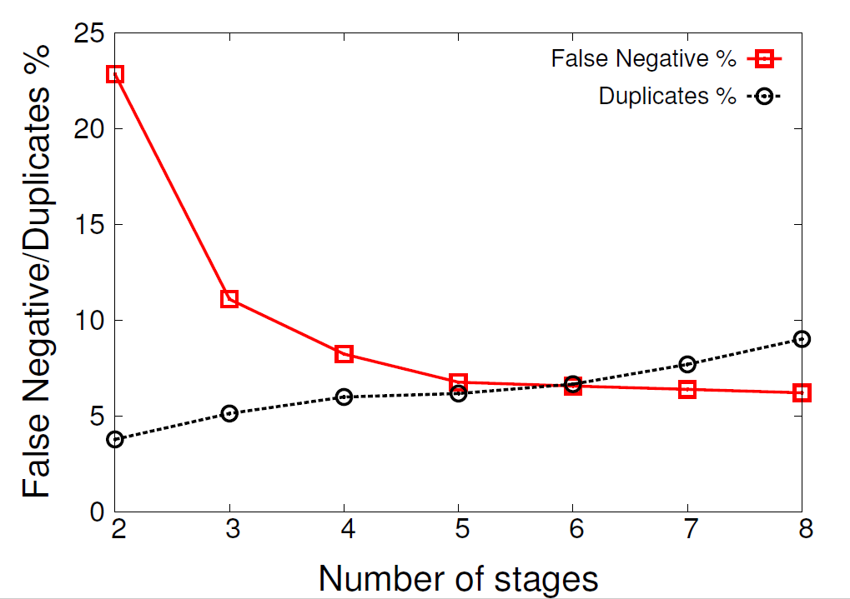
Tuning HashPipe
k = 210
5040 flowids maintained in table
Notes:
We first tune hashPipe to get optimal accuracy. Mention what False negatives or duplicates are The only parameter that needs to be set in HashPipe is the number of stages. For a fixed amount of memory for the entire hash table, increasing the number of stages helps us sample more locations to get a more accurate picture of the minimum. But, it also increases the chances of duplicates since there are now fewer keys in the first stage itself and we treat a flow as new if it isn’t present in the first stage. We evaluate this tradeoff on varying sets of memory and K values. This tables shows the tradeoff for K = 210, and a total of 5040 flow id, count pairs. Based on this table, we set our optimal number of stages at 6 based on the fact that these two opposing forces reach an almost stable point where increasing the stages any further doesn’t give that much better accuracy.

Slide 20
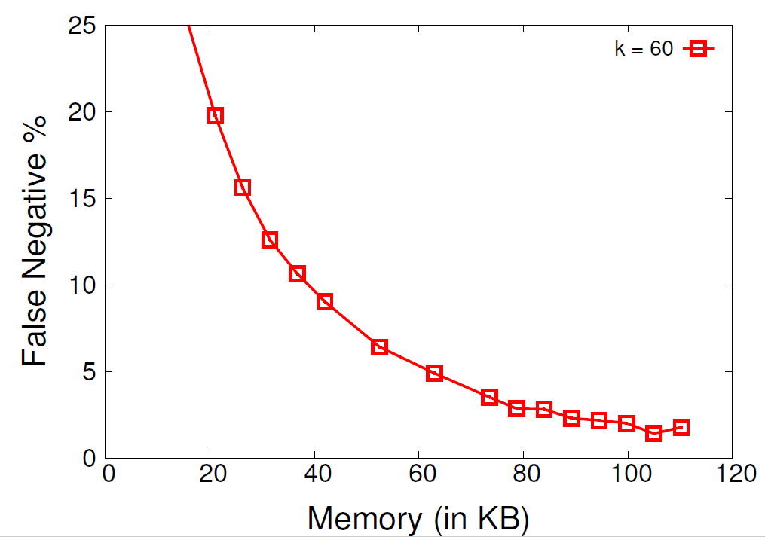
HashPipe Accuracy
5-10% false negatives for detecting heavy hitters
Notes:
Now, we evaluate HashPipe’s accuracy in isolation. This graph here illustrated the false negatives when HashPipe with 6 stages is used to detect the top K flows at different amount of memory. The y axis depicts the false negative percentage while the x axis has the memory in KB. We can see that HashPipe is able to achieve a false negative rate that is lower than 10% for the top 60 heavy hitters with just 80KB of memory (WHAT FRACTION OF TOTAL MEMORY IS THIS ). The accuracy also increases as we increase the memory allocated.
In the data center trace, the error settles to under 10% at just 9KB of memory (520 counters) for all the k values we tested.

Slide 21
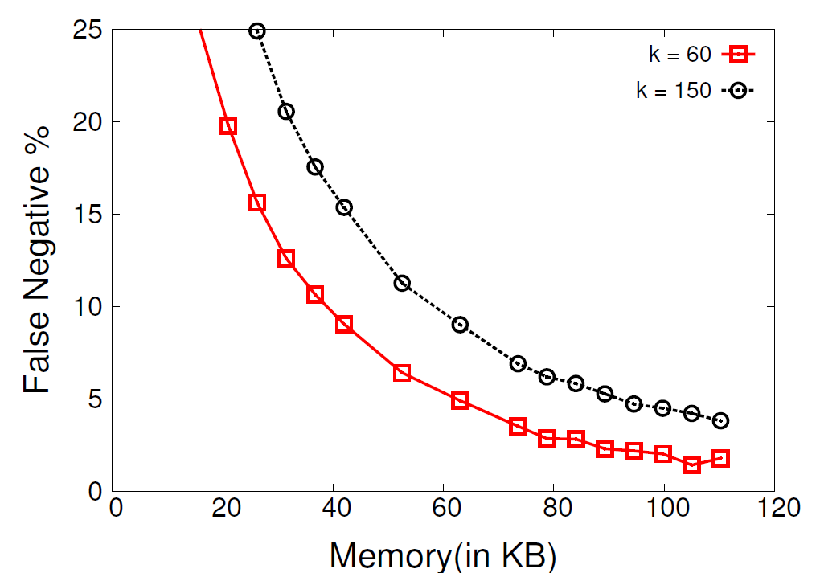
HashPipe Accuracy
5-10% false negatives for the detecting heavy hitters
4500 flow counters on traces with 400,000 flows
Notes:
We repeat this for varying values of k like 150 and …..
We can see that HashPipe is still achieves a false negative rate that is lower than 10% for the top 60 to 300 heavy hitters with just 80KB of memory. The rough conversion is that 80 KB translates to about 4500 flow id count pairs, which is only about 1% of the 400,000 flows seen on this link. We also find that the factor of k required in the number of counters so as to achieve a
particular accuracy reduces as k increases. (It is also worth noting that when flows are missed, they are more likely to be smaller flows amongst the top –K flows themselves.)

Slide 22
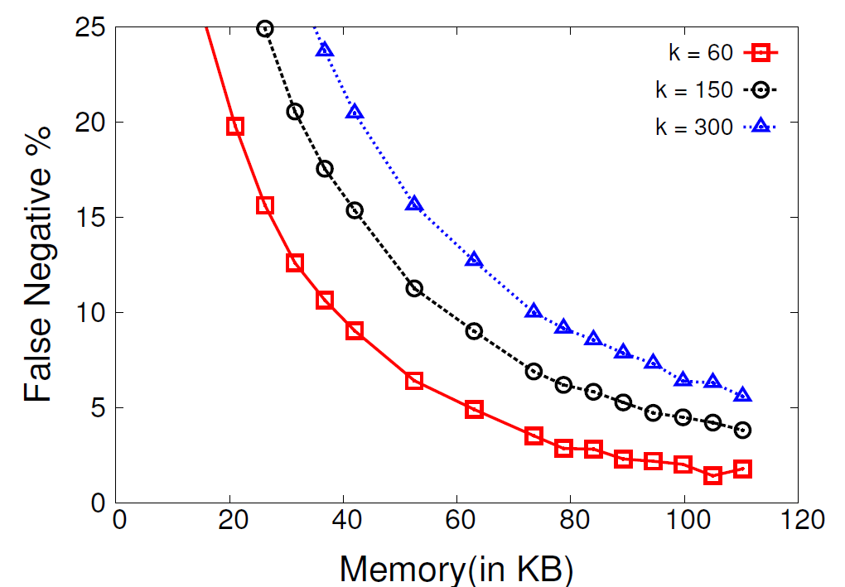
HashPipe Accuracy
5-10% false negatives for the detecting heavy hitters
4500 flow counters on traces with 400,000 flows
Notes:
Ad k = 300. We can see that HashPipe is still achieves a false negative rate that is lower than 10% for the top 60 to 300 heavy hitters with just 80KB of memory. The rough conversion is that 80 KB translates to about 4500 flow id count pairs, which is only about 1% of the 400,000 flows seen on this link. We also find that the factor of k required in the number of counters so as to achieve a particular accuracy reduces as k increases. (It is also worth noting that when flows are missed, they are more likely to be smaller flows amongst the top –K flows themselves.)

Slide 23
Competing Schemes
Sample and Hold
Sample packets of new flows
Increment counters for all packets of a flow once sampled
Count-Min Sketch
Increment counters for every packet at d hashed locations
Estimate using minimum among d location
Track heavy hitters in cache
Notes:
We compare HashPipe against its major sketching and sampling counterparts. Figure out this delivery These two form a natural way to filter out the heavy hitters given that we don’t have enough memory to track all the heavy hitters. One filters the heavy flows. We use Sample and Hold which samples packets belonging to new flows and then increments counters for all subsequent packets of a flow in a small flow memory once it is sampled. This flow memory then has the association between flow identifiers and counts and can be read off to identify the heavy hitters.
Other maintains datastructure for all flows, where the heavier ones are more likely to be correct. Count-min sketch on the other hand, updates a set of d counters for every flow depending on where it hashes to. The estimated size of a flow is based on the minimum of these d locations. If this minimum exceeds a certain threshold corresponding to the kth heaviest item, it is tracked in a cache along with its flow id from where it can be flagged as a heavy hitter. This has been widely used in recent implementations of sketches including OpenSketch and UnivMon

Slide 24
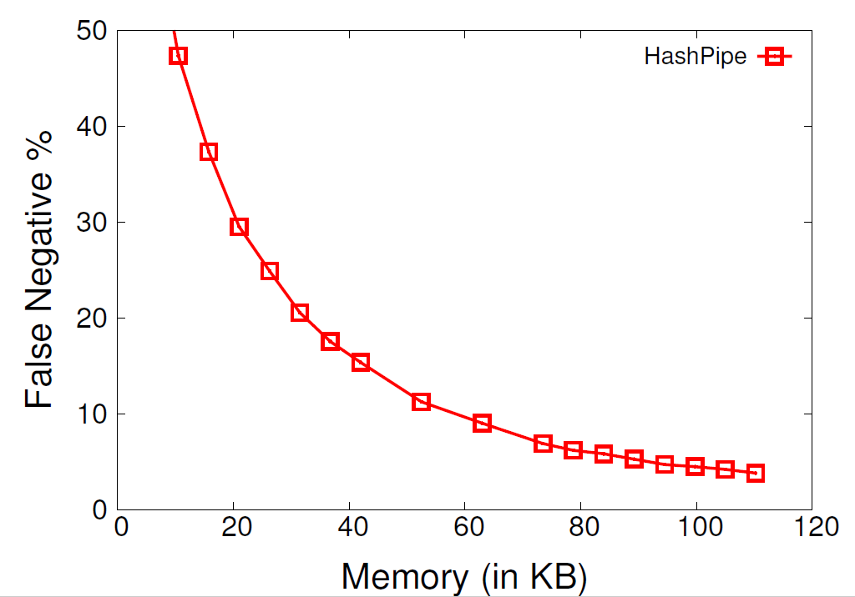
HashPipe vs. Existing Solutions
Notes:
We compare all these schemes for the same amount of memory in Kilobytes as indicated in the x-axis. On the y-axis we plot the observed false negatives amongst these schemes in identifying the top 150 flows. We observe that HashPipe outperforms the other two schemes over the entire memory range.

Slide 25
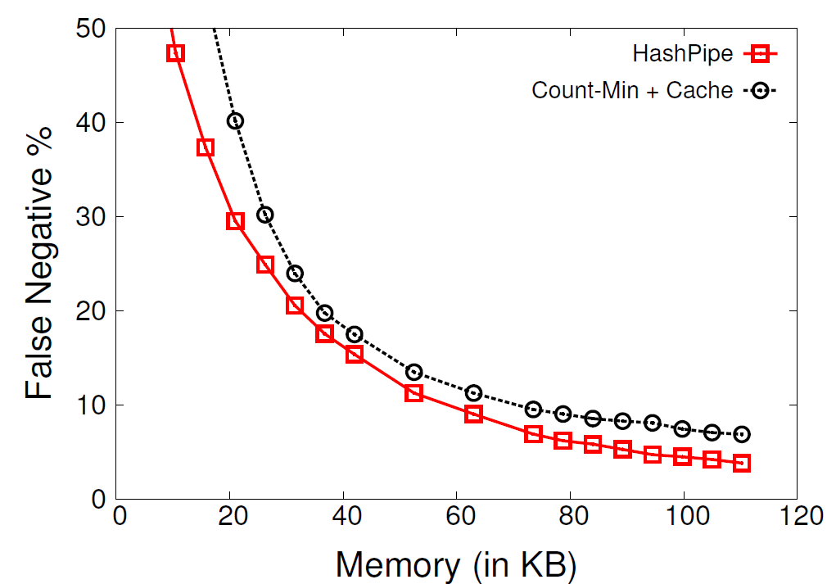
HashPipe vs Existing Solutions
Notes:
We compare all these schemes for the same amount of memory in Kilobytes as indicated in the x-axis. On the y-axis we plot the observed false negatives amongst these schemes in identifying the top 150 flows. We observe that HashPipe outperforms the other two schemes over the entire memory range. The difference is less pronounced with the Count-Min sketch which stays within 3 – 4% of HashPipe. However, we liberally allocate half of the available memory to the cache as well as perform overwrites upon hash collisions in the cache as opposed to chaining together the multiple entries. Upon further investigation, we identified that the error comes from the Count-min sketch often overestimating small flows preventing true large flows from being tracked.

Slide 26
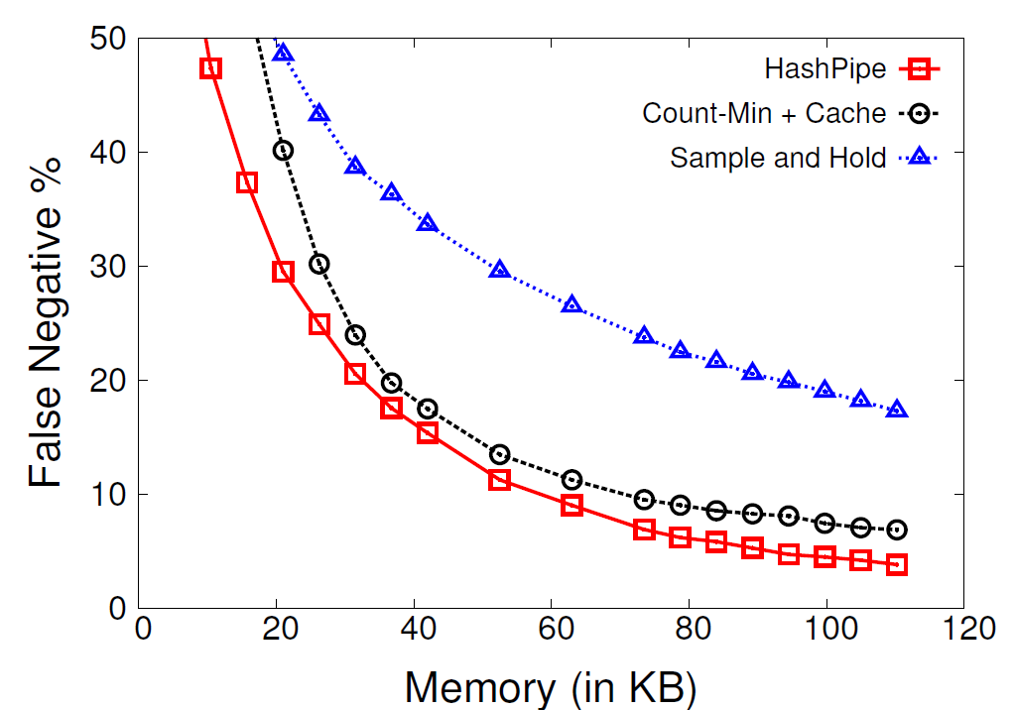
HashPipe vs Existing Solutions
Notes:
We compare all these schemes for the same amount of memory in Kilobytes as indicated in the x-axis. On the y-axis we plot the observed false negatives amongst these schemes in identifying the top 150 flows. We observe that HashPipe outperforms the other two schemes over the entire memory range. HashPipe outperforms sample and Hold by almost 15% at 100 KB memory. Upon further investigation, we identified that with Sample and Hold underestimating large flows and sometimes even missing them altogether is what causes the error

Slide 27
Contributions and Future Work
Contributions:
Heavy hitter detection on programmable data planes
Pipelined hash table with preferential eviction of smaller flows
P4 prototype - https://github.com/vibhaa/iw15-heavyhitters
Future Work:
Analytical results and theoretical bounds
Controlled experiments on synthetic traces
Notes:
In summary, I have presented an algorithm for heavy hitter detection for emerging programmable data planes that would allow us to detect and respond to heavy hitters in the data plane itself. Our algorithm, HashPipe uses a pipeline of hash tables to compute an approximate minimum whenever a new flow has to be inserted into the hash table. It preferentially evicts smaller flows and focuses on the heavier flows. We prototyped the algorithm in P4. We also showed that we perform better than existing sketching and sampling procedures to tackle the same problem.
We are currently investigating analytical bounds to understand how to employ the algorithm more effectively. We would also evaluate it on synthetic traces so that we are able to analyze the best case and worst case scenarios more clearly.

Slide 28
THANK YOU
vibhaa@princeton.edu

Slide 29
Backup Slides

Slide 30
P4 prototype – Stage 1

Slide 31
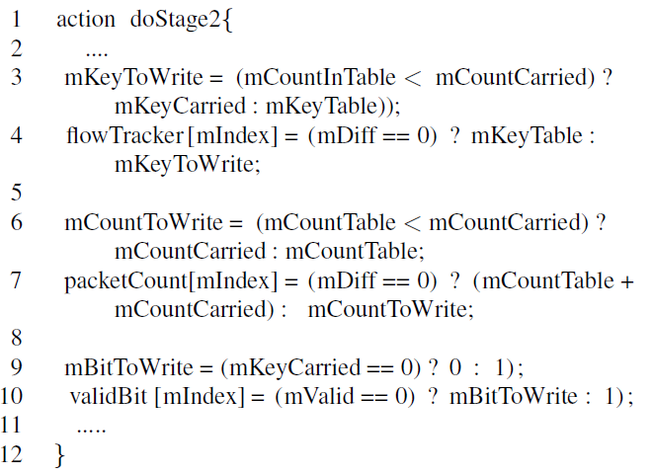
P4 prototype – Stage 2 onwards

Slide 32
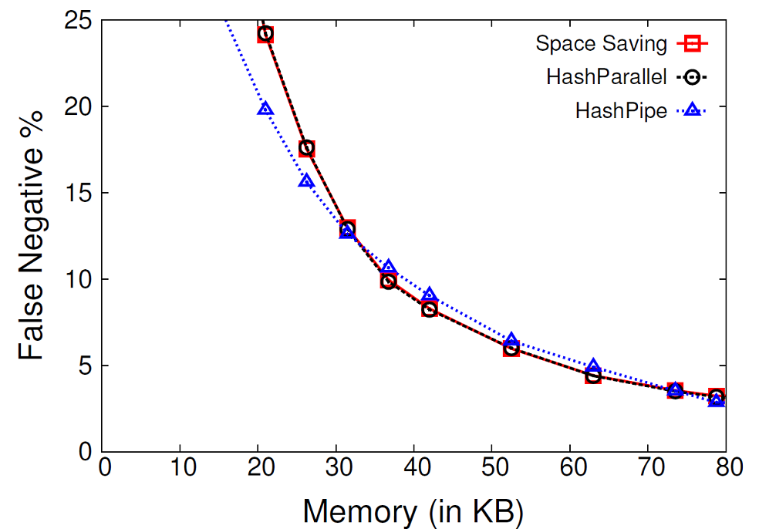
HashPipe vs Idealized Schemes
Performance of three schemes is comparable
HashPipe may outperform SpaceSaving
Notes:
Next, we compare HashPipe against the schemes that we attempted to model it based on, Space Saving and HashParallel. Space Saving evicts the minimum in the entire table to place a new flow and HashParallel samples locations from one large table and replaces the minimum amongst them. This graph shows the performance of these schemes on the y-axis in terms of their false negatives in detecting the top 60 flows amongst the 400,000 flows on the link. The x axis shows varying amounts of memory in Kilobytes. Once again, 80 KB translates to roughly 4500 flow identifier and count paris.
At a high level, the performance of the three schemes is comparable. There are regions of the graph where HashPipe outperforms Space Saving while HashParallel closely tracks it. This is because Sapce-Saving guarantees that the kth heaviest item will be in the table only if its count is larger than the average count amongst all flows in the table. This condition is satisfied only around 30 KB or 1700 counters for k = 60 on our trace. After this point, we see that Space Saving clearly outperforms HashPipe. Since Space Saving increments some counter for some flow on every packet, as opposed to starting a new count at 1, at lower amounts of memory, a number of small flows collude together to have large counters in Space Saving. This evicts true large flows in the process, which is what causes its poor performance.

Slide 33
Programmable Switches
New switches that allow us to run novel algorithms
Barefoot Tofino, RMT, Xilinx, Netronome, etc.
Languages like P4 to program the switches
Notes:
However, given the emergence of new programmable switches, we can provide a lot of opportunities for a whole new set of algorithms on the switches. These switches have also been gaining a lot of traction in the commercial space too with Barefoot, Xilinx and Netronome producing programmable switches. Further, languages like P4 that let you specify packet processing rules as a series of match action tables have made development of these algorithms that much easier.

