Slide 1
Scalable Causal Consistency
COS 418/518: Distributed Systems
Lecture 15
Wyatt Lloyd, Mike Freedman

Slide 2
Consistency Hierarchy (review)
Linearizability
e.g., RAFT
Sequential Consistency
Causal+ Consistency
e.g., Bayou
Eventual Consistency
e.g., Dynamo

Slide 3
Causal+ Consistency (review)
Writes that are potentially causally related must be seen by all processes in same order.
Concurrent writes may be seen in a different order on different processes.
Concurrent: Ops not causally related

Slide 4
Causal+ Consistency (review)
Partially orders all operations, does not totally order them
  Does not look like a single machine
Guarantees
  For each process, ∃ an order of all writes + that process’s reads
  Order respects the happens-before (→) ordering of operations
  + replicas converge to the same state
    Skip details, makes it stronger than eventual consistency

Slide 5
Causal consistency within replicated systems

Slide 6

Implications of laziness on consistency
shl
Consensus
Module
State
Machine
Consensus
Module
State
Machine
Consensus
Module
State
Machine
Log
Log
Log
add
jmp
mov
shl
add
jmp
mov
shl
add
jmp
mov
shl
Linearizability / sequential: Eager replication
Trades off low-latency for consistency

Slide 7
Implications of laziness on consistency
shl
State
Machine
State
Machine
State
Machine
Log
Log
Log
add
jmp
mov
shl
add
jmp
mov
shl
add
jmp
mov
shl
Causal consistency: Lazy replication
Trades off consistency for low-latency
Maintain local ordering when replicating
Operations may be lost if failure before replication

Slide 8
Consistency vs Scalability
Scalability: Adding more machines allows more data to be stored and more operations to be handled!
System | Consistency | Scalable?
Paxos/RAFT | Linearizable
Bayou | Causal
No
No
It’s time to think about scalability!

Slide 9
Consistency vs Scalability
Scalability: Adding more machines allows more data to be stored and more operations to be handled!
System | Consistency | Scalable?
Bayou | Causal | No
COPS | Causal | Yes
Paxos/RAFT | Linearizable | No
 |  | Next Time!

Slide 10
COPS:
Scalable Causal Consistency for Geo-Replicated Storage

Slide 11
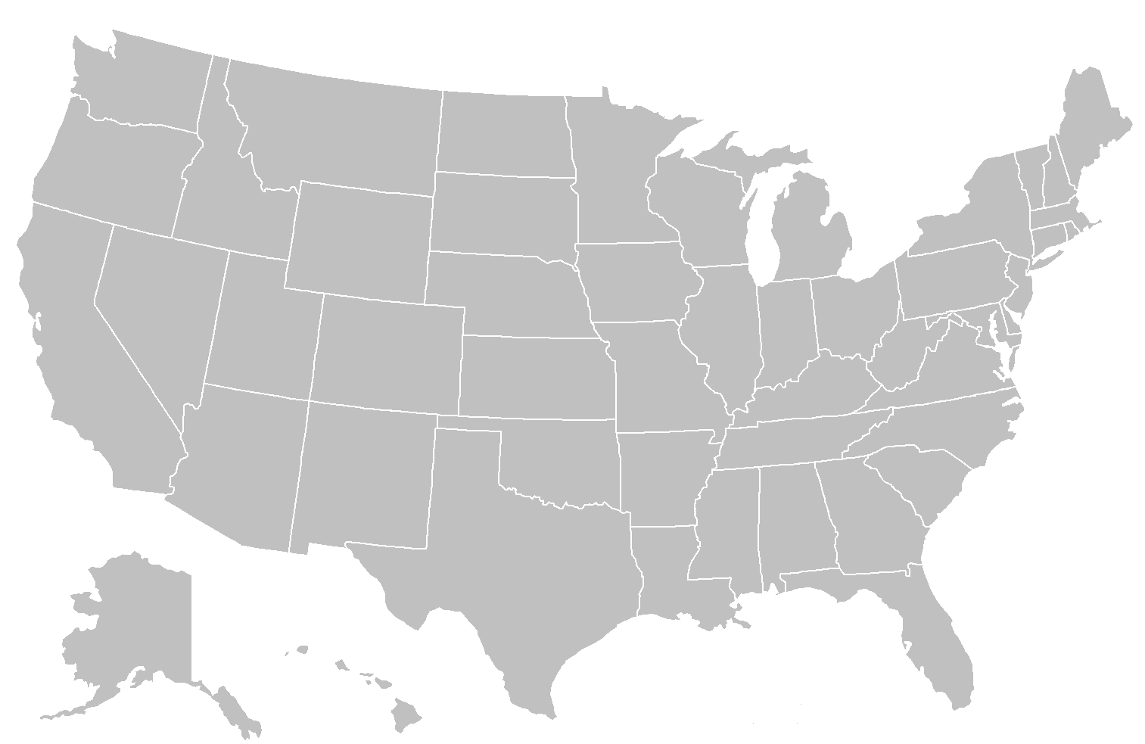
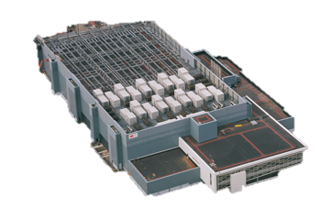
Geo-Replicated Storage
serves requests quickly

Slide 12

Inside the Datacenter
Web Tier
Storage Tier
A-F
Replication
Remote DC
G-L
Web Tier
Storage Tier
A-F
M-R
G-L
M-R
S-Z
S-Z

Slide 13
Scalability through Sharding
A-C
A-Z
A-Z
A-F
A-F
A-L
A-C
A-L
D-F
G-L
G-L
M-Z
D-F
M-Z
G-J
M-R
M-R
G-J
K-L
S-Z
S-Z
K-L
M-O
M-O
P-S
P-S
T-V
T-V
W-Z
W-Z
Notes:
What I mean by scalability is that we can increase the capacity and the throughput of the storage tier in each datacenter
So initially, if we have a small service, we can start with a single server in each datacenter.
But as our site grows and our capacity and throughput requirements increase, we can add servers to each datacenter to meet those needs[click click click] with each server handling different portions of the dataset.
Note that an important part of this scale-out property is that *parallel* replication occurs across these datacenters between servers storing the same portions of the dataset – (as shown by the parallel arrows)
So in addition to the ALPS properties we want …

Slide 14
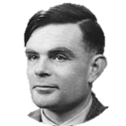


Causality By Example
Causality ( )
Same process
Reads-From
(message receipt)
Transitivity
Remove boss from
friends group
Post to friends:
“Time for a new job!”
Friend reads post
Friends
Boss
New Job!

Slide 15
Bayou’s Causal Consistency
Log-exchange based
Log is single serialization point within DC
  Implicitly captures & enforces causal order
Local Datacenter
Remote DC
4
3
2
1
4
3
2
1
√

Slide 16
Sharded Log Exchange
What happens if we use a separate log per shard?
What happens if we use a single log?

Slide 17
Scalability Key Idea
Capture causality with explicit dependency metadata
Enforce with distributed verifications
  Delay exposing replicated writes until all dependencies are satisfied in the datacenter
3
after
1
Local Datacenter
Remote DC
1
3
1
3
4
2
4
2

Slide 18
COPS Architecture
A-F
G-L
M-R
A-F
S-Z
Client
A-F
G-L
G-L
All Ops Local
=
Available and Low Latency
M-R
S-Z
M-R
S-Z
Notes:
Mention logical server abstraction here

Slide 19
COPS Architecture
A-F
G-L
Client Library
M-R
A-F
S-Z
A-F
G-L
G-L
M-R
S-Z
M-R
S-Z

Slide 20
Read
A-F
G-L
Client Library
M-R
A-F
S-Z
read
A-F
G-L
G-L
read
M-R
S-Z
M-R
S-Z

Slide 21
Write
write
+
ordering
metadata
write
after
=
A-F
G-L
Client Library
M-R
A-F
S-Z
A-F
G-L
G-L
write
M-R
S-Z
write_after
M-R
S-Z
Replication
write
after

Slide 22
Replicated Write
Exposing values after dep_checks return ensures causal
Unique Timestamp
Locator Key
deps
L ₃₃₇
A ₁₉₅
A-F
dep_check(A₁₉₅)
G-L
dep
check
(L₃₃₇)
M-R
write_after(…,deps)
S-Z

Slide 23
Basic Architecture Summary
All ops local, replicate in background
  Availability and low latency
Shard data across many nodes
  Scalability
Control replication with dependencies
  Causal consistency

Slide 24
Challenge: Many Dependencies
Dependencies grow with client lifetime
Write
Transitive Closure
Same Process
Write
Read
Reads-From
Write
Read
Current Write

Slide 25
Nearest Dependencies
Transitively capture ordering constraints
Notes:
“Predecessor set of transitive reduction”

Slide 26
Nearest Dependencies
Transitively capture ordering constraints
Need extra server-side state to calculate

Slide 27
One-Hop Dependencies
Small superset of nearest dependencies
Simple to track:
  Last write
  Subsequent reads
Transitive Closure
Reads-From
Thread-of-Execution

Slide 28
One-Hop Dependencies
Checking them suffices for causality
  Competitive to eventually-consistent system
Never store dependencies on the server
Simplifies client-side dep tracking
  Clear on every write
Transitive Closure

Slide 29
Scalable Causal+
A-F
From fully distributed operation
G-L
M-R
S-Z
read
A-F
read
A-F
G-L
write_after
G-L
M-R
S-Z
read
M-R
write_after
S-Z

Slide 30
Scalability
Shard data for scalable storage
New distributed protocol for scalably applying writes across shards
Also need a new distributed protocol for consistently reading data across shards…

Slide 31

Reads Aren’t Enough
Asynchronous requests + distributed data = ??
Turing’s
Operations
Progress
A-F
Boss
Boss
Boss
Boss
1
Progress
2
Web Srv
G-L
New Job!
Progress
Boss
New Job!
M-R
from 1
from 4
4
S-Z
I <3 Job
I <3 Job
New Job!
3

Slide 32
Read-Only Transactions
Consistent up-to-date view of data
  Across many servers
1
11
Alan…Friends
Boss
Boss
2
19
Alan…Status
I <3 Job
New Job!
1
11
Alonzo…Friends
Alan
Alan
Logical Time
More on transactions next time!

Slide 33
COPS Scaling Evaluation
More servers => More operations/sec

Slide 34
COPS
Scalable causal consistency
  Shard for scalable storage
  Distributed protocols for coordinating writes and reads
    Evaluation confirms scalability
All operations handled in local datacenter
  Availability
  Low latency
We’re thinking scalably now!
  Next time: scalable strong consistency

