Slide 1
Bayou / Chord
2025 Spring
[Adapted from Andrew Or and Ion Stoica’s original slides]

Slide 2
Context on Bayou: Disconnected Nodes [Stoica]
Early days: nodes always on when not crashed
Network bandwidth always plentiful.
Never needed to work on a disconnected node
Now: nodes detach then reconnect elsewhere
Even when attached, bandwidth is variable
Reconnection elsewhere means often talking to different replica
Work done on detached nodes
Notes:
Highlight the problem of disconnected devices, they are not crashed like the early days, and there can be local work done on the disconnected device , by the time the device reconnects, it may have new states
This motivates Bayou

Slide 3
Bayou
”Replicated, [eventually] consistent storage system designed for … portable machines with less-than-ideal network connectivity.”
System developed at PARC in the mid-90’s
First coherent attempt to fully address the problem of disconnected operation
Notes:
PARC = Palo Alto Research Center They also developed: GUI, Computer mouse, Ethernet, Laser Printing, Object-Oriented Programming (OOP), Distributed Computing

Slide 4
Bayou
What is it?
Weakly consistent, replicated storage system
Goals:
Maximize availability, support offline collaboration
Minimize network communication
Agree on all values (eventually)

Slide 5
Bayou Update Protocol: Review from Class
Client sends update to a server
Updates uniquely identified by: <Commit Sequence Number (CSN), Local Timestamp, Node ID>
Updates are either committed or tentative CSNs increase monotonically Tentative updates have commit-stamp = ∞
Only Primary server can commit updates Allocates CSN in monotonically increasing order CSN is different from time-stamp
Notes:
Go over Bayou protocol, this slide is update, next slide is anti-entropy (how to resolve inconsistency between local states among devices)

Slide 6
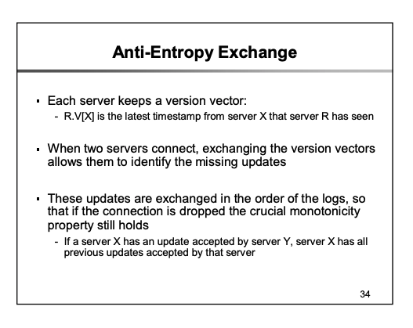
Source: Berkeley CS 268 Lecture 20 Slide Deck
Notes:
Ongoing entropy would mean stability is never reached (this is one of entropy’s definitions) Y accepted means in Y’s log

Slide 7
Bayou Writes
Primary
Versions
P: 0
A: 0
B: 0
W(X, 4)
Client 1
value1 : value2 : value3 denotes
Commit Sequence Number (CSN) : Local Timestamp : Node ID
A
Versions
B
Versions
P: 0
A: 0
B: 0
P: 0
A: 0
B: 0
Notes:
Assume client 1 contacts the primary, write X → primary gives it a local timestamp of 1

Slide 8
Bayou Writes
Primary
Versions
∞:1:P W(X,4)
P: 1
A: 0
B: 0
Client 1
value1 : value2 : value3 denotes
Commit Sequence Number (CSN) : Local Timestamp : Node ID
A
Versions
B
Versions
P: 0
A: 0
B: 0
P: 0
A: 0
B: 0
Notes:
EXPLAIN THE COLON SYNTAX (Commit timestamp:write timestamp:write server) Commit timestamp is infinity if tentative write.

Slide 9
Bayou Writes
Primary
Versions
∞:1:P W(X,4)
P: 1
A: 0
B: 0
Client 1
value1 : value2 : value3 denotes
Commit Sequence Number (CSN) : Local Timestamp : Node ID
W(Y, 8)
Client 2
A
B
Versions
Versions
W(X, 3)
P: 0
A: 0
B: 0
P: 0
A: 0
B: 0
Notes:
Two events happen concurrently:
Client 1 contacts primary, write Y → We will assume primary gives this operation a local timestamp of 7 (which will reflect in the next slide)
Client 2 contacts node A, write X → Node A gives it a local timestamp of 7 as well

Slide 10
Bayou Writes
Primary
Versions
∞:1:P W(X,4)
∞:7:P W(Y,8)
P: 7
A: 0
B: 0
Client 1
value1 : value2 : value3 denotes
Commit Sequence Number (CSN) : Local Timestamp : Node ID
W(Z, 8)
Client 2
A
B
W(Y, 4)
Versions
Versions
∞:7:A W(X,3)
P: 0
A: 7
B: 0
P: 0
A: 0
B: 0
Notes:
Two events happen concurrently:
Client 2 contacts node A, write Y → A gives it a local timestamp of 12
Client 1 contacts Node B, write Z → B gives it a local timestamp of 5

Slide 11
Bayou Writes
Primary
Versions
∞:1:P W(X,4)
∞:7:P W(Y,8)
P: 7
A: 0
B: 0
value1 : value2 : value3 denotes
Commit Sequence Number (CSN) : Local Timestamp : Node ID
A
Versions
B
Versions
∞:7:A W(X,3)
∞:12:A W(Y,4)
P: 0
A: 12
B: 0
∞:5:B W(Z,8)
P: 0
A: 0
B: 5
Notes:
At this point, the 3 nodes in the system ( primary, node A and node B ) haven’t contacted each other yet and their local logs are inconsistent / diverge.
We will resolve inconsistency of log via a anti-entropy session, namely sync-up to resolve inconsistencies

Slide 12
Bayou Anti-Entropy (Sync)
P
Versions
∞:1:P W(X,4)
∞:7:P W(Y,8)
P: 7
A: 0
B: 0
Anti-entropy Session
A & B
A
Versions
B
Versions
P: 0
A: 0
B: 5
∞:5:B W(Z,8)
∞:7:A W(X,3)
∞:12:A W(Y,4)
P: 0
A: 12
B: 0
∞:5:B W(Z,8)
P: 0
A: 0
B: 5
P: 0
A: 12
B: 0
∞:7:A W(X,3)
∞:12:A W(Y,4)
Notes:
Assume A and B now contact each other
They exchange their local logs and also update them locally

Slide 13
P
Versions
Bayou Anti-Entropy (Sync)
∞:1:P W(X,4)
∞:7:P W(Y,8)
P: 7
A: 0
B: 0
A
Versions
B
Versions
∞:5:B W(Z,8)
∞:7:A W(X,3)
∞:12:A W(Y,4)
P: 0
A: 12
B: 5
∞:5:B W(Z,8)
∞:7:A W(X,3)
∞:12:A W(Y,4)
P: 0
A: 12
B: 5
Notes:
Now A and B have the same log for data (X, Y, Z) A merges logs in the correct order, and then replays reordered operations to update all variables correctly.

Slide 14
Bayou Commit
P
Versions
1:1:P W(X,4)
2:7:P W(Y,8)
P: 7
A: 0
B: 0
Primary commits its entries
A
Versions
B
Versions
∞:5:B W(Z,8)
∞:7:A W(X,3)
∞:12:A W(Y,4)
P: 0
A: 12
B: 5
∞:5:B W(Z,8)
∞:7:A W(X,3)
∞:12:A W(Y,4)
P: 0
A: 12
B: 5
Notes:
At some point, the primary commits and assigns the commit timestamp for operations in its log

Slide 15
Bayou Write
P
Versions
1:1:P W(X,4)
2:7:P W(Y,8)
P: 7
A: 0
B: 0
Write after anti-entropy session
Write timestamp = max(clock, max(TS)+1)
Client 1
D(Y)
A
Versions
B
Versions
∞:5:B W(Z,8)
∞:7:A W(X,3)
∞:12:A W(Y,4)
P: 0
A: 12
B: 5
∞:5:B W(Z,8)
∞:7:A W(X,3)
∞:12:A W(Y,4)
∞:13:B D(Y)
P: 0
A: 12
B: 13
Notes:
D(Y) == delete(Y)
Client 1 contacts node B, and deletes Y → we assign a local timestamp 13 to this operation

Slide 16
P
Versions
Bayou Anti-Entropy (Sync)
1:1:P W(X,4)
2:7:P W(Y,8)
P: 7
A: 0
B: 0
Anti-entropy Session
P & B
P: 0
A: 12
B: 13
∞:5:B W(Z,8)
∞:7:A W(X,3)
∞:12:A W(Y,4)
∞:13:B D(Y)
A
Versions
B
Versions
1:1:P W(X,4)
2:7:P W(Y,8)
∞:5:B W(Z,8)
∞:7:A W(X,3)
∞:12:A W(Y,4)
P: 0
A: 12
B: 5
∞:5:B W(Z,8)
∞:7:A W(X,3)
∞:12:A W(Y,4)
∞:13:B D(Y)
P: 0
A: 12
B: 13
P: 7
A: 0
B: 0
Notes:
Later, primary and node B contact each other and exchange their logs

Slide 17
Bayou Anti-Entropy
P
Versions
1:1:P W(X,4)
2:7:P W(Y,8)
∞:5:B W(Z,8)
∞:7:A W(X,3)
∞:12:A W(Y,4)
∞:13:B D(Y)
P: 7
A: 12
B: 13
Anti-entropy Session
P & B
Primary respects causality
A
Versions
B
Versions
∞:5:B W(Z,8)
∞:7:A W(X,3)
∞:12:A W(Y,4)
P: 0
A: 12
B: 5
1:1:P W(X,4)
2:7:P W(Y,8)
∞:5:B W(Z,8)
∞:7:A W(X,3)
∞:12:A W(Y,4)
∞:13:B D(Y)
P: 7
A: 12
B: 13
Notes:
Since the Primary begins its log at 1 and each commit timestamp is incremented by 1 B knows that it’s tentative write will be committed after those writes with commit timestamps 1 and 2.

Slide 18
Bayou Commit
P
Versions
1:1:P W(X,4)
2:7:P W(Y,8)
3:5:B W(Z,8)
4:7:A W(X,3)
5:12:A W(Y,4)
6:13:B D(Y)
P: 7
A: 12
B: 13
Primary commits Its entries
A
Versions
B
Versions
∞:5:B W(Z,8)
∞:7:A W(X,3)
∞:12:A W(Y,4)
P: 0
A: 12
B: 5
1:1:P W(X,4)
2:7:P W(Y,8)
∞:5:B W(Z,8)
∞:7:A W(X,3)
∞:12:A W(Y,4)
∞:13:B D(Y)
P: 7
A: 12
B: 13
Notes:
Primary later commits the operations sent from B

Slide 19
Bayou
P
Versions
1:1:P W(X,4)
2:7:P W(Y,8)
3:5:B W(Z,8)
4:7:A W(X,3)
5:12:A W(Y,4)
6:13:B D(Y)
P: 7
A: 12
B: 13
After a number of commits and anti-entropy sessions (without further writes),
all nodes converge on the same state.
A
Versions
B
Versions
1:1:P W(X,4)
2:7:P W(Y,8)
3:5:B W(Z,8)
4:7:A W(X,3)
5:12:A W(Y,4)
6:13:B D(Y)
P: 7
A: 12
B: 13
1:1:P W(X,4)
2:7:P W(Y,8)
3:5:B W(Z,8)
4:7:A W(X,3)
5:12:A W(Y,4)
6:13:B D(Y)
P: 7
A: 12
B: 13
Notes:
Eventually, every node in the system will have the same log (that is, the same view of event orders happening within the system)

Slide 20
Bayou (review from class)
Eventual consistency: if updates stop, all replicas eventually have the same view.
Update functions for automatic app-driven conflict resolution.
Ordered update log is the real truth, not the DB.
Use Lamport clocks: eventual consistency that respects causality.
Notes:
Update functions mean application-specific merge or conflict resolution functions

Slide 21
Context for Chord: Key Value Stores
Credit: Ion Stoica’s slide deck
Notes:
Talk about the context.
We need to partition the keys across nodes.

Slide 22
Context for Chord: Key Value Stores
Credit: Ion Stoica’s slide deck

Slide 23
Chord
Chord: “a distributed lookup protocol” for a peer-to-peer distributed hash table [Stoica ‘01]
Consistent hashing for partitioning key space + lookup
Notes:
We will focus on consistent hashing in this class.
It has two parts:
How to do partitioning?
How to do lookups?

Slide 24
Identifiers in Chord
Key identifier = SHA1(key) mod 2^{m}
Node identifier = SHA1(IP address) mod 2^{m}
Both are uniformly distributed in the same identifier space
The identifier length, m, must be large enough to make the probability of two nodes or keys hashing to the same identifier negligible (e.g. m = 160)
How do we map key IDs to node IDs?
Notes:
Hashing naturally solves the partitioning problem.

Slide 25
Consistent Hashing
A node owns the preceding key range, including its own identifier.
Key k is stored at its successor node, the first node whose identifier is equal to or greater than the identifier of key k.
m = 7
(120, 10]
120
10
(90, 105]
105
32
90
k = 40
60
k = 90
Notes:
What is consistent hashing?
From the original paper: Consistent hashing assigns keys to nodes as follows. Identifiers are ordered in an identifier circle modulo . Key is assigned to the first node whose identifier is equal to or follows (the identifier of) in the identifier space. This node is called the successor node of key k, denoted by successor(k).
Ask the class.
What is the key space node 10 is responsible for? Ans: (120, 10]
What about node 105? Ans: (90, 105]
What is the successor of key 40? Ans: node 60
What about key 90? Ans: node 90

Slide 26
Basic Lookups
N = 6
m = 7
Each node only remembers its successor node in the circle.
Lookups in clockwise direction.
Assume N nodes and K keys.
m is the number of bits in the node/key identifier.
120
10
105
What is the lookup time?
32
k = 80
entry point
O(N) hops
90
60
Notes:
Each node keeps a small amount of routing information.
Every node only needs to remember its successor node in the circle.
However, this scheme is inefficient as it may require traversing all N nodes to find the appropriate mapping.
Why? Walk through the example of k = 80 with assume the entry node is 105 (in chord, key lookup can contact any node)
The lookup time is O(N)
To accelerate this process, every node in Chord maintains additional information (not for correctness, just for lookup performance). This additional information is the finger table.

Slide 27
Finger Table Notations
Each node maintains additional routing information (e.g., finger tables) to accelerate lookups.
A finger table contains m entries
m = 7
n is the identifier of the node
120
10
105
32
start interval node
k = 1
91 [91, 92) 105
k = 2
k = 3
k = 4
k = 5
k = 6
k = 7
92 [92, 94) 105
90
94 [94, 98) 105
98 [98, 106) 105
106 [106, 122) 120
122 [122, 26) 10
26 [26, 90) 32
60
Notes:
To accelerate this process, Chord maintains additional information (that is, finger table) to accelerate lookups.
The notations are taken from the original Chord paper.
Explain these 3 important variables.
Show the class the finger table for node 90 and the calculation.
Be careful with the interval, it is circular, don’t forget to mod

Slide 28
Finger Table of Node 10
n is the identifier of the node
A finger table contains m entries
start interval node
N = 6
m = 7
11 [11, 12) 32
120
12 [12, 14) 32
14 [14, 18) 32
18 [18, 26) 32
26 [26, 42) 32
42 [42, 74) 60
74 [74, 10) 90
10
105
32
start interval node
91 [91, 92) 105
92 [92, 94) 105
94 [94, 98) 105
98 [98, 106) 105
106 [106, 122) 120
122 [122, 26) 10
26 [26, 90) 32
90
60
Notes:
Ask the class, what is the finger table of node 10? Walk through it

Slide 29
Route k = 15
n is the identifier of the node
A finger table contains m entries
start interval node
N = 6
m = 7
11 [11, 12) 32
120
12 [12, 14) 32
14 [14, 18) 32
18 [18, 26) 32
26 [26, 42) 32
42 [42, 74) 60
74 [74, 10) 90
10
105
32
start interval node
91 [91, 92) 105
92 [92, 94) 105
94 [94, 98) 105
98 [98, 106) 105
106 [106, 122) 120
122 [122, 26) 10
26 [26, 90) 32
90
60
k = 15
Notes:
Assume key = 15 comes in and contacts node 90. How do we route it to its correct successor node?

Slide 30
Route k = 15
n is the identifier of the node
A finger table contains m entries
start interval node
N = 6
m = 7
11 [11, 12) 32
120
12 [12, 14) 32
14 [14, 18) 32
18 [18, 26) 32
26 [26, 42) 32
42 [42, 74) 60
74 [74, 10) 90
10
105
32
start interval node
91 [91, 92) 105
92 [92, 94) 105
94 [94, 98) 105
98 [98, 106) 105
106 [106, 122) 120
122 [122, 26) 10
26 [26, 90) 32
90
60
k = 15
Notes:
Find the node ID that is not greater than the key ID

Slide 31
Route k = 15
n is the identifier of the node
A finger table contains m entries
start interval node
N = 6
m = 7
11 [11, 12) 32
120
12 [12, 14) 32
14 [14, 18) 32
18 [18, 26) 32
26 [26, 42) 32
42 [42, 74) 60
74 [74, 10) 90
10
105
32
start interval node
91 [91, 92) 105
92 [92, 94) 105
94 [94, 98) 105
98 [98, 106) 105
106 [106, 122) 120
122 [122, 26) 10
26 [26, 90) 32
90
60
k = 15

Slide 32
Route k = 15
n is the identifier of the node
A finger table contains m entries
start interval node
N = 6
m = 7
11 [11, 12) 32
120
12 [12, 14) 32
14 [14, 18) 32
18 [18, 26) 32
26 [26, 42) 32
42 [42, 74) 60
74 [74, 10) 90
10
105
32
start interval node
91 [91, 92) 105
node 32 is your successor
92 [92, 94) 105
94 [94, 98) 105
98 [98, 106) 105
106 [106, 122) 120
122 [122, 26) 10
26 [26, 90) 32
90
60
k = 15
Notes:
At node 10, all nodes in the table are greater than 15. So 32 is the successor node.

Slide 33
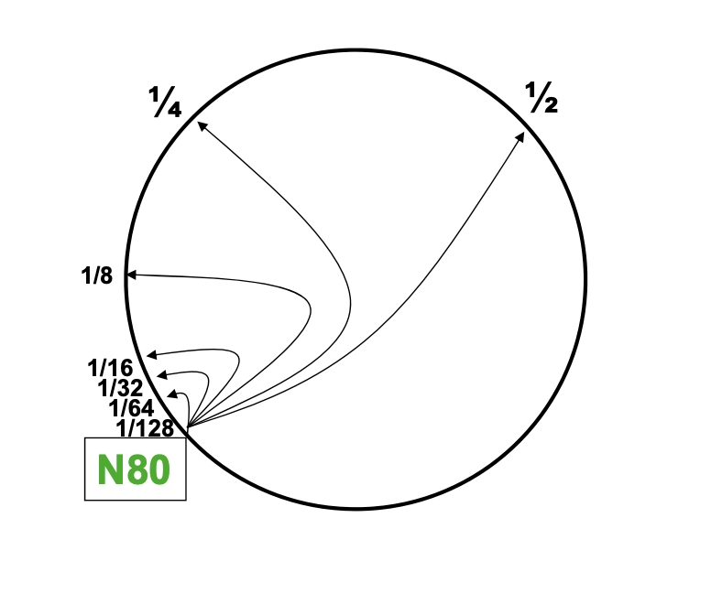
Summary: Finger Table
Each node maintains additional routing information (e.g., finger tables) to accelerate lookups.This information is not essential for correctness, as long as the successor information is correct.
A finger table contains m entries
We trade off space for better lookup performance
What is the lookup time?
O(logN) hops
Credit: UC Berkeley CS 262a Fall 2023 slide deck.
Notes:
Summarize.
Emphasize we are making a tradeoff, by keep more states per node, we improve lookup performance.
And note that the finger table is not essential for correctness of routing. As long as each node remembers who its successor node is correctly, we can always route a key to the right node in Chord. We are relying on the fact that nodes are distributed uniformly between keys

