Slide 1
Interdomain Routing
advertisements
peer
peer
traffic
Mike Freedman
COS 461: Computer Networks
http://www.cs.princeton.edu/courses/archive/spr20/cos461/

Slide 2
How to avoid BGP Instability
Detecting conflicting policies
CON: Computationally expensive
CON: Requires too much cooperation
Detecting oscillations
Observing the repetitive BGP routing messages
CON: Requires dynamic, stateful analysis
Restricted routing policies and topologies
Policies based on business relationships
2

Slide 3
AS (Autonomous System) Business Relationships
3

Slide 4
Customer-Provider Relationship
Customer pays provider for access to Internet
Provider exports its customer routes to everybody
Customer exports provider routes only to its customers
Traffic to customer
Traffic from customer
d
provider
advertisements
provider
traffic
customer
d
customer
4

Slide 5
Peer-Peer Relationship
Peers exchange traffic between their customers
AS exports only customer routes to a peer
AS exports a peer’s routes only to its customers
Traffic to/from the peer and its customers
advertisements
peer
peer
traffic
d
5

Slide 6
Hierarchical AS Relationships
Provider-customer graph is directed and acyclic
If u is a customer of v and v is a customer of w
… then w is not a customer of u
w
v
u
6

Slide 7
Valid and Invalid Paths
Path 1 2 d
Path 7 d
Path 5 8 d
Path 6 4 3 d
Path 8 5 d
Path 6 5 d
Path 1 4 3 d
1
2
3
4
d
5
6
Provider-Customer
Peer-Peer
7
8
7

Slide 8
Valid and Invalid Paths
Path 1 2 d
Path 7 d
Path 5 8 d
Path 6 4 3 d
Path 8 5 d
Path 6 5 d
Path 1 4 3 d
Valid
Valid
Invalid
Valid
Valid
Invalid
Invalid
Y) Valid M) Invalid
1
2
3
4
d
5
6
Provider-Customer
Peer-Peer
7
8
8

Slide 9
Valid and Invalid Paths
Valid paths: “1 2 d” and “7 d”
Invalid path: “5 8 d”
1
2
3
4
d
5
6
Provider-Customer
Peer-Peer
7
8
9

Slide 10
Valid and Invalid Paths
Valid paths: “6 4 3 d” and “8 5 d”
Invalid paths: “6 5 d” and “1 4 3 d”
1
2
3
4
d
5
6
Provider-Customer
Peer-Peer
7
8
10

Slide 11
Local Control, Global Stability: “Gao-Rexford Conditions”
Route export
Don’t export routes learned from a peer or provider to another peer or provider
Global topology
Provider-customer relationship graph is acyclic
E.g., my customer’s customer is not my provider
Route selection
Prefer routes through customers over routes through peers and providers
Guaranteed to converge to unique, stable solution
11

Slide 12
How do we implement Interdomain Routing Policy?

Slide 13
Selecting a Best Path
Routing Information Base
Store all BGP routes for each destination prefix
Withdrawal: remove the route entry
Announcement: update the route entry
BGP decision process
Highest local preference
Shortest AS path
Closest egress point
Arbitrary tie break

Slide 14
Import Policy: Local Preference
Favor one path over another
Override the influence of AS path length
Example: prefer customer over peer
Local-pref = 90
AT&T
Sprint
Local-pref = 100
Tier-2
Tier-3
Princeton

Slide 15
Import Policy: Filtering
Discard some route announcements
Detect configuration mistakes and attacks
Examples on session to a customer
Discard route if prefix not owned by the customer
Discard route with other large ISP in the AS path
AT&T
USLEC
Princeton
128.112.0.0/16

Slide 16
Export Policy: Filtering
Discard some route announcements
Limit propagation of routing information
Examples
Don’t announce routes from one peer to another
Don’t announce routes for management hosts
UUNET
AT&T
Sprint
network operator
Princeton
128.112.0.0/16

Slide 17
Export Policy: Attribute Manipulation
Modify attributes of the active route
To influence the way other ASes behave
Example: AS prepending
Artificially inflate AS path length seen by others
Convince some ASes to send traffic another way
AT&T
Sprint
USLEC
88 88
Princeton
88
128.112.0.0/16

Slide 18
Reflect Business Relationships
Common relationships
Customer-provider
Peer-peer
Backup, sibling, …
ISP terminology:
Tier-1 (~15 worldwide): No settlement or transit
Tier-2 ISPs: Widespread peering, still buy transit
Policies implementing in BGP, e.g.,
Import: Ranking customer routes over peer routes
Export: Export only customer routes to peers and providers

Slide 19
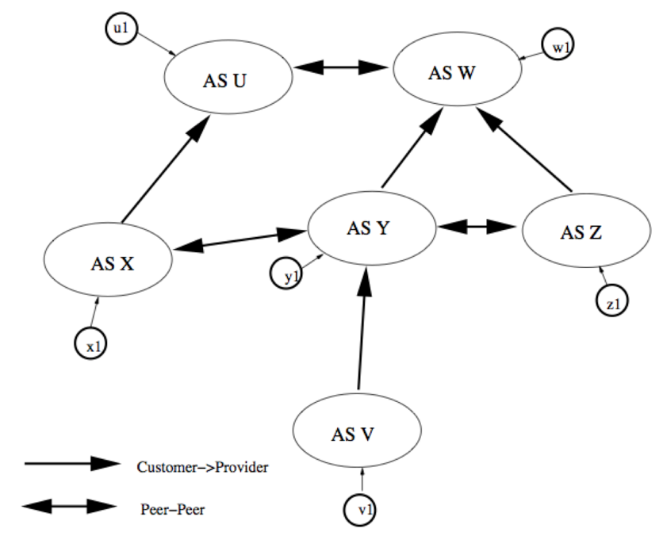
BGP Policy
Tier 1 ISPs?
Y. U, W
M. U, X
C. X, Y, Z
Which path may packets take (given commercial policies)?
Y. Red
M. Blue
C. Green
A. Orange
Notes:
Tier 1: UW (no providers)
Which paths: Orange

Slide 20
BGP Policy
Tier 1 ISPs?
Y. U, W
M. U, X
C. X, Y, Z
Which path may packets take (given commercial policies)?
Y. Red
M. Blue
C. Green
A. Orange
Notes:
Tier 1: UW (no providers)
Which paths: Orange

Slide 21
BGP Policy
Tier 1 ISPs?
Y. U, W
M. U, X
C. X, Y, Z
Which path may packets take (given commercial policies)?
Y. Red
M. Blue
C. Green
A. Orange
Notes:
Tier 1: UW (no providers)
Which paths: Orange

Slide 22
BGP Policy
Tier 1 ISPs?
Y. U, W
M. U, X
C. X, Y, Z
Which path may packets take (given commercial policies)?
Y. Red
M. Blue
C. Green
A. Orange
Notes:
Tier 1: UW (no providers)
Which paths: Orange

Slide 23
BGP Policy Configuration
Routing policy languages are vendor-specific
Not part of the BGP protocol specification
Different languages for Cisco, Juniper, etc.
Still, all languages have some key features
List of clauses matching on route attributes
… and discarding or modifying the matching routes
Configuration done by human operators
Implementing the policies of their AS
Business relationships, traffic engineering, security

Slide 24
How do backbone AS operate?
Backbone Topology

Slide 25
Backbone Networks
Backbone networks
Multiple Points-of-Presence (PoPs)
Lots of communication between PoPs
Accommodate traffic demands and limit delay

Slide 26
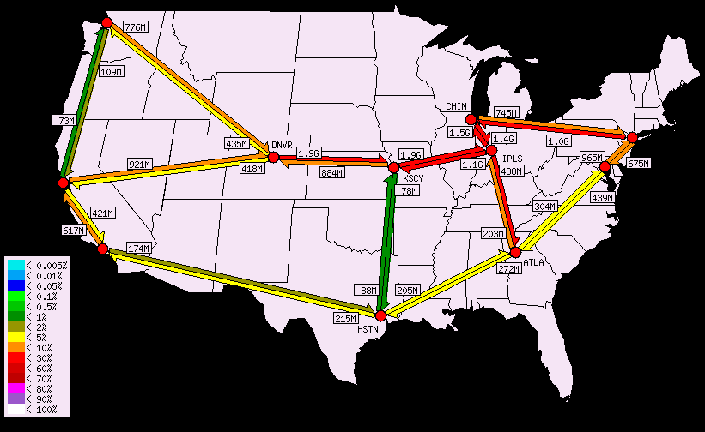
Abilene Internet2 Backbone

Slide 27
Points-of-Presence (PoPs)
Inter-PoP links
Long distances
High bandwidth
Intra-PoP links
Short cables between racks or floors
Aggregated bandwidth
Links to other networks
Wide range of media and bandwidth
Inter-PoP
Intra-PoP
Other networks

Slide 28
Where to Locate Nodes and Links
Placing Points-of-Presence (PoPs)
Large population of potential customers
Other providers or exchange points
Cost and availability of real-estate
Mostly in major metropolitan areas (“NFL cities”)
Placing links between PoPs
Already fiber in the ground
Needed to limit propagation delay
Needed to handle the traffic load

Slide 29
Peering
Customer B
Exchange traffic between customers
Settlement-free
Diverse peering locations
Both coasts, and middle
Comparable capacity at all peering points
Can handle even load
Provider B
multiple
peering
points
Provider A
Customer A

Slide 30
Combining Intradomain and Interdomain Routing

Slide 31
Intradomain Routing
9
B
A
B
4
A
3
D
8
3
10
4
G
5
8
E
F
C
Compute shortest paths between routers
Router C takes path C-F-A to router A
Using link-state routing protocols
E.g., OSPF, IS-IS

Slide 32
Interdomain Routing
Learn paths to remote destinations
AT&T learns two paths to Yale
Applies local policies to select a best route
AT&T
Sprint
Tier-2
Tier-3
Princeton

Slide 33
An AS is Not a Single Node
Multiple routers in an AS
Need to distribute BGP information within the AS
Internal BGP (iBGP) sessions between routers
AS1
eBGP
iBGP
AS2

Slide 34
Internal BGP and Local Preference
Both routers prefer path through AS 100
… even though right router learns external path
AS 200
AS 100
AS 300
Local Pref = 100
Local Pref = 90
AS 256
I-BGP

Slide 35
Hot-Potato (Early-Exit) Routing
Hot-potato routing
Each router selects the closest egress point
… based on the path cost in intradomain protocol
BGP decision process
Highest local preference
Shortest AS path
Closest egress point
Arbitrary tie break
dst
9
B
A
B
A
D
4
3
8
10
4
3
G
F
5
8
E
C

Slide 36
Hot-Potato Routing
Customer B
Selfish routing
Each provider dumps traffic on the other
As early as possible
Asymmetric routing
Traffic does not flow on same path in both directions
Provider B
multiple
peering
points
Early-exit
routing
Provider A
Customer A

Slide 37
Joining BGP and IGP Information
Border Gateway Protocol (BGP)
Announces reachability to external destinations
Maps a destination prefix to an egress point
128.112.0.0/16 reached via 192.0.2.1
Interior Gateway Protocol (IGP)
Used to compute paths within the AS
Maps an egress point to an outgoing link
192.0.2.1 reached via 10.10.10.10
10.10.10.10
192.0.2.1

Slide 38
Joining BGP with IGP Information
128.112.0.0/16
Next Hop = 192.0.2.1
128.112.0.0/16
10.10.10.10
AS 7018
192.0.2.1
AS 88
IGP
destination
next hop
(Y) True (M) False
The FIB of internal routers are of size O(all dest prefixes known to ISP)
The FIB of internal routers point to border router to neighbor ISP
192.0.2.0/30
10.10.10.10
+
BGP
destination
next hop
128.112.0.0/16
192.0.2.1
Notes:
Questions:
FIB of size: TRUE
Point to neighbor ISP: False (point to next hop internal router)

Slide 39
Joining BGP with IGP Information
128.112.0.0/16
Next Hop = 192.0.2.1
128.112.0.0/16
10.10.10.10
AS 7018
192.0.2.1
AS 88
IGP
destination
next hop
(Y) True (M) False
The FIB of internal routers are of size O(all dest prefixes known to ISP)
The FIB of internal routers point to border router to neighbor ISP
192.0.2.0/30
10.10.10.10
+
TRUE
BGP
destination
next hop
FALSE
128.112.0.0/16
192.0.2.1
Notes:
Questions:
FIB of size: TRUE
Point to neighbor ISP: False (point to next hop internal router)

Slide 40
Joining BGP with IGP Information
128.112.0.0/16
Next Hop = 192.0.2.1
128.112.0.0/16
10.10.10.10
AS 7018
192.0.2.1
AS 88
IGP
destination
next hop
192.0.2.0/30
10.10.10.10
+
Forwarding Table
destination
next hop
BGP
128.112.0.0/16
10.10.10.10
destination
next hop
192.0.2.0/30
10.10.10.10
128.112.0.0/16
192.0.2.1

Slide 41
Backbone Traffic Engineering

Slide 42
Routing With “Static” Link Weights
Routers flood information to learn topology
Determine “next hop” to reach other routers…
Compute shortest paths based on link weights
Link weights configured by network operator
2
3
1
1
3
2
1
5
4
3

Slide 43
Setting the Link Weights
How to set the weights
Inversely proportional to link capacity?
Proportional to propagation delay?
Network-wide optimization based on traffic?
2
3
1
1
3
2
3
1
5
4
3

Slide 44
Measure, Model, and Control
Network-wide
“what if” model
Topology/
Configuration
Offered
traffic
Changes to
the network
measure
control
Operational network

Slide 45
Limitations of Shortest-Path Routing
Sub-optimal traffic engineering
Restricted to paths expressible as link weights
Limited use of multiple paths
Only equal-cost multi-path, with even splitting
Disruptions when changing the link weights
Transient packet loss and delay, and out-of-order
Slow adaptation to congestion
Network-wide re-optimization and configuration
Overhead of the management system

Slide 46
Constrained Shortest Path First
Run a link-state routing protocol
Configurable link weights
Plus other metrics like available bandwidth
Constrained shortest-path computation
Prune unwanted links
(e.g., not enough bw)
Compute shortest path on the remaining graph
s
5, bw=10
d
3,
bw=80
5
bw=70
6, bw=60

Slide 47
Conclusions
Interdomain routing
Business relationships reflected in interdomain routing, leads to more stable paths
Peering and transit key ideas between providers, peers, and customer AS
Backbone networks
Transit service for customers
Combine inter and intradomain routing
Glue that holds the Internet together

