Slide 1
Middleboxes and Tunneling
Mike Freedman
COS 461: Computer Networks
http://www.cs.princeton.edu/courses/archive/spr20/cos461/

Slide 2

Internet Ideal: Simple Network Model
Globally unique identifiers
  Each node has a unique, fixed IP address
  … reachable from everyone and everywhere
Simple packet forwarding
  Network nodes simply forward packets
  … rather than modifying or filtering them
source
destination
IP network

Slide 3
Internet Reality
Host mobility
  Host changing address as it moves
IP address depletion
  Multiple hosts using the same address
Security concerns
  Detecting and blocking unwanted traffic
Replicated services
  Load balancing over server replicas
Performance concerns
  Allocating bandwidth, caching content, …
Incremental deployment
  New technology deployed in stages

Slide 4
Middleboxes
Middleboxes are intermediaries
  Interposed between communicating hosts
  Often without knowledge of one or both parties
Myriad uses
  Address translators
  Firewalls
  Traffic shapers
  Intrusion detection
  Transparent proxies
  Application accelerators
“An abomination!”
  Violation of layering
  Hard to reason about
  Responsible for subtle bugs
“A practical necessity!”
  Solve real/pressing problems
  Needs not likely to go away

Slide 5
Firewalls

Slide 6
Firewalls
Should arriving packet be allowed in? Departing packet let out?
administered
network
public
Internet
firewall
Firewall filters packet-by-packet, based on:
  Source and destination IP addresses and port #’s
  TCP SYN and ACK bits; ICMP message type
  Deep packet inspection on packet contents (DPI)

Slide 7
Packet Filtering Examples
Block all packets with IP protocol field = 17 and with either source or dest port = 23.
  All incoming and outgoing UDP flows blocked
  All Telnet connections are blocked
Block inbound TCP packets with SYN but no ACK
  Prevents external clients from making TCP connections with internal clients
  But allows internal clients to connect to outside
Block all packets with TCP port of Fortnite

Slide 8
Firewall Configuration
Firewall applies a set of rules to each packet
  To decide whether to permit or deny the packet
Each rule is a test on the packet
  Comparing headers, deciding whether to allow/deny
Order matters
  Once packet matches a rule, the decision is done

Slide 9
Firewall Configuration Example
Alice runs a network in 222.22.0.0/16
Wants to let Bob’s school access certain hosts
  Bob is on 111.11.0.0/16
  Alice’s special hosts on 222.22.22.0/24
Alice doesn’t trust Trudy, inside Bob’s network
  Trudy is on 111.11.11.0/24
Alice doesn’t want any other Internet traffic

Slide 10
Firewall Configuration Rules
1. Allow Bob’s network in to special destinations
  Permit (src=111.11.0.0/16, dst = 222.22.22.0/24)
2. Block Trudy’s machines
  Deny (src = 111.11.11.0/24, dst = 222.22.0.0/16)
3. Block world
  Deny (src = 0.0.0.0/0, dst = 0.0.0.0/0)
Order?
  (Y) 3, 1 (M) 3, 1, 2 (C) 1, 3 (A) 2, 1, 3

Slide 11
Firewall Configuration Rules
1. Allow Bob’s network in to special destinations
  Permit (src=111.11.0.0/16, dst = 222.22.22.0/24)
2. Block Trudy’s machines
  Deny (src = 111.11.11.0/24, dst = 222.22.0.0/16)
3. Block world
  Deny (src = 0.0.0.0/0, dst = 0.0.0.0/0)
Order?
  (Y) 3, 1 (M) 3, 1, 2 (C) 1, 3 (A) 2, 1, 3

Slide 12

Stateful Firewall
Stateless firewall:
  Treats each packet independently
Stateful firewall
  Remembers connection-level information
  E.g., client initiating connection with a server
  … allows the server to send return traffic
SYN
SYN
SYN-ACK
SYN-ACK

Slide 13
A Variation: Traffic Management
Permit vs. deny is too binary a decision
  Classify traffic using rules, handle classes differently
Traffic shaping (rate limiting)
  Limit the amount of bandwidth for certain traffic
Separate queues
  Use rules to group related packets
  And then do weighted fair scheduling across groups

Slide 14
Clever Users Subvert Firewalls
Example: filtering dorm access to a server
  Firewall rule based on IP addresses of dorms
  … and the server IP address and port number
  Problem: users may log in to another machine
Example: filtering P2P based on port #s
  Firewall rule based on TCP/UDP port numbers
    E.g., allow only port 80 (e.g., Web) traffic
  Problem: software using non-traditional ports
    E.g., write P2P client to use port 80 instead

Slide 15
Network Address Translation

Slide 16
History of NATs
IP address space depletion
  Clear in early 90s that 2³² addresses not enough
  Work began on a successor to IPv4
In the meantime…
  Share addresses among numerous devices
  … without requiring changes to existing hosts
Meant as a short-term remedy
  Now: NAT is widely deployed, much more than IPv6

Slide 17
Network Address Translation
138.76.29.7
10.0.0.1
Problem: Local address not globally addressable
outside
NAT
NAT rewrites the IP addresses
  Make “inside” look like single IP addr
  Change header checksums accordingly
inside
10.0.0.2

Slide 18
Network Address Translation
  Outbound: Rewrite the src IP addr
  Inbound: Rewrite the dest IP addr
138.76.29.7
10.0.0.1
Problem: Local address not globally addressable
outside
NAT
NAT rewrites the IP addresses
  Make “inside” look like single IP addr
  Change header checksums accordingly
inside
10.0.0.2

Slide 19
Port-Translating NAT
Two hosts communicate with same destination
  Destination needs to differentiate the two
Map outgoing packets
  Change source address and source port
Maintain a translation table
  Map of (src addr, port #) to (NAT addr, new port #)
Map incoming packets
  Map the destination address/port to the local host

Slide 20
Network Address Translation Example
NAT translation table
WAN side addr LAN side addr
138.76.29.7, 5001 10.0.0.1, 3345 ……
S: 10.0.0.1, 3345
D: 128.119.40.186, 80
10.0.0.1
1
2
S: 138.76.29.7, 5001
D: 128.119.40.186, 80
10.0.0.2
138.76.29.7
S: 128.119.40.186, 80
D: 138.76.29.7, 5001
S: 128.119.40.186, 80
D: 10.0.0.1, 3345
4
3
10.0.0.3

Slide 21
Maintaining the Mapping Table
Create an entry upon seeing an outgoing packet
  Packet with new (source addr, source port) pair
Eventually, need to delete entries to free up #’s
  When? If no packets arrive before a timeout
  (At risk of disrupting a temporarily idle connection)
Yet another example of “soft state”
  I.e., removing state if not refreshed for a while

Slide 22
Where is NAT Implemented?
Home router (e.g., Linksys box)
  Integrates router, DHCP server, NAT, etc.
  Use single IP address from the service provider
Campus or corporate network
  NAT at the connection to the Internet
  Share a collection of public IP addresses
  Avoid complexity of renumbering hosts/routers when changing ISP (w/ provider-allocated IP prefix)

Slide 23
Practical Objections Against NAT
Port #s are meant to identify sockets
  Yet, NAT uses them to identify end hosts
  Makes it hard to run a server behind a NAT
138.76.29.7
Requests to 138.76.29.7 on port 80
10.0.0.1
NAT
Which host should get the request???
Explicit config at NAT for incoming conn’s
10.0.0.2

Slide 24
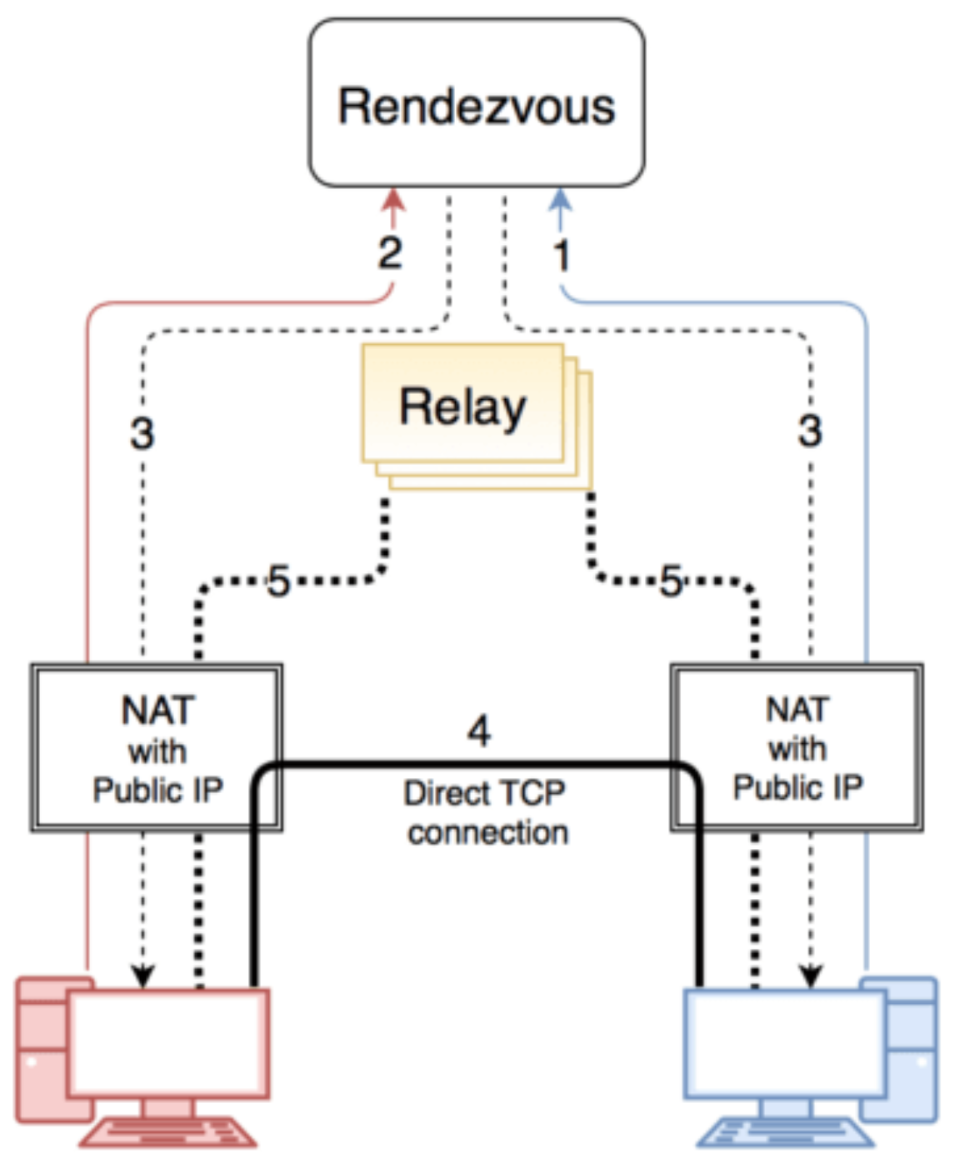
Not just servers: peer-to-peer traffic
Peer “registers” with rendezvous
Other peer contacts rendezvous
Rendezvous sends to each peer the others’ IP:port
Try to connect in each direction. If one succeeds, done
Otherwise, proxy through relay

Slide 25
Principled Objections Against NAT
Routers are not supposed to look at port #s
  Network layer should care only about IP header
  … and not be looking at the port numbers at all
NAT violates the end-to-end argument
  Network nodes should not modify the packets
IPv6 is a cleaner solution
  Better to migrate than to limp along with a hack
That’s what happens when network puts power in hands of end users!

Slide 26
Load Balancers

Slide 27
Replicated Servers
One site, many servers
  www.youtube.com

Slide 28
Load Balancer
Dedicated IP addresses
Splits load over server replicas
  At the connection level
Apply load balancing policies
10.0.0.1
Virtual IP address
12.1.11.3
10.0.0.2
10.0.0.3

Slide 29
Supports Layer-2 failover!
10.0.0.1
Virtual IP address
12.1.11.3
10.0.0.2
10.0.0.3
10.0.0.1
Gratuitous ARP:
10.0.0.1 is MAC aa:bb:cc
Handles new TCP connections?
Handles existing TCP connections?

Slide 30
Supports Layer-2 failover!
10.0.0.1
Virtual IP address
12.1.11.3
10.0.0.2
10.0.0.3
10.0.0.1
Gratuitous ARP:
10.0.0.1 is MAC aa:bb:cc
Yes
Handles new TCP connections?
Handles existing TCP connections?
No

Slide 31
Wide-Area Accelerators

Slide 32
At Connection Point to the Internet
Appliance
Internet
Appliance
Improve end-to-end performance
  Through buffering, compression, caching, …
Incrementally deployable
  No changes to end hosts or the rest of the Internet

Slide 33
Example: Improve TCP Throughput
ACK
Appliance
Internet
Appliance
Appliance with a lot of local memory
Sends ACK packets quickly to the sender
Overwrites receive window with a large value
Or, even run a new and improved version of TCP

Slide 34
Example: Compression
Appliance
Internet
Appliance
Compress the packet
Send the compressed packet
Uncompress at the other end
Maybe compress across successive packets

Slide 35
Example: Caching
Appliance
Internet
Appliance
Cache copies of the outgoing packets
Check for sequences of bytes that match past data
Just send a pointer to the past data
And have the receiving appliance reconstruct

Slide 36
Example: Encryption
Appliance
Internet
Appliance
Two sites share keys for encrypting traffic
Sending appliance encrypts the data
Receiving appliance decrypts the data
Protects the sites from snoopers on the Internet

Slide 37
Tunneling

Slide 38
IP Tunneling
IP tunnel is a virtual point-to-point link
  Illusion of a direct link between two nodes
Encapsulation of the packet inside IP datagram
  Node B sends a packet to node E
  … containing another packet as the payload
A
B
tunnel
E
F
Logical view:
A
B
E
F
Physical view:

Slide 39
6Bone: Deploying IPv6 over IP4
A
B
E
F
Logical view:
tunnel
IPv6
IPv6
IPv6
IPv6
A
B
C
D
E
F
Physical view:
IPv6
IPv6
IPv4
IPv4
IPv6
IPv6
Flow: X
Src: A
Dest: F
data
Src:B
Dest: E
Src:B
Dest: E
Flow: X
Src: A
Dest: F
data
Flow: X
Src: A
Dest: F
data
Flow: X
Src: A
Dest: F
data
A-to-B:
IPv6
E-to-F:
IPv6
B-to-C:
IPv6 inside
IPv4
B-to-C:
IPv6 inside
IPv4

Slide 40
Remote Access Virtual Private Network
VPN server
12.1.1.73
Internet
12.1.1.0/24
12.1.1.1
1.2.3.4
Tunnel from user machine to VPN server
  A “link” across the Internet to the local network
Encapsulates packets to/from the user
  Packet from 12.1.1.73 to 12.1.1.100
  Inside a packet from 1.2.3.4 to 12.1.1.1
  Interior packet can be point-to-point encrypted

Slide 41
“Commercial” VPNs
VPN server + proxy
Internet
3.4.5.6
12.1.1.1
1.2.3.4
Tunnel from user machine to VPN server
VPN server NATs or TCP proxies traffic to origin sites
  Traffic between client and VPN encrypted
  VPN “anonymizes” the IP of client to rest of Internet, and can circumvent censorship on client-side
  Client must fully trust VPN provider

Slide 42
Conclusions
Middleboxes address important problems
  Getting by with fewer IP addresses
  Blocking unwanted traffic
  Making fair use of network resources
  Improving end-to-end performance
Middleboxes cause problems of their own
  No longer globally unique IP addresses
  Cannot assume network simply delivers packets

