Slide 1
COS 461: Computer Networks
Mike Freedman
Spring 2020
Lectures: MW 1:30-2:50pm in Richardson 002
http://www.cs.princeton.edu/courses/archive/spring20/cos461/

Slide 2
The Internet is an Exciting Place

Slide 5
https://en.wikipedia.org/wiki/Global_Internet_usage

Slide 6
How does the design of the Internet support growth and foster innovation?

Slide 7
The Internet is a Tense Place

Slide 8
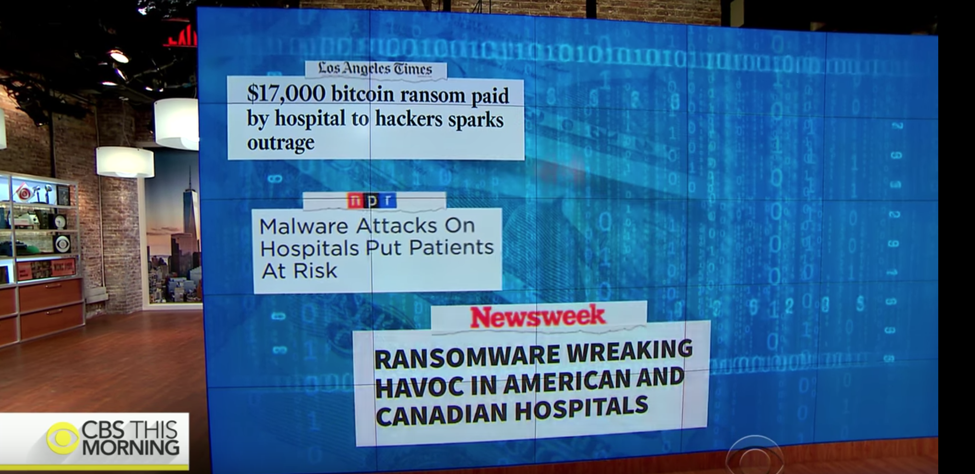

Slide 9
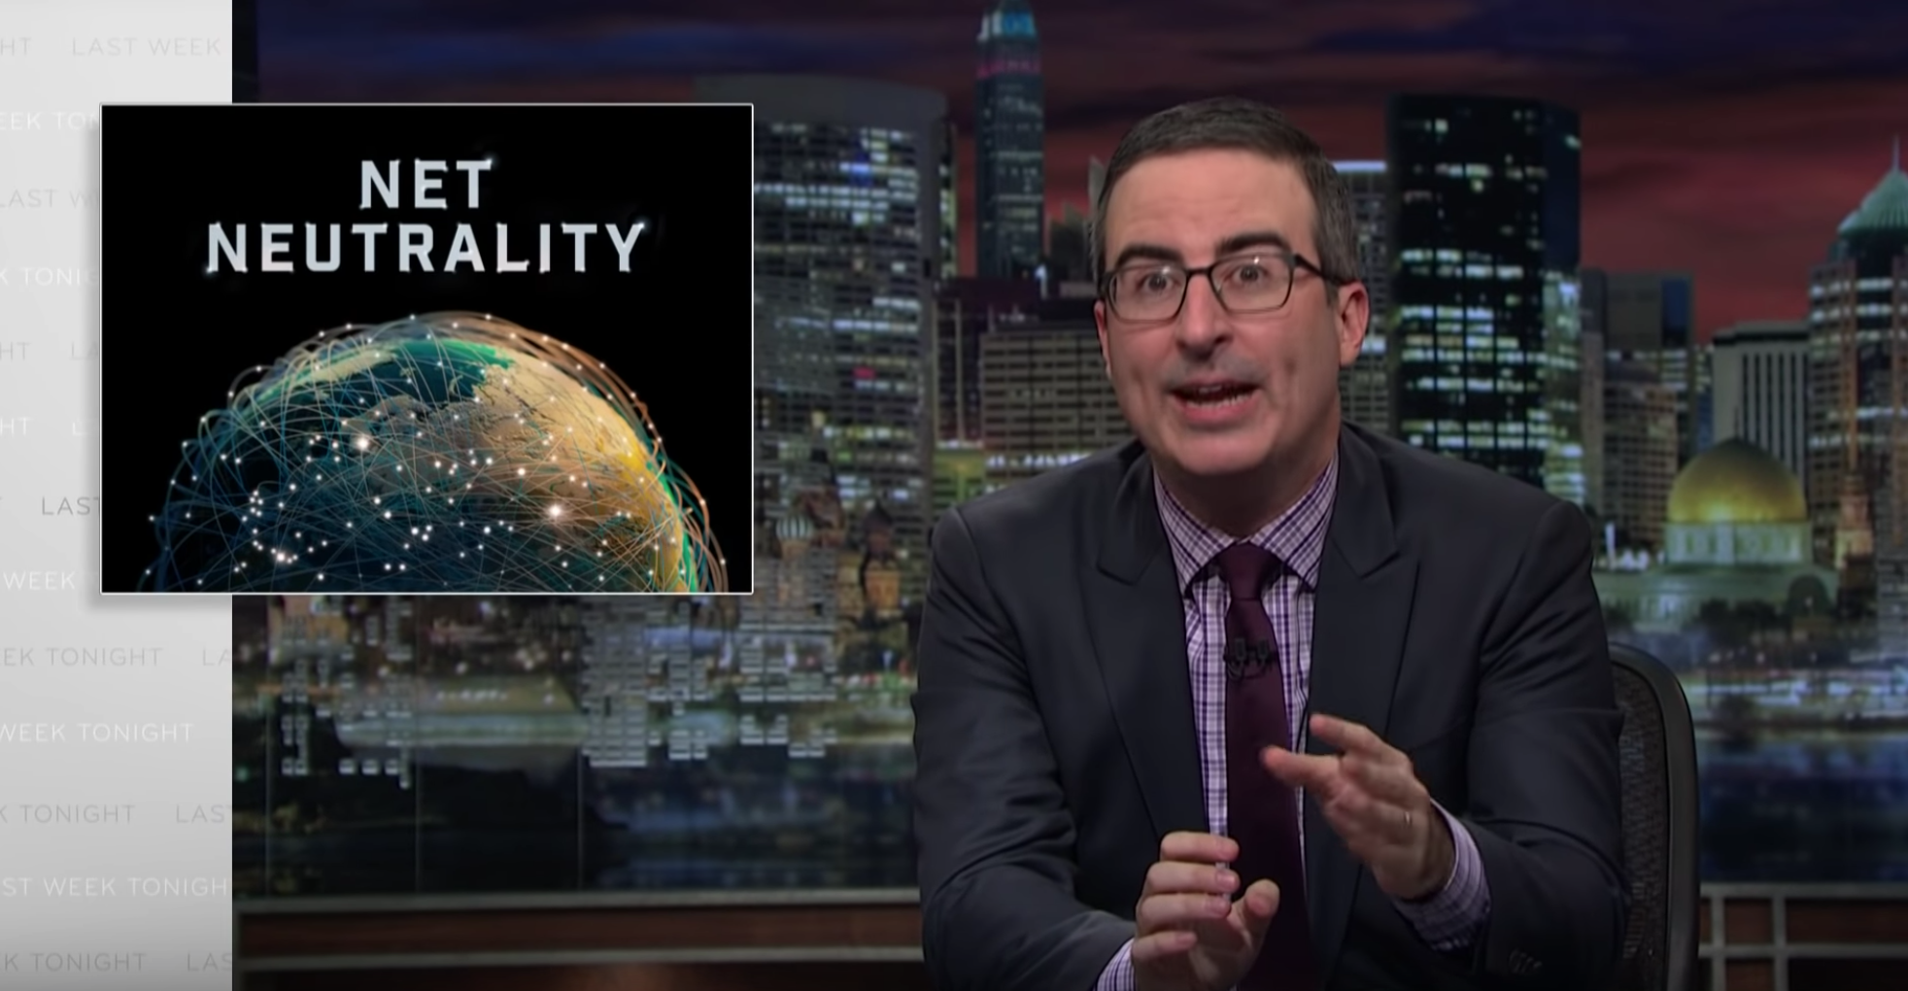

Slide 10
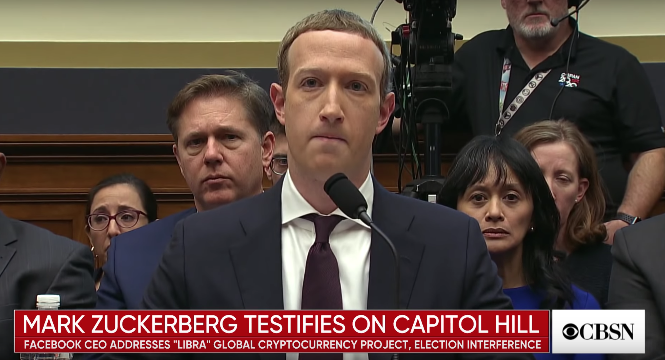

Slide 11
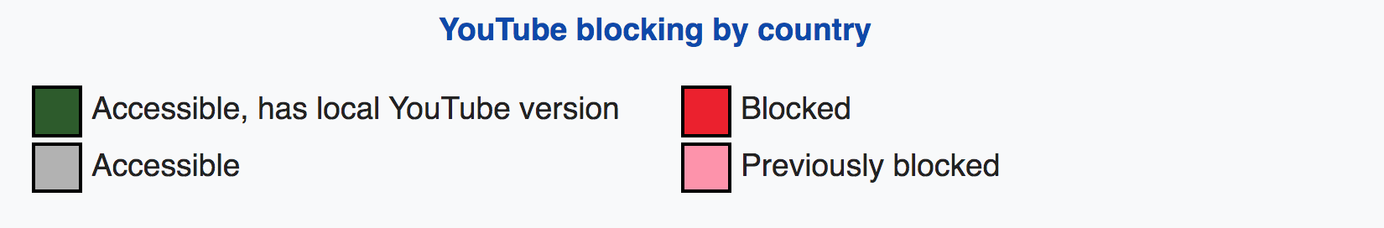
https://en.wikipedia.org/wiki/Global_Internet_usage

Slide 12
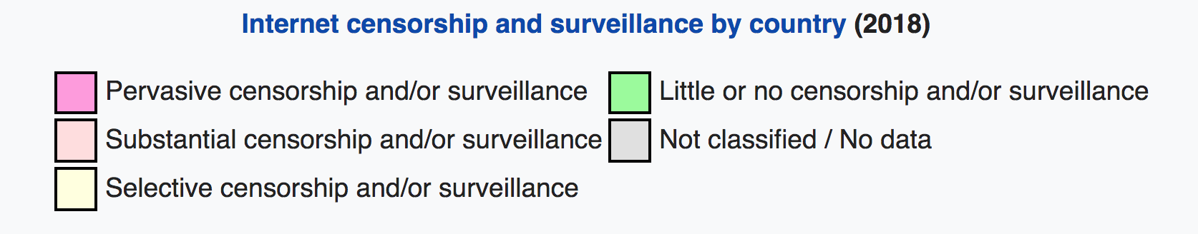
https://en.wikipedia.org/wiki/Global_Internet_usage

Slide 13
How does the design of the Internet create or exacerbate these tensions?

Slide 14
What is the Internet?

Slide 15
I Can Haz Wikipedia
The Internet is the worldwide, publicly accessible network of interconnected computer networks that transmit data by packet switching using the standard Internet Protocol (IP).
It is a "network of networks" that consists of millions of smaller domestic, academic, business, and government networks, which together carry various information and services.
http://en.wikipedia.org/wiki/Internet

Slide 16
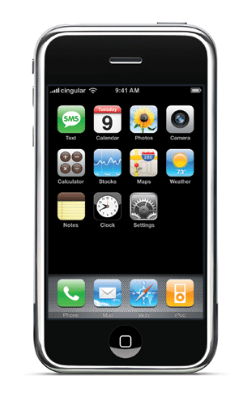
“Best-Effort Packet Delivery Service”
THE
INTERNET
packets

Slide 17
Power at the Edge
End-to-End Principle
Whenever possible, communications protocol operations should be defined to occur at the end-points of a communications system.
Programmability
With programmable end hosts, new network services can be added at any time, by anyone.
And end hosts became powerful and ubiquitous….

Slide 18

“A Network of Networks”
THE
INTERNET
4
3
5
2
7
6
1
Web server
@ Google
Client
Browser
@ Princeton
How do you name?
How do you find a name?

Slide 19
Announcing a Route
4
3
5
2
7
6
1
Web server
@ Google
Client
Browser
@ Princeton
“Princeton is in this direction”

Slide 20
Forwarding Traffic
4
3
5
2
7
6
1
Web server
@ Google
Client
Browser
@ Princeton

Slide 21
Withdrawing a traffic route
4
3
5
2
7
6
1
???
Web server
@ Google
Client
Browser
@ Princeton
“Princeton is NOT in this direction”

Slide 22

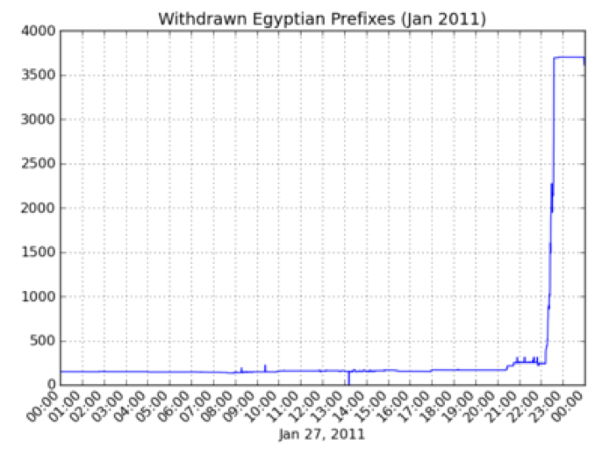

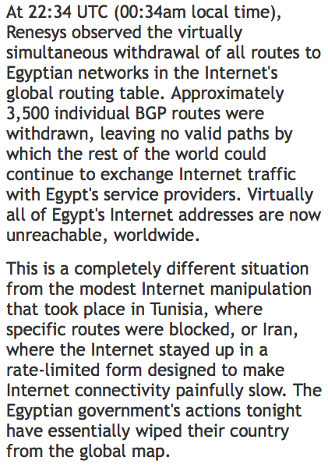

Slide 23
Central concepts in networking

Slide 24
Abstraction through Protocol Layering
Layers partition the system
  Each layer solely relies on services from layer below
  Each layer solely exports services to layer above
Interface between layers defines interaction
  Hides implementation details
  Layers can change without disturbing other layers
Application
Application-to-application channels
Host-to-host connectivity
Link hardware

Slide 25
The Internet Protocol Suite
FTP
HTTP
NV
TFTP
Applications
TCP
UDP
UDP
TCP
Waist
IP
Data Link
NET₁
NET₂
…
NET_{n}
Physical
The Hourglass Model
The “narrow waist” facilitates interoperability

Slide 26
Application: HyperText Transfer Protocol
GET /courses/archive/spr20/cos461/ HTTP/1.1
Host: www.cs.princeton.edu
User-Agent: Mozilla/4.03
CRLF
Request
HTTP/1.1 200 OK
Date: Mon, 4 Feb 2013 11:09:03 GMT
Server: Netscape-Enterprise/3.5.1
Last-Modified: Mon, 2 Feb 2013 19:12:23 GMT
Content-Length: 21
CRLF
Site under construction
Response

Slide 27
Layer Encapsulation in HTTP
User A
User B
Application
Get index.html
App-to-app
channels
Connection ID
Host-to-host
connectivity
Source/Destination
Link hardware
Link Address

Slide 28
End Hosts vs. Routers
host
host
HTTP message
HTTP
HTTP
TCP segment
TCP
TCP
router
router
IP packet
IP packet
IP packet
IP
IP
IP
IP
Ethernet
interface
Ethernet
interface
SONET
interface
SONET
interface
Ethernet
interface
Ethernet
interface

Slide 29

Socket and Process Communication
application layer
application layer
User Process
Internet
User Process
Socket
Socket
OS network
stack
OS network
stack
transport layer (TCP/UDP)
transport layer (TCP/UDP)
Internet
network layer (IP)
network layer (IP)
link layer (e.g. ethernet)
Internet
link layer (e.g. ethernet)
The interface that the OS provides to its networking subsystem

Slide 30
Socket and Process Communication
Receiving host
  Destination address that uniquely identifies host
  IP address: 32-bit quantity (“1.2.3.4”)
Receiving socket
  Host may be running many different processes
  Destination port that uniquely identifies socket
  Port number: 16-bits (“80”)
Process
A
Process
B
port X
Port
Number
port Y
TCP/UDP
Protocol
IP
Host
Address
Ethernet Adapter

Slide 31
Key Concepts in Networking
Naming
  What to call computers, services, protocols, …
Layering
  Abstraction is the key to managing complexity
Protocols
  Speaking the same language
  Syntax and semantics
Resource allocation
  Dividing scare resources among competing parties
  Memory, link bandwidth, wireless spectrum, paths

Slide 32
Course Summary

Slide 33
What You Learn in This Course
Knowledge: how the Internet works, and why
  Protocol stack: link, network, transport, application
  Resource allocation: congestion control, routing
  Applications: Web, P2P, …
  Networks: enterprise, cloud, backbone, wireless, …
Insight: key concepts in networking
  Naming, layering, protocols, resource allocation, …
Skill: network programming
  Many nodes are general-purpose computers
  Can innovate and develop new uses of networks

Slide 34
meClickers: Quick Surveys
Growth/innovation vs. create/exacerbate tensions
Does Internet design prevent misuse?
  Individual endpoints can only use addresses given to them when connect to the network
  Individual end-points can “spoof” any IP address

Slide 35
meClickers: Quick Surveys
Growth/innovation vs. create/exacerbate tensions
Does Internet design prevent misuse?
Networks are assigned unique IP address blocks from a central authority (“IANA”): Princeton has 128.112.*
  Network can only announce assigned addresses
  Networks can spoof any address

Slide 36
meClickers: Quick Surveys
Growth/innovation vs. create/exacerbate tensions
Does “Internet” provide reliable packet delivery?
  Yes, that’s necessary for protocols like HTTP that require in-order streams
  No, packets may be arbitrary dropped or reordered

Slide 37
Course Organization

Slide 38
Learning the Material: People
Instructor: Prof. Mike Freedman
  Slides available online at course Web site
TAs: David Liu, Ashwini Raina, Srikar Kasi
Main Q&A forum: www.piazza.com
  No anonymous posts or questions, can DM instructors
  Setting expectation: TAs will monitor/respond to Piazza 1-2 times per day in a burst of activity

Slide 39
Learning the Material: Lectures! (primary)
Lectures: MW 1:30 – 2:50, Robertson 002
Attend lectures and take notes!
  Lecture slides posted day/night before
  Recommendation: Print slides & take notes
  Not everything covered in class is on slides
  You are responsible for everything covered in class

Slide 40
Learning the Material: Books (secondary)
Main textbook
  Computer Networks: A Systems Approach, by Peterson and Davie
  Also online: https://book.systemsapproach.org/
Additional books (may be of interest)
  Networking textbooks
    Computer Networking: A Top-Down Approach Featuring the Internet, by Kurose and Ross
    Computer Networks, by Tanenbaum
  Network programming references
    TCP/IP Illustrated, Volume 1: The Protocols, by Stevens
    Unix Network Programming, Vol 1: Sockets Networking API, by Stevens, Fenner, & Rudolf

Slide 41
Grading
Six assignments (9% each)
  90% 24 hours late, 80% 2 days late, 50% >5 days late
  Three free late days (we’ll figure which one is best)
  Only failing grades I’ve given are for students who don’t / try to do assignments
Two exams (46% total)
  Midterm exam before spring break (20%)
  Final exam during exam period (26%)

Slide 42
Policy: Write Your Own Code
Programming is an individual creative process. At first, discussions with friends is fine. When writing code, unless stated otherwise, the program must be your own work.
Do not copy another person’s programs, comments, or any part of submitted assignment. This includes character-by-character transliteration but also derivative works. Cannot use another’s code, etc. even while “citing” them.
Writing code for use by another or using another’s code is academic fraud in context of coursework.
Do not publish your code e.g., on github, during/after course!

Slide 43
Policy: Write Your Own Code
Programming is an individual creative process. At first, discussions with friends is fine. When writing code, unless stated otherwise, the program must be your own work.
Do not copy another person’s programs, comments, or any part of submitted assignment. This includes character-by-character transliteration but also derivative works. Cannot use another’s code, etc. even while “citing” them.
Writing code for use by another or using another’s code is academic fraud in context of coursework.
Do not publish your code e.g., on github, during/after course!
Don’t Plagiarize!

Slide 44
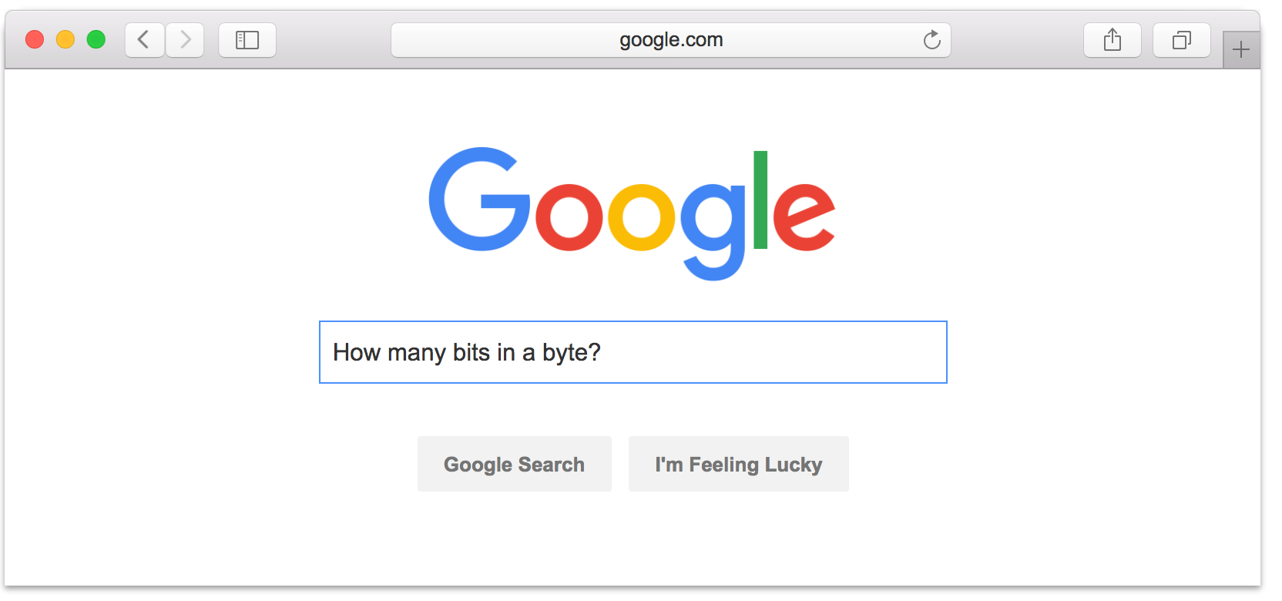
Setting Expectations:
Don’t expect 24x7 answers
Try to figure out yourself
Piazza not designed for debugging
  Utilize right venue: Go to TA office hours
  Send detailed Q’s / bug reports, not “no idea what’s wrong”
Instructors are not on pager duty 24 x 7
  Don’t expect response before next business day
  Questions Friday night @ 11pm should not expect fast responses. Be happy with something before Monday.
Implications
  Students should answer each other; start your assignments early!

Slide 45
Assignment 1:
Socket Programming

Slide 46
Client-Server Communication
Client "sometimes on"
  Initiates a request to the server when interested
  E.g., Web browser on your laptop or cell phone
  Doesn't communicate directly with other clients
  Needs to know server's address
Server is "always on"
  Handles services requests from many client hosts
  E.g., Web server for the www.cnn.com Web site
  Doesn't initiate contact with the clients
  Needs fixed, known address

Slide 47
Using IP + Ports to Identify Services
Server host 128.2.194.242
Service request for
128.2.194.242:80
(i.e., the Web server)
Client host
Web server
(port 80)
Client
OS
Echo server
(port 7)
Service request for
128.2.194.242:7
(i.e., the echo server)
Web server
(port 80)
Client
OS
Echo server
(port 7)

Slide 48
Two Types of Application Processes Communication
Datagram Socket (UDP)
  Collection of messages
  Best effort
  Connectionless
Stream Socket (TCP)
  Stream of bytes
  Reliable
  Connection-oriented

Slide 49
Client-Server Communication
Datagram Sockets (UDP): Connectionless
Server
Client
socket()
Create a socket
Create a socket
socket()
bind(addr, port)
Bind the socket
Bind the socket
bind()
data (request)
Send the request
sendto(addr, port)
recvfrom()
Receive Request
data (reply)
sendto(addr, port)
Send response
Receive response
recvfrom()

Slide 50
Client-Server Communication
Stream Sockets (TCP): Connection-oriented
Server
socket()
Create a socket
bind(addr, port)
Bind the socket
(what port am I on?)
Client
Create a socket
socket()
listen()
Listen for client
(Wait for incoming connections)
establish connection
Connect to server
conn = connect(addr, port)
conn = accept()
Accept connection
data (request)
Send the request
send(conn)
recv(conn)
Receive Request
send(conn)
Send response
data (reply)
Receive response
recv(conn)

