Slide 1
Computer Science:
A new way to think
COS 116, Spring 2012
Adam Finkelstein

Slide 2
“Computer science is no more about computers than
astronomy is about telescopes.” Edsger Dijkstra.
Today: Computer science ideas have led to a rethinking of
Epistemology, Physics, Statistics, Economics, Biology,
Social Sciences, Privacy, etc.

Slide 3
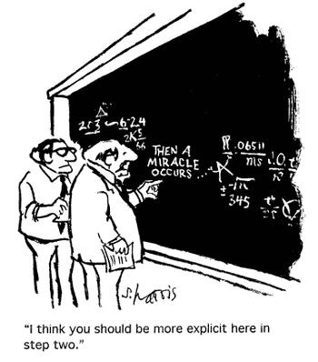
Field 1: Mathematics
Traditional math proofs (recall our
discussion of axiomatic math):
one needs to check every line
PCP Theorem[A., Safra, Lund, Motwani, Sudan, Szegedy1992,..]
Every math theorem has a proof that can be probabilistically
checked by looking at 3 bits in them.
Not trivial!
Implies that computing approximate solutions to CLIQUE
is tantamount to computing optimal solutions.

Slide 4
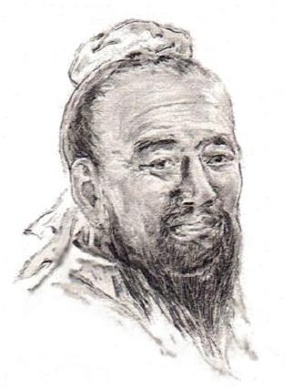
Field 2: Epistemology
(theory of the nature and grounds of knowledge especially with reference to its limits and validity.)
Zhuang Tse: “See how the small fish are darting about in the
river. That is the happiness of the fish.”
Hui Tse: “You are not a fish yourself. How can you know the happiness of the fish?”
Zhuang Tse: “And you not being I, how can you know that I do not know?”
[Zhuang Tse, 300BC.]

Slide 5
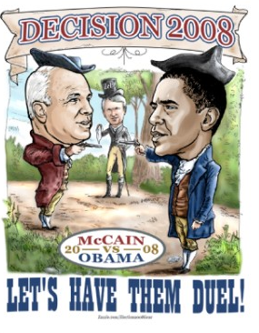
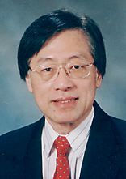
(Epistemology 1): Public closed-ballot elections
Hold an election in this room s.t.
  Voters can speak only publicly.
  At the end everyone must agree on who won and by what margin
  No one should know which way anyone else voted
Is this possible??
Answer: Yes [Yao’85,GMW’86]
“Whatever you see
from others,
you could have
produced yourself,
with no interaction.”
“Privacy-preserving Computations”

Slide 6
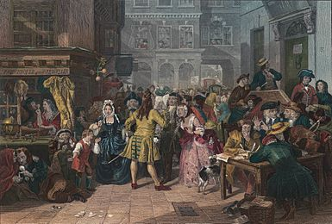
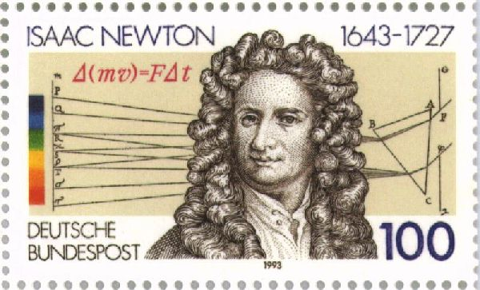
Epistemology 2: Asset bubbles
Tulip bubble in Netherlands, 1630s
South Sea bubble in England, 1720
…etc…
dot-com bubble, 1990s
real estate bubble, 2001-08.
“ I can calculate the motions of the heavenly bodies,
but not the madness of people.” -- [Isaac Newton]
(Newton lost money in South Sea bubble.)
Also a challenge to modern economic theory.

Slide 7
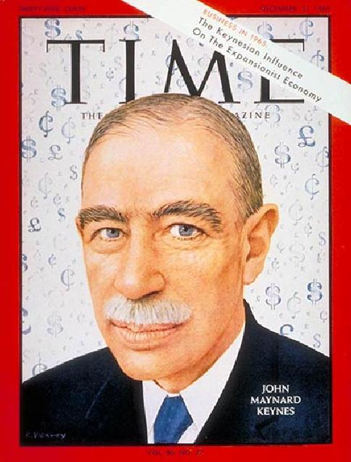
Keynes: stock market vs. beauty contests
It is not a case of choosing those [faces] that, to the best of one’s judgment, are really the prettiest, nor even those that average opinion genuinely thinks the prettiest. We have reached the third degree where we devote our intelligences to anticipating what average opinion expects the average opinion to be. And there are some, I believe, who practice the fourth, fifth and higher degrees.”
(J. M. Keynes, General Theory of Employment,
Interest and Money, 1936).

Slide 8
Keynes: stock market vs. beauty contests
1st degree thinking: pick the stock you like best.
2nd degree thinking: pick stock that is best by
1st order thinking
3rd degree thinking: pick the stock that is best by
2nd order thinking…
“Impossibility of bubbles” (backwards induction argument):
Suppose bubble will burst in 30 days and everybody knows it.
Anticipating this, smart investors will exit the market on day 29.
Realizing this, smart investors should exit on day 28, etc.….
→ If market has enough rational investors, bubble cannot form.”

Slide 9
Meanwhile, over in computer science….
In 1970s and 1980s (continuing since), great interest in
what can or cannot be achieved by distributed
systems of processors with unreliable communication….

Slide 10
Coordinated attack problem [Gray’78]+ many others
Two generals in an army. If attack enemy simultaneously,
they win. If only one attacks, the enemy wins.
“Lets attack at dawn!”
Messenger
General A
Got your message. Agreed!
General B
Messenger
Can B go ahead and
attack at dawn??
Can A go ahead and
attack at dawn??
Got your reply
Messenger
Can A go ahead and attack at dawn??
Can B go ahead and attack at dawn??
No! Messenger could be intercepted and killed!
Attack possible iff “A knows that B knows that A knows….”
Common knowledge (Halpern and Moses, ’84,’90).
Unachievable with unreliable message passing.
approximate common knowledge achievable!

Slide 11
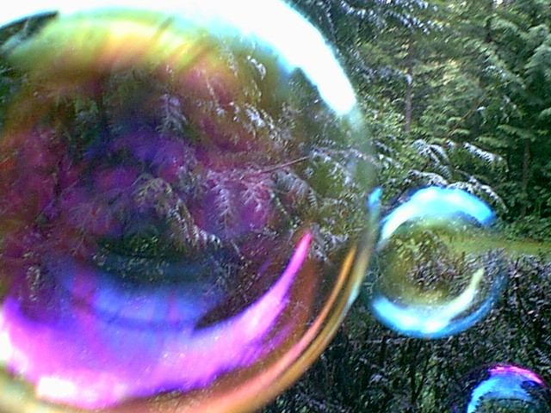
Dynamic model for bubbles
[Brunnermeier, Abreu 2002]
Market contains both irrational and rational agents
Irrational agents cause bubble.
Rational agents willing to prick bubbles, but require
a coordinated attack (if too few attack, they lose!)
Bubbles last until bubble’s existence is “approximate
common knowledge.” (Before then, rational to join
bubble!).
Synchronization mechanisms inspired by
“asynchronous clocking” in distributed computing.

Slide 12
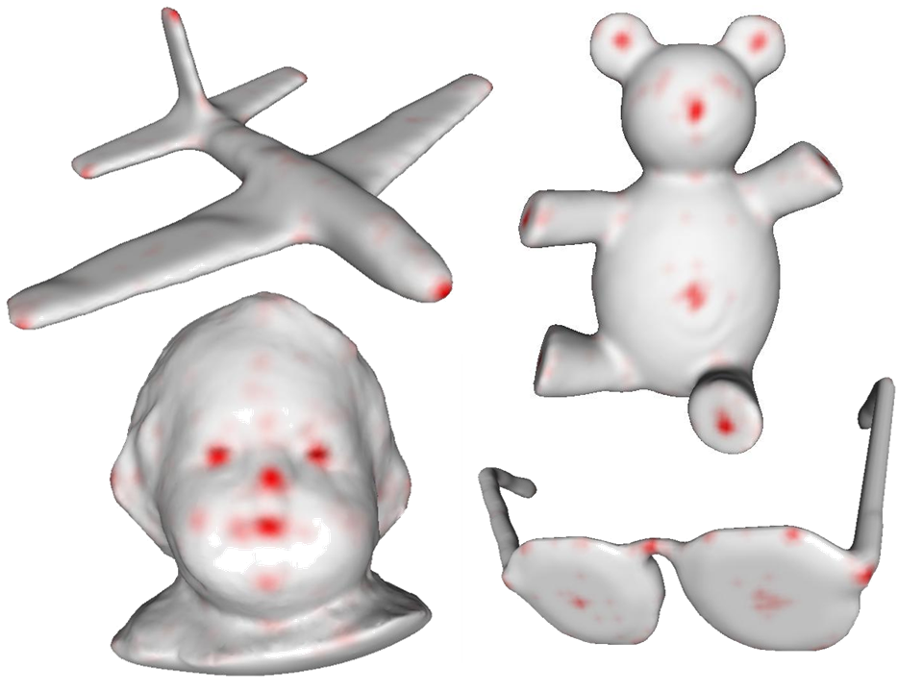
Schelling Points on 3D Surfaces
[Chen 2012]

Slide 13
Field 3: Finance
“Computational intractability of pricing
financial derivatives
and its economic effects.”
(Arora, Barak, Brunnermeier, Ge 2010)

Slide 14
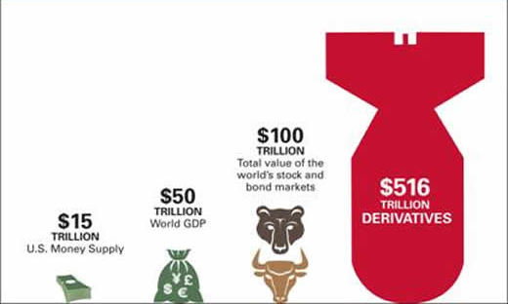
Crash of ‘08 (in 1 slide)
Relative Market Sizes
Lesson Learnt
Small Error in Derivatives ➔ Huge Effects in Economy
Notes:
First 2 figures show that derivatives have large influence.
Last 2 figures show that derivatives are hard to price because even a small market can cause significant effects to the global economy.
Notational value of financial derivatives overwhelmed world’s GDP. The fall of subprime market highly effected the performances of the derivatives.
Change the figures: make a bar graph of derivatives and gdp.
Use another figure for subprime
6.8% 43% foreclosures

Slide 15

Example of derivative
Contract
Seller to Pay Buyer
$1M if DOW >11,000
one year from today
“Fair price” = $1M X Pr[ DOW >11,000 ]
Derivative implicated in ‘08 crash: CDO (collateralized debt
obligation)

Slide 16
CDOs: Simplistic explanation
Imagine 100 mortgages, each $1M, default probability 10%.
Expected total yield: $90M
Create two tranches: senior and junior.
Senior gets first $70M of yield; junior gets rest
Senior tranche less risky, attractive to pension funds etc.
Junior tranche more risky, attractive to hedge funds
Senior
Junior
Notes:
Both senior tranche and junior tranche are CDOs.

Slide 17
The recent financial crisis had many causes:
regulatory failure, incorrect modeling, excessive
risk-taking. All of these contributed to mispricing of
derivatives.
Qs. Even if we fix these issues,
is there still an issue with derivative pricing?
[ABBG’10]: Probably yes. (Even in case of everyday CDOs.)
Even if models are correct, pricing involves solving
computationally intractable problems!! Negates some of
their theoretical advantages.

Slide 18
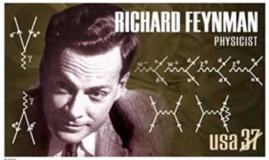
Field 4: Physics
“I think I can safely say that nobody understands Quantum Mechanics”
The only difference between a probabilistic classical world
and (the quantum one) is that… the probabilities would have
to go negative.

Slide 19
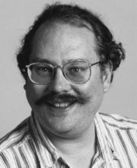
Usual vs “Negative” probabilities
Do quantum operation on each.
Randomly flip each one.
System is in “probabilistic
superposition”; each of 2^{n}
configurations has associated
nonnegative probability.
o
o
o
o
quantum
N classical bits
amplitude that could be -ve
Quantum mechanics can be used to factor
Integers efficiently. [Shor94]
Is quantum mechanics correct??

Slide 20
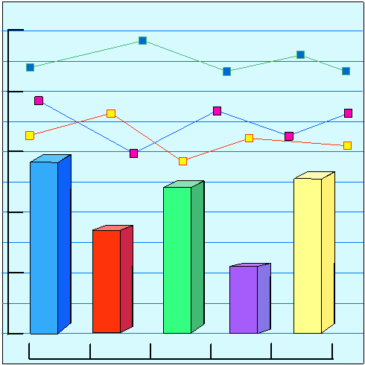
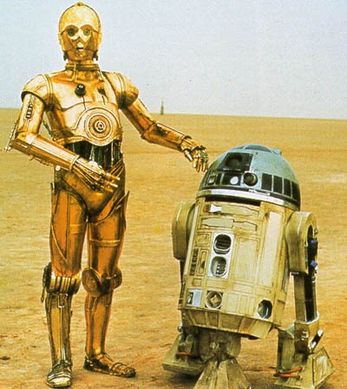
Field 5: Statistics
“development and application of methods to collect, analyze and interpret data.”
Computer science versions:
“machine learning”, “data mining”, etc.
(Aside: is “learning from experience” = “Automatized statistics”??)

Slide 21
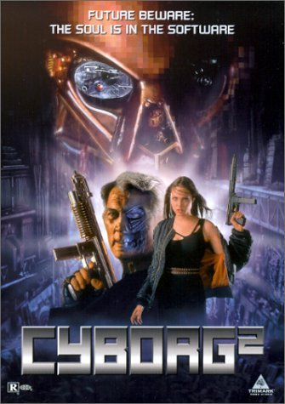
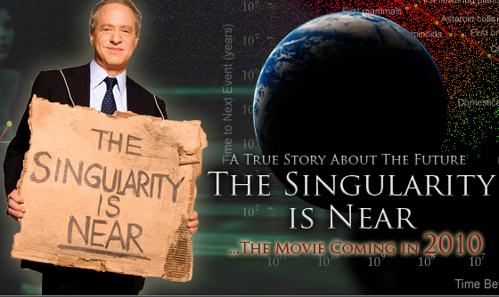
Rest of lecture: Man + machine
“Singularity”: When machine
intelligence overtakes ours.

Slide 22
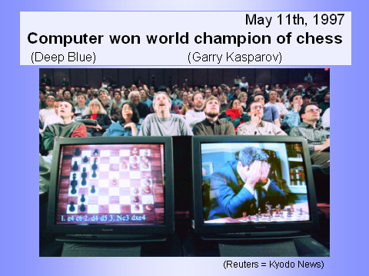
Thoughts about Deep Blue
Tremendous computing power (ability to “look ahead”
several moves)
Programmed by a team containing chess grandmasters.
Had access to huge database of past chess games.
Used machine learning tools on database to hone its
skills.
“Human-machine computing”
Aside: Humans + Cheapo Chess software > Best Chess Software

Slide 23

Another example of human-computer computing…
Olde dream: “central repository of knowledge; all
facts at your finger-tips.
How it happened:
100s of millions of people created “content” for their own
pleasure.
Powerful algorithms were used to extract meaningful info
out of this, and have it instantly available.

Slide 24

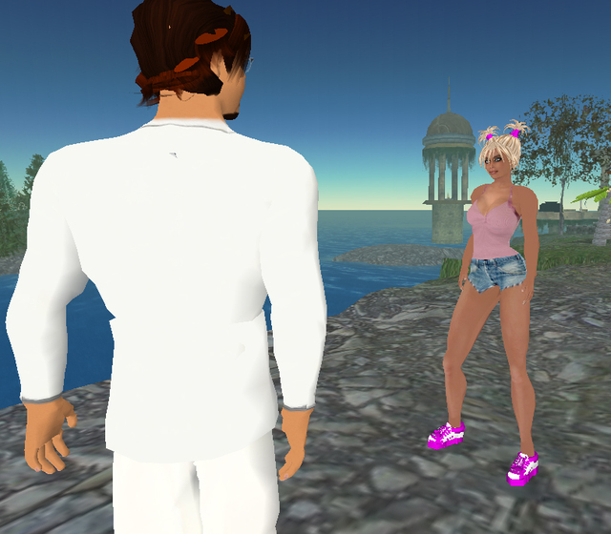
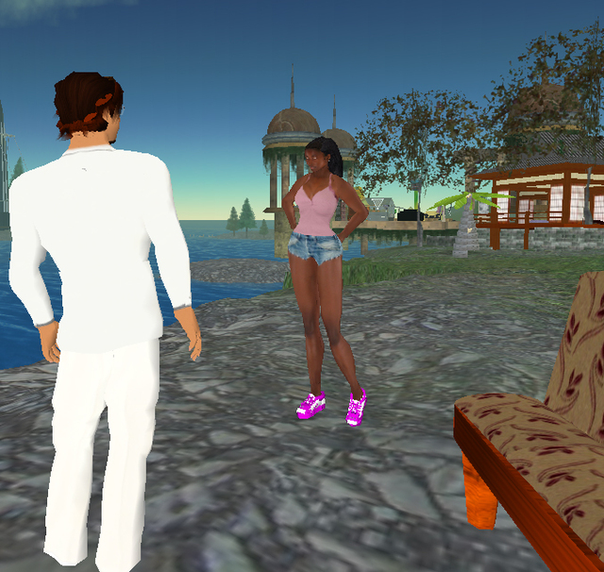
“Second Life”
Online community where everybody acquires
an “avatar.” (Piece of code; point-and-click
programming as in Scribbler.)
Avatar customizable but follows laws of physics in
imaginary world (remember: weather simulation)

Slide 25
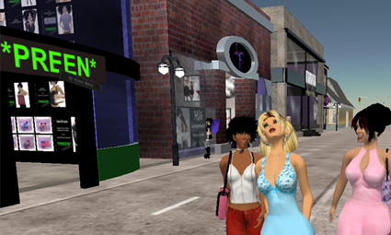

Weird 2nd life facts
Ability to buy/sell.
(“Linden dollars”)
Budding markets in real estate,
avatar skins, clothes, entertainment,
“teaching” avatars new skills, etc.
Emerging political systems
Interface with real world (eg Swedish embassy!)
An interesting viewpoint: Second-Lifers are teaching
the computer what “human life” is.
(Analogies: Chess database and Deep Blue,
WWW and Google.)

Slide 26
The most interesting question in the computational universe in the foreseeable future
Not:
“Will computers ever be conscious?”
But:
Where will all this take us?
(and our science, society, politics,…)

Slide 27
Administrivia
One final blogging assignment (due May 6): Write 2-3
paragraphs about AI, your expectations about it before
you took this course, how they were shaped by this
course, and the Searle article.
Review sessions, probably afternoon of May 6.
Final Exam Fri May 13, 7:30pm

Slide 28
Want to join COS major? Take a programming class
in the summer and skip COS126.
Good luck with the final and have a great summer! Enjoy your time in the computational universe!

