Slide 1
What computers talk about and how.
(Networking & the Internet.)
COS 116, Spring 2012
Adam Finkelstein

Slide 2
Brief history
Local area networks & university networks
Military communication networks
  ARPANET ['68] (a.k.a. DARPANET), etc.
Early 1980s: US government decides on new way to connect various networks: the “Internet”
1989: World Wide Web; html, browsers
1998: Internet naming system handed over to
private non-profit corporation ICANN.

Slide 3

Modern Internet
Rest of Internet
Collection of computers (including devices, servers, etc.) connected by wires, optical cables, wireless, etc.
To join, need:
  Device capable of “speaking the right protocol” (TCP/IP)
  IP “address” given by an Internet provider
  Connection to provider's servers (via modem, DSL, wireless, etc.)
Your PC
IP Address: 128.156.16.201

Slide 4
Today: A Peek Underneath the 'Net
Why?
Dominant technological artifact of
second half of 20th century
Interesting example of design of a
large, heterogeneous system
(decentralized, yet fairly robust).

Slide 5
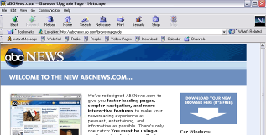
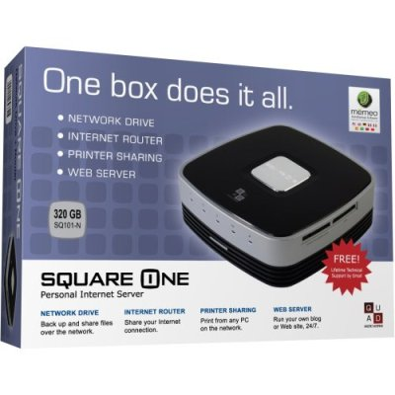
Caveat: Internet ≠ W W W
WWW: hyperlinked content (webpages) stored on servers; requested and served using http protocol
Built on top of the internet
Internet: network connecting computers, devices, etc.
Internet

Slide 6
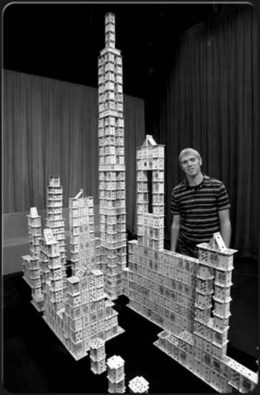
Theme 1:
Building reliability on top of unreliable protocols

Slide 7
The (shaky) foundation of the Internet: TCP/IP Protocol
All transmissions broken up into packets
A Packet:
Destination address
Book-keeping info
Data
32 bits
Often about 1500 bytes
(but can vary)

Slide 8

Hopping along
Internet is actually a bunch of connected computers called routers
Packets hop from router to router until they reach destination
Internet
See, for example: http://network-tools.com

Slide 9
“Best effort transmission”
Internet
Packet not guaranteed to arrive quickly (or ever!)
If many packets sent, may arrive out of order
Sender
Receiver

Slide 10
Discussion
Is there some unreliable communications device you use everyday?
How do you cope with the cellphone's unreliability?

Slide 11
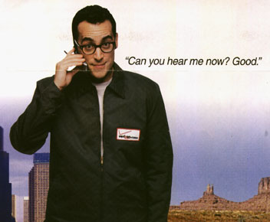
Some mechanisms
Retransmission (“Could you say that again?”)
Timeout (“Let me hang up and try redialing?”)
Acknowledgements (“Finally understood you. Go on.”)
(In TCP/IP: if sequence of packets, number them and sort at
receiver end.)

Slide 12
Theme 2:
Decentralized control

Slide 13





Political and Military Setup in Medieval Europe (?)
King
What is a suitable postal system for this “army”?
Duke
Count
Duke
Count
Knight
Knight
Peasants

Slide 14
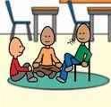
Discussion
Time
How should a peasant in one town
send mail to a peasant in another town?
What happens if a knight leaves the army?

Slide 15



First example of decentralization: Physical network
12 major providers
Many local providers
USLEC
Princeton
Schools
McCarter
Princeton homes &
businesses

Slide 16

The Second Decentralization: Domain Name System
.com
.in
.edu
.uk
.net
.princeton.edu
.cs.princeton.edu
.econ.princeton.edu

Slide 17
What happens when you type URL?
Address translated by asking appropriate DNS server up/down the DNS hierarchy
  www.nytimes.com → query to .com server →199.239.136.200
Physical routing of packets up/down the physical network hierarchy based upon address
Other stuff

Slide 18

Theme 3.
Dependence upon the kindness of strangers

Slide 19
Congestion
Router 2
Router 1
Queue full → packets are dropped
Queue

Slide 20
How does a good netizen respond to congestion?
Packets getting dropped?
→ Halve the transmission rate
All packets getting through?
→ Increase transmission rate a little.
Done in all TCP/IP software
But, no enforcement mechanism!
(Allows “cheating”, as well as VoIP Telephony, Streaming media, etc.)

Slide 21
What's in the future?
128-bit instead of 32-bit addresses.
  Can send email to your toaster.
  (Especially if it lives in Asia)
Mechanisms for pricing, security,
quality of service, etc.
  NSF's GENI initiative

