Slide 1
Artificial intelligence
COS 116, Spring 2012
Adam Finkelstein

Slide 2
Artificial Intelligence
Definition of AI (Merriam-Webster):
  The capability of a machine to imitate intelligent human behavior
  Branch of computer science dealing with the simulation of intelligent behavior in computers
Learning:
  To gain knowledge or understanding of or skill
  in by study, instruction, or experience
  Machine learning (last lecture) - branch of AI

Slide 3
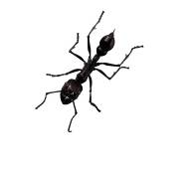

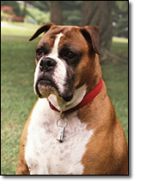
Intelligence in animal world
Is an ant intelligent?
Build huge, well-structured colonies
organized using chemical-based
messaging (“Super-organism”)
What about dogs?

Slide 4
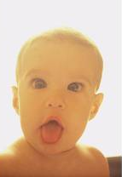
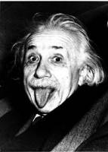
Deep mystery: How do higher animals (including humans) learn?
How does
become

Slide 5

A crude first explanation: Behaviorism [Pavlov 1890's, Skinner 1930's]
Animals and humans can be understood in a “black box” way as a sum total of all direct conditioning events
Bell → “Food is coming” →Salivate
“This person likes me more if I call her “Mama”
and that one likes me more if I call him “Papa”.

Slide 6
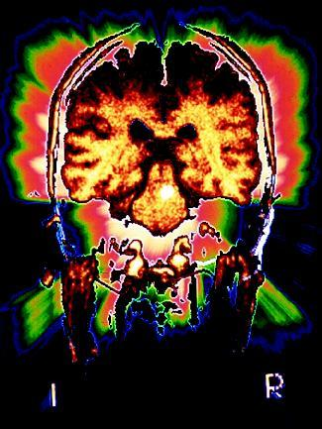
More thoughts on behaviorism
Original motivation: Cannot look inside
the working brain, so theory that
assumes anything about its working
is not scientific or testable.
Today
Little insight into how to design machines with intelligence.
How did dogs, rats, humans sort through sensory
experiences to understand reward/punishment?

Slide 7
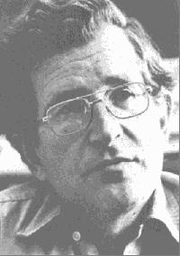
Chomsky's influential critique of Behaviorism [1957]
“Internal mental structures crucial
for learning.”
  Evidence: universal linguistic rules (“Chomsky grammars”); “self-correction” in language learning, ability to appreciate puns.
Brain is “prewired” for language.
Must understand mental structures to understand behavior

Slide 8
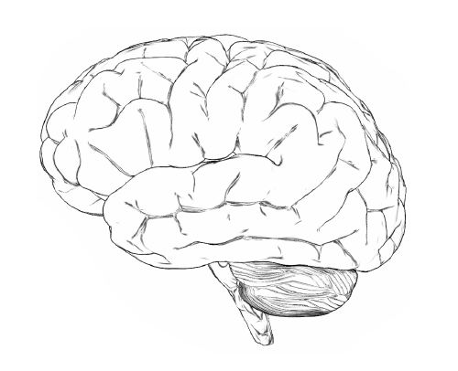
Presenting:
Your brain

Slide 9
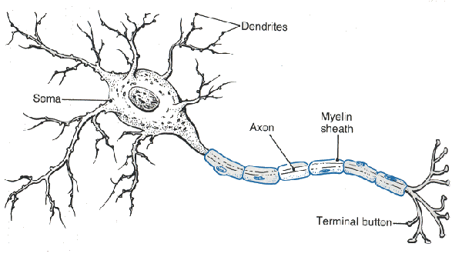
The brain
Network of 100 billion neurons
Evidence of timing mechanisms (“clock”)
About 100 firings per second
  Total of 10¹³ firings (“operations”) per second
  Number of operations per sec in fast desktop PC: 10¹⁰
  Kurzweil predicts PC will match brain computationally by 2020

Slide 10

A comparison
Your brain
10¹¹ neurons
Your life on a DVD
  4.3 Gb for 3 hours
  > 10¹⁷ bytes for entire life
Conclusion: Brain must contain structures that compress information and store it in an interconnected way for quick associations and retrieval

Slide 11
A simplistic model of neurons—
Neural Net [McCulloch – Pitts 1943]
Neuron computes “thresholds”
Take the sum of strengths of all neighbors that are firing
If sum of inputs > T, fire output
Output
T: “threshold value”
s₁
Inputs
s₂
s_{i}: “strength” assigned to input i
s_{k}

Slide 12

Why AI is feasible in principle: the simulation argument
Write a simulation program that simulates all 10¹¹ neurons in the brain and their firings.
For good measure, also simulates underlying chemistry, blood flow, etc.
In principle doable on today's compute clusters
Practical difficulty: How to figure out properties (threshold value, s_{i}) of each of 10¹⁰ neurons,
the intricate wiring and chemistry

Slide 13
Hope
Maybe the brain is organized
around simpler principles.

Slide 14
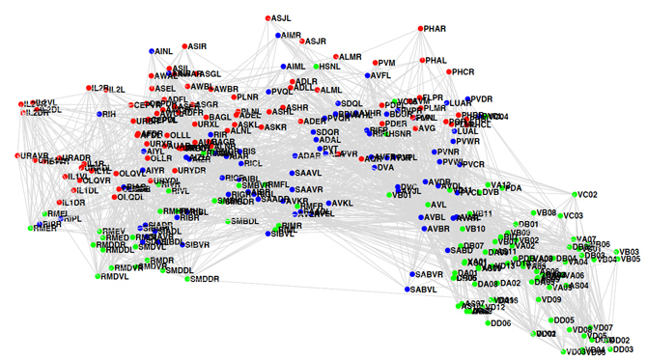
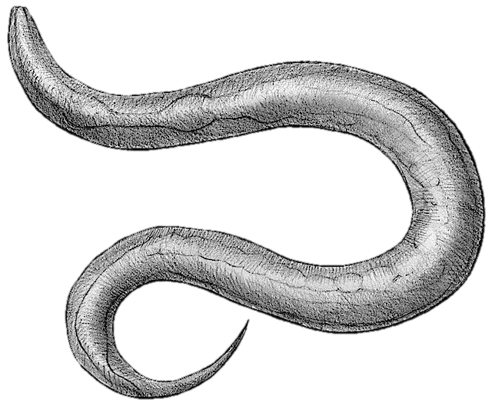
C. Elegans connectome

Slide 15
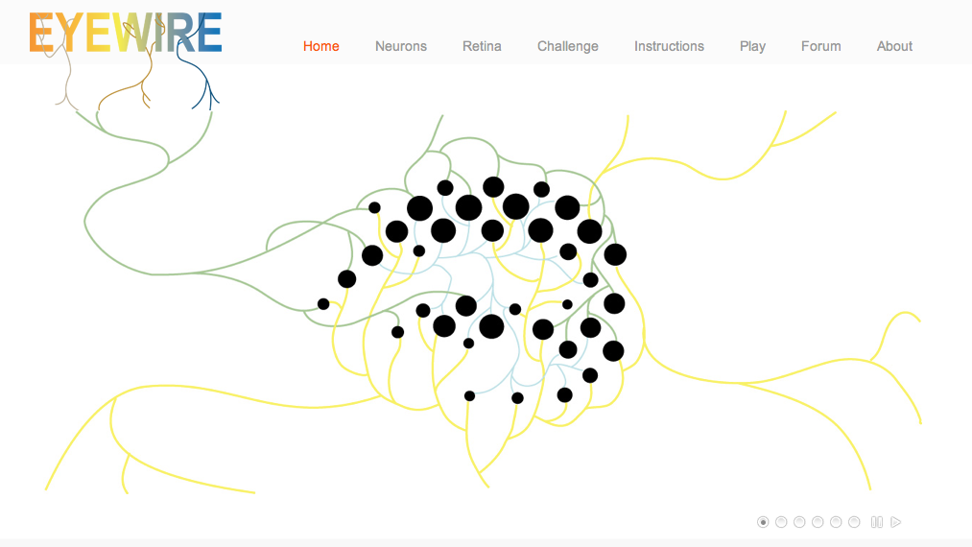
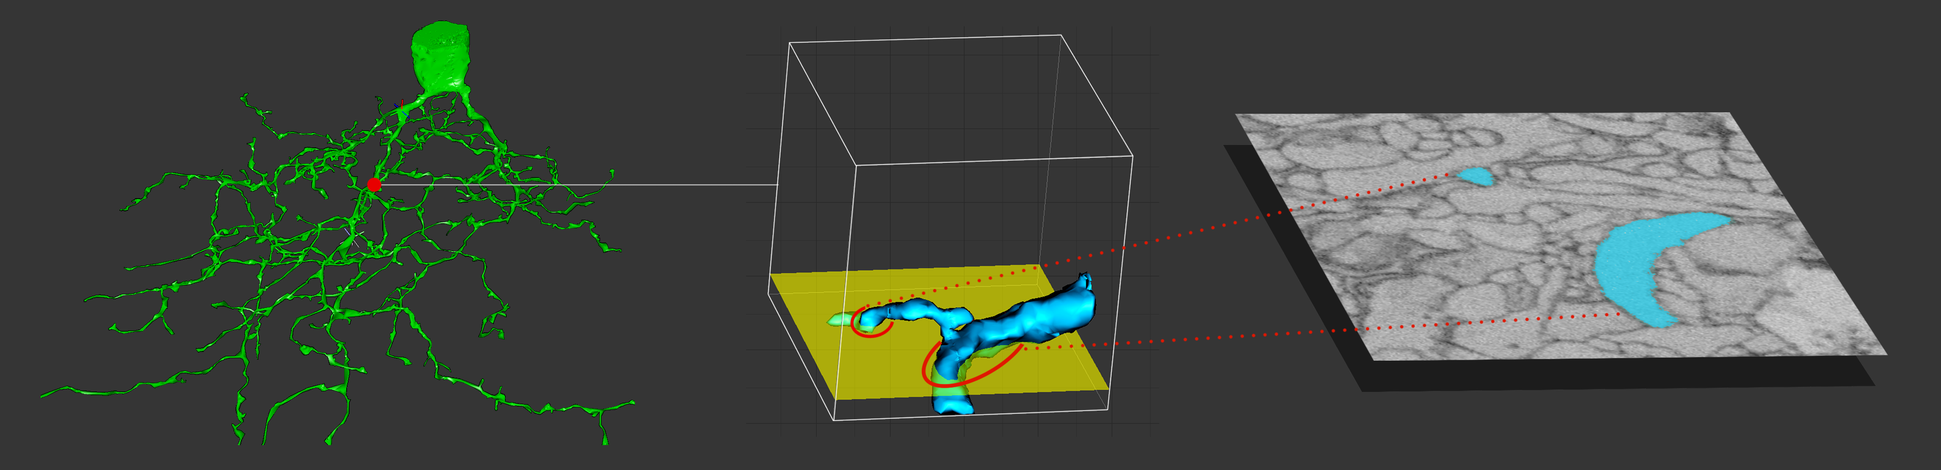
[Sebastian Seung]

Slide 16
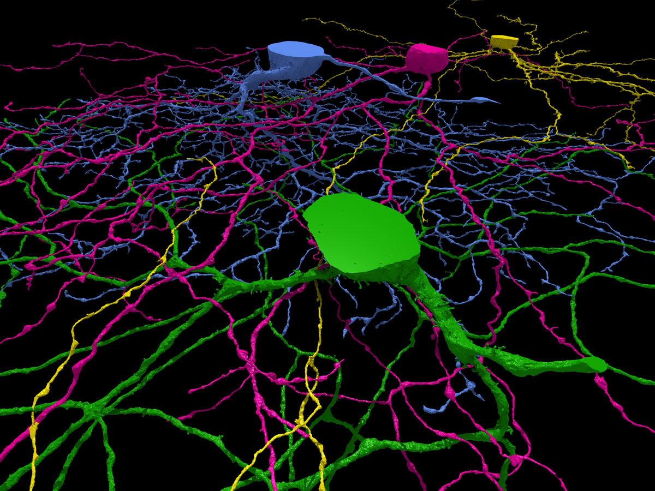

Slide 17
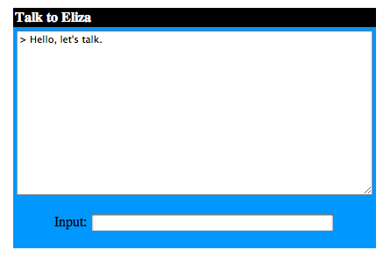
Eliza, the Computer Therapist
http://cyberpsych.org/eliza

Slide 18
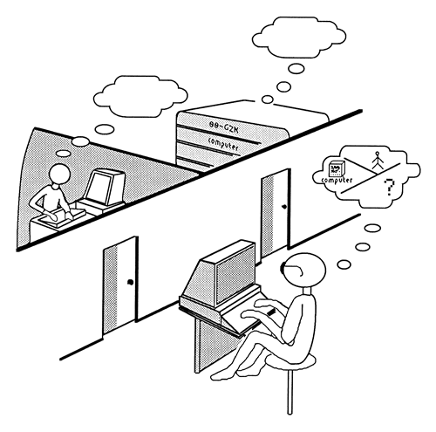
Turing test (Turing 1950; see turinghub.com)
You are allowed to chat with a machine or a human
(don't know which)
You have to guess at the
end if you were talking to a machine or human.
(Machine wins if you have
only 50-50 success rate.)
Note: Impossible for machine to store answers to all possible 5-minute conversations!

Slide 19
What are strengths and weaknesses of the Turing test?
(Feel free to contrast with other tests, e.g.
Stanford-Binet IQ, SAT)
Strengths
Weaknesses
Not reducible to formula
No obvious way to cheat
Customizable to different
topics
Behavioral/ black box.
Too subjective
Too human-centric
Too behaviorist.
Tests only one kind
of intelligence.

Slide 20






Text Captchas
EZ-Gimpy [2001]
Google [present]
Beaten by Mori & Mailk [2002]
Beaten by hackers? [NYT 2008]

Slide 21
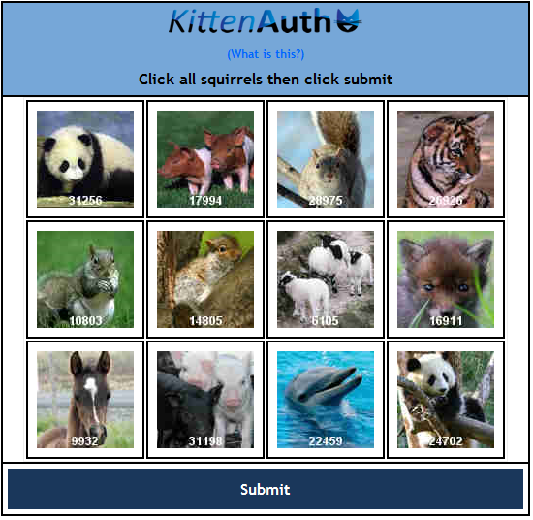
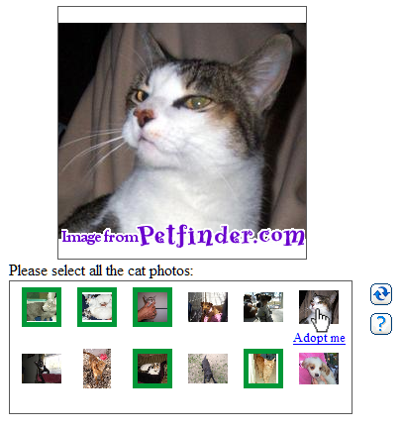
Image Captchas
KittenAuth [2006] | Asirra [2007]

Slide 22
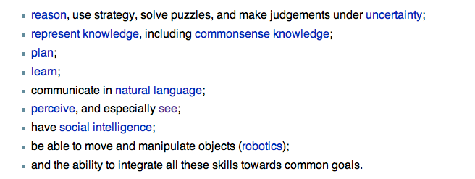
Strong AI (Searle)
A machine able to:
Other potentially relevant traits (unclear if necessary or even
definable): consciousness, wisdom, self-awareness,…

