Slide 1
Self-improvement for dummies
(Machine Learning)
COS 116, Spring 2012
Adam Finkelstein

Slide 2
Artificial Intelligence
Definition of AI (Merriam-Webster):
  The capability of a machine to imitate intelligent human behavior
  Branch of computer science dealing with the simulation of intelligent behavior in computers
Definition of Learning:
  To gain knowledge or understanding of or skill in by study, instruction, or experience
Later:
Today:

Slide 3
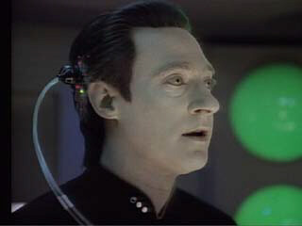
Today's lecture: Machine Learning
Machine learning =
“Programming by example”
Show the computer what to do,
without explaining how to do it.
The computer programs itself!
In fact, continuous improvement
via more data/experience.

Slide 4
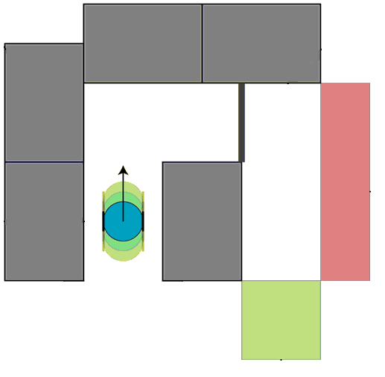
Recall your final Scribbler lab
Task: Program Scribbler to navigate a maze.
  Avoid walls, avoid “lava”,
  head towards the goal.
As maze becomes more complex,
programming becomes much harder. (Why?)

Slide 5
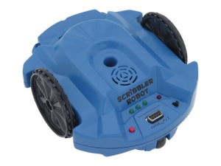
Program Teach Scribbler to navigate a maze
Program Scribbler to navigate a maze
Start with a simple program:
Run the maze.
Label this trial GOOD or BAD, depending on whether goal was reached.
Submit this trial to a “learning algorithm”, which uses it to devise a better program.
Repeat as needed.
Is this how you learned to drive a car?

Slide 6



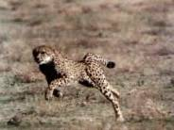
Note: imitating nature may not be best
Examples:
Airplanes
Birds
vs
Cheetahs
Race cars
vs

Slide 7
Machine's “experience” of the world
n sensors, each produces a number:
“experience” = an array of n numbers
Example: video camera: 480 x 640 pixels
n = 480 × 640 = 307200
In practice, reduce n via some processing

Slide 8
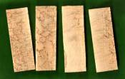
Example: Representing wood samples
Brownness scale 1 … 10
Texture scale 1 … 10
(3, 7) = wood that is fairly light brown but kind of on the rough side
light
dark
smooth
rough

Slide 9
A learning task and its mathematical formulation
Given: 100 samples of oak, maple
Figure out labeling
(“clustering”)
Given a new sample,
classify it as oak, maple…
maple
“Clustering”
oak
texture
New point
color

Slide 10
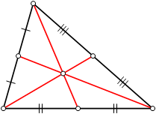
3-Means Algorithm
Start with two familiar notions:
  Mean of k points (x₁, y₁), (x₂, y₂), ... , (x_{k}, y_{k})
  is
  (a.k.a. “center of gravity” or “average”)
  Distance between points (x₁, y₁), (x₂, y₂) is
  ( (x₁ – x₂)² + (y₁ – y₂)² )^{½}

Slide 11
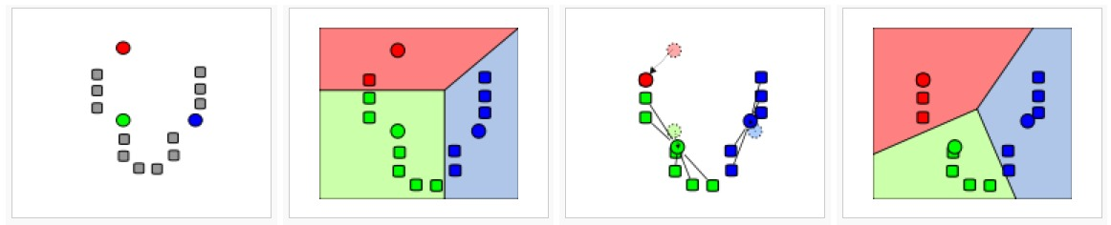
3-Means Algorithm (cont.)
Start by randomly picking 3 data points as your “means”
Repeat many times:
{
  Assign each point to the cluster whose mean is closest to it
  Compute means of the clusters
}
http://en.wikipedia.org/wiki/K-means_clustering

Slide 12
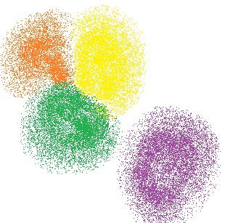
k-Means Algorithm
Can use any number “k”
(instead of 3)
http://www.aishack.in/2010/07/k-means-clustering/

Slide 13

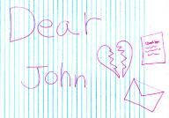
How about more complex concepts?
Speech?
Motion?
Handwriting?
Use similar data
representations,
more “dimensions”

Slide 14
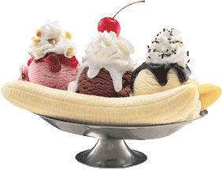
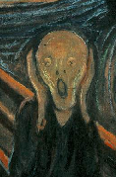
One major idea: modeling uncertainty using probabilities
Example: Did I just hear
“Ice cream” or “I scream”?
Assign probability ½ to each
Listen for subsequent phoneme
  _?_ “is”: use knowledge of usage patterns…
  Increase probability of “Ice cream” to 0.9

Slide 15
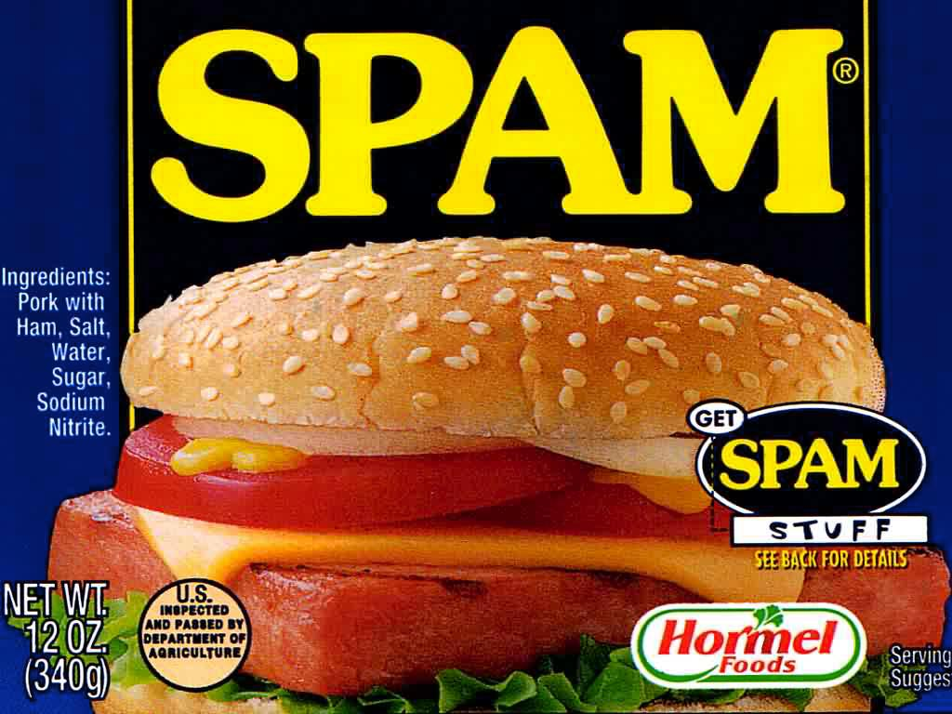

Slide 16
Spam filtering
How would you define Spam to a computer?
Descriptive approach:
  “Any email in ALL CAPS, unless it's from my kid brother, or that contains the word 'mortgage', unless it's from my real estate agent, …”
  Difficult to come up with an good description!
Learning approach:
  “Train” the computer with labeled examples of spam and non-spam (a.k.a. ham) email.
  Easy to find examples of spam – you probably get hundreds a day!

Slide 17
Spam Filtering
Given: A spam corpus and ham corpus.
Goal: Determine whether a new email is spam or ham.
Step 1: Assign a “spam score” to each word:
  F_{spam}(word) = Fraction of emails in spam corpus that contain word.
  F_{ham}(word) = Fraction of emails in ham corpus that contain word.
  Observe:
    SpamScore(word) > 1 if word is more prevalent in spam.
    SpamScore(word) < 1 if word is more prevalent in ham.

Slide 18
Spam Filtering
Step 2: Assign a “spam score” to the email:
  SpamScore(email) = SpamScore(word₁) x … x SpamScore(word_{n}),
where word_{i} is the i^{th} word in email.
  Observe:
    SpamScore(email) >> 1 if email contains many spammy words.
    SpamScore(email) << 1 if email contains many hammy words.
Step 3: Declare email to be spam if SpamScore(email) is high

Slide 19
Spam Filtering
Advantages of this type of spam filter:
  Though simple, catches 90+% of spam!
  No explicit definition of spam required.
  Customized for your email.
  Adaptive – as spam changes, so does filter

Slide 20
Text synthesis (simplistic version)
Idea: Use example text to generate similar text.
  Input: 2007 State of the Union Address.
  Output: “This war is more competitive by strengthening math and science skills. The lives of our nation was attacked, I ask you to make the same standards, and a prompt up-or-down vote on the work we've done and reduce gasoline usage in the NBA.”

Slide 21
Text synthesis
How it works: Output one word at a time.
  Let (v, w) be the last two words outputted.
  Find all occurrences of (v, w) in the input text.
  Of the words following the occurrences of (v, w),
  output one at random.
  Repeat.
Variants: Last k words instead of last 2 words.

Slide 22
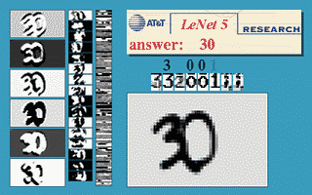
Handwriting recognition
[LeCun et al, AT&T, 1998]
The LeNet-5 system
  Trained on a database:
  60,000 handwritten digits
  Reads ~10% of all checks cashed in the US

Slide 23
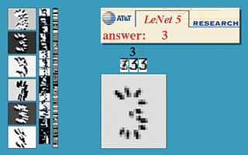
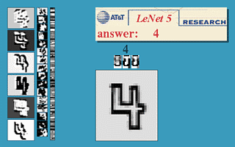
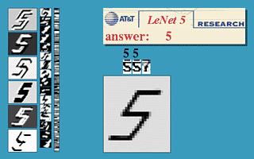
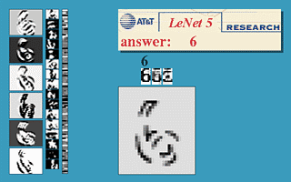
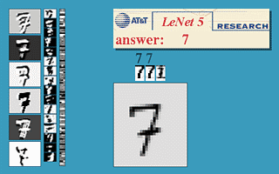
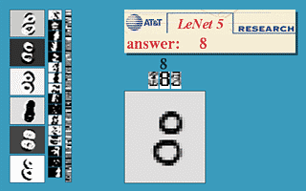
Handwriting recognition: LeNet-5
Can recognize weird styles:

Slide 24
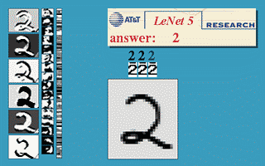
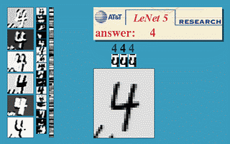
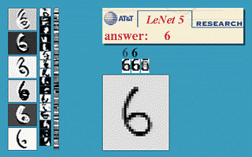
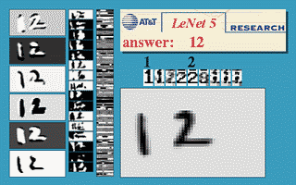
Handwriting recognition: LeNet-5
Can handle stray marks and deformations:
Mistakes are usually ambiguous anyway:

Slide 25
Aside: How to get large amounts of data? (major problem in ML)
Answer 1: Use existing corpuses (lexis-nexis, WWW for text)
Answer 2: Create new corpuses by enlisting people
in fun activities. (Recall Image-Labeling Game in Lab 1)

Slide 26

Example: SAT Analogies
Bird : Feathers :: Fish : ____
Idea: Search web to learn relationships between words. [Turney 2004]
  Example: Is the answer above “water” or “scales”?
    Most common phrases on the web:
    “bird has feathers”, “bird in air”, “fish has scales”, “fish in water”.
    Conclusion:
    Right answer is “scales”.

Slide 27
SAT Analogies [Turney 2004]
On a set of 374 multiple-choice SAT analogies, this approach got 56% correct.
High-school seniors on the same set:
  57% (!)
Mark of “Scholastic Aptitude”?

Slide 28
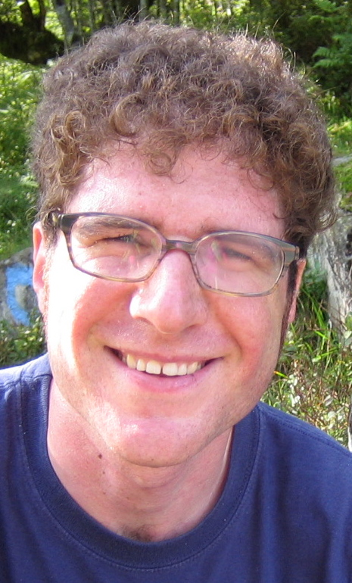
Image labeling [Blei et al, 2003]
Princeton prof!
Another solution:
Learn captions from examples.
  System trained on a Corel database
    6,000 images with captions.
  Applied to images without captions.

Slide 29
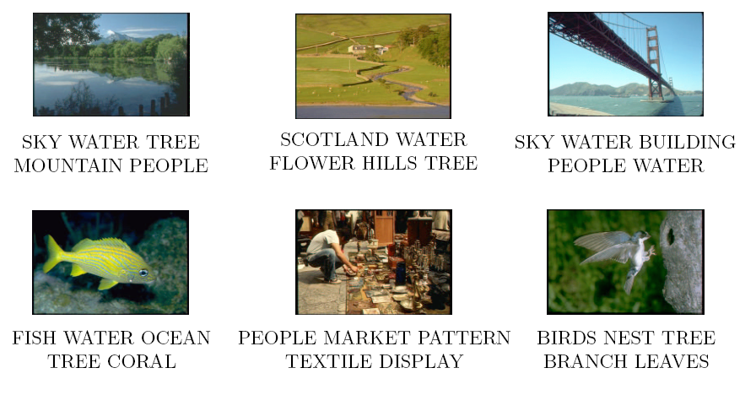

Slide 30
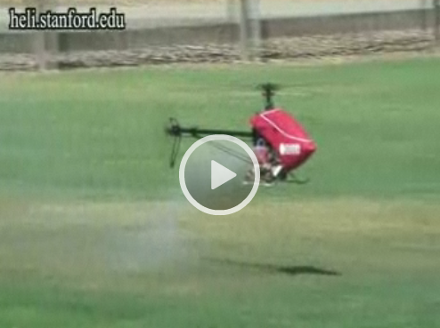
Helicopter flight [Abbeel et al 2005]
Algorithm learns to pilot a helicopter by observing a human pilot.
Results even better than the human pilot.
http://videolectures.net/ijcai09_coates_sah

