Slide 1
Rumination on illumination (computer graphics)
COS 116, Spring 2012
Adam Finkelstein

Slide 2
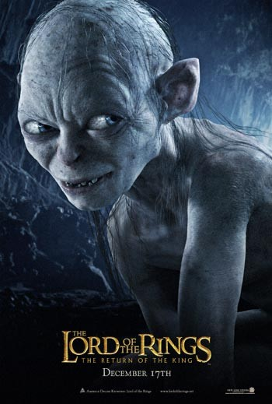
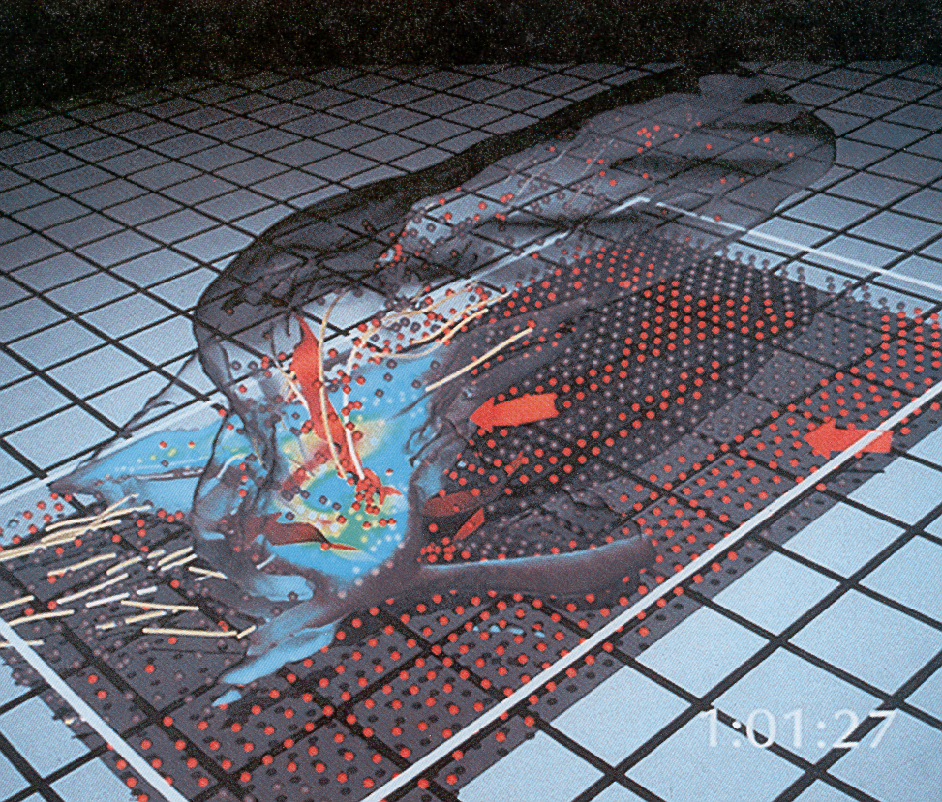
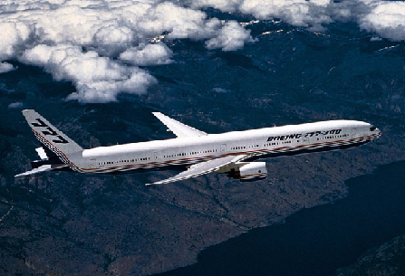
Applications
Entertainment
Computer-aided design
Scientific visualization
Training
Education
E-commerce
Computer art
Inside a Thunderstorm
(Bob Wilhelmson, UIUC)
Boeing 777 Airplane

Slide 3
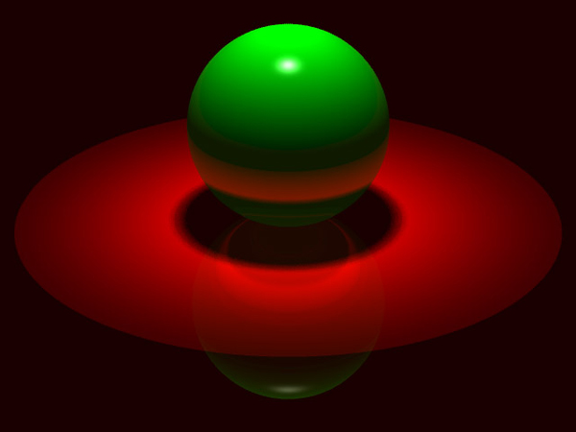
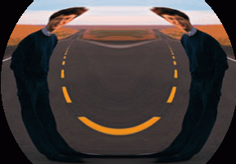
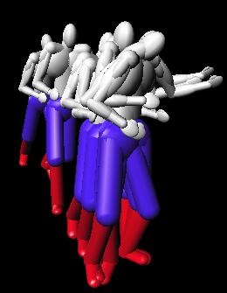
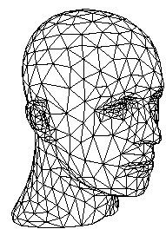
Overview
I. Images
II. Modeling
III. Rendering
IV. Animation
Rendering
(Michael Bostock, CS426, Fall99)
Image Processing
(Rusty Coleman, CS426, Fall99)
Modeling
(Dennis Zorin, CalTech)
Animation
(Jon Beyer,
CS426, Spring04)

Slide 4
Part 1: Images
Q: What is an image?

Slide 5
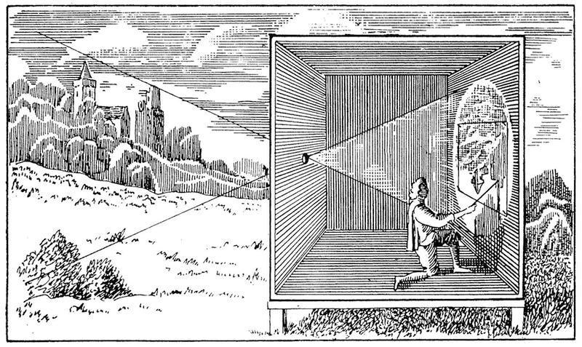
Brief history of image capture
Camera obscura
Known to Chinese 5thC. BC
19th century: Camera
Hole ➔ Lens
Paper ➔ Light sensitive
Late 20th century: Digital camera
Light-senstive paper ➔ CCD/electronics

Slide 6
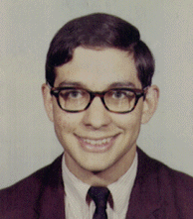

Digital images
Rectangular (2D) array of pixels
Continuous image
Digital image

Slide 7
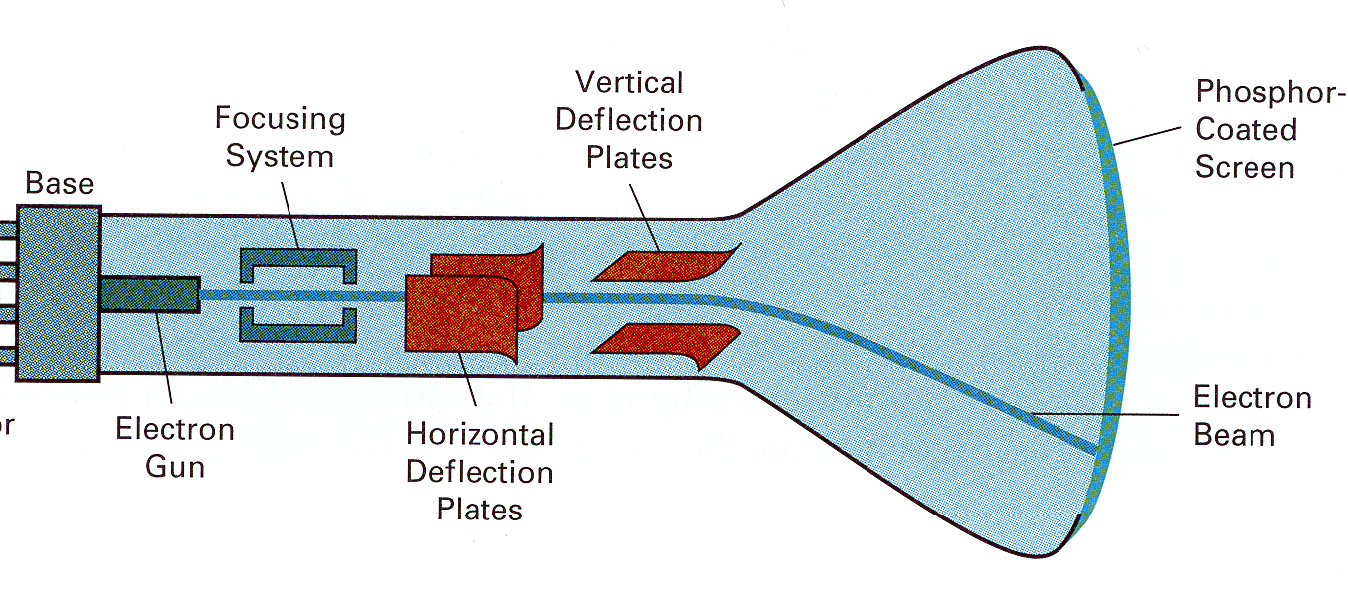
Image Display
Re-create continuous function from samples
  Example: cathode ray tube (CRT)
Image is reconstructed
by displaying pixels
with finite area of color

Slide 8
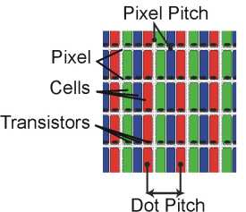
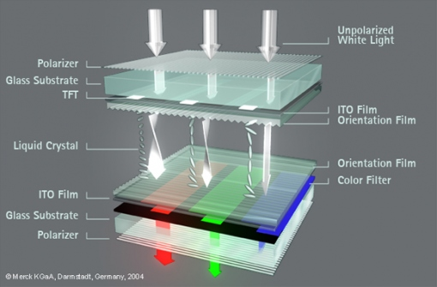
LCD Screen

Slide 9
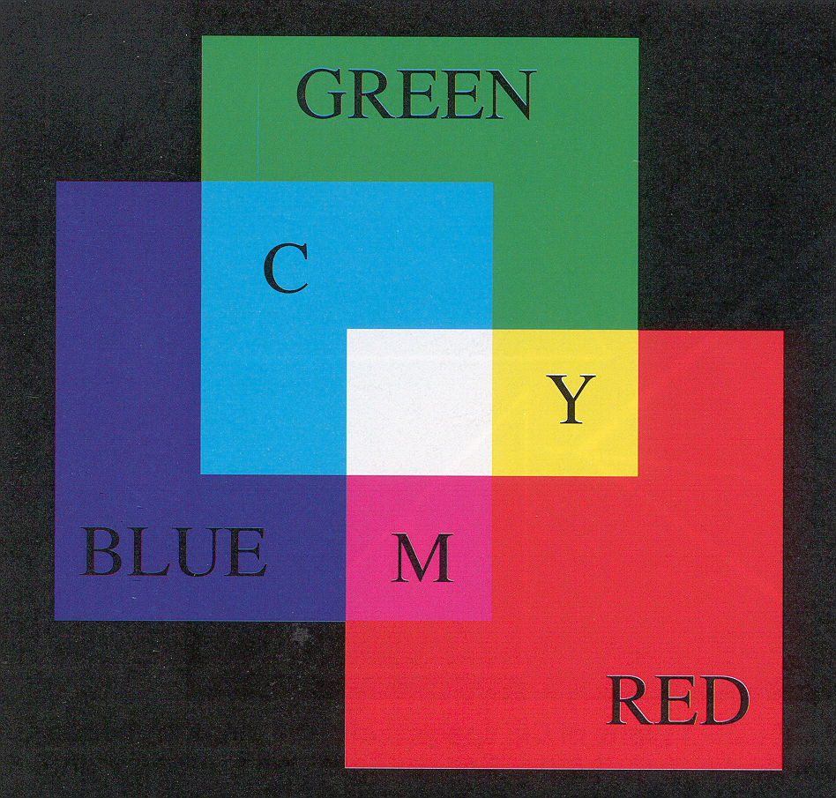
RGB Color Model
R G B Color
0.0 0.0 0.0 Black
1.0 0.0 0.0 Red
0.0 1.0 0.0 Green
0.0 0.0 1.0 Blue
1.0 1.0 0.0 Yellow
1.0 0.0 1.0 Magenta
0.0 1.0 1.0 Cyan
1.0 1.0 1.0 White
0.5 0.0 0.0 ?
1.0 0.5 0.5 ?
1.0 0.5 0.0 ?
0.5 0.3 0.1 ?
Colors are additive
Plate II.3 from FvDFH

Slide 10
What is an Image?
Rectangular (2D) array of pixels
Continuous image
Digital image

Slide 11
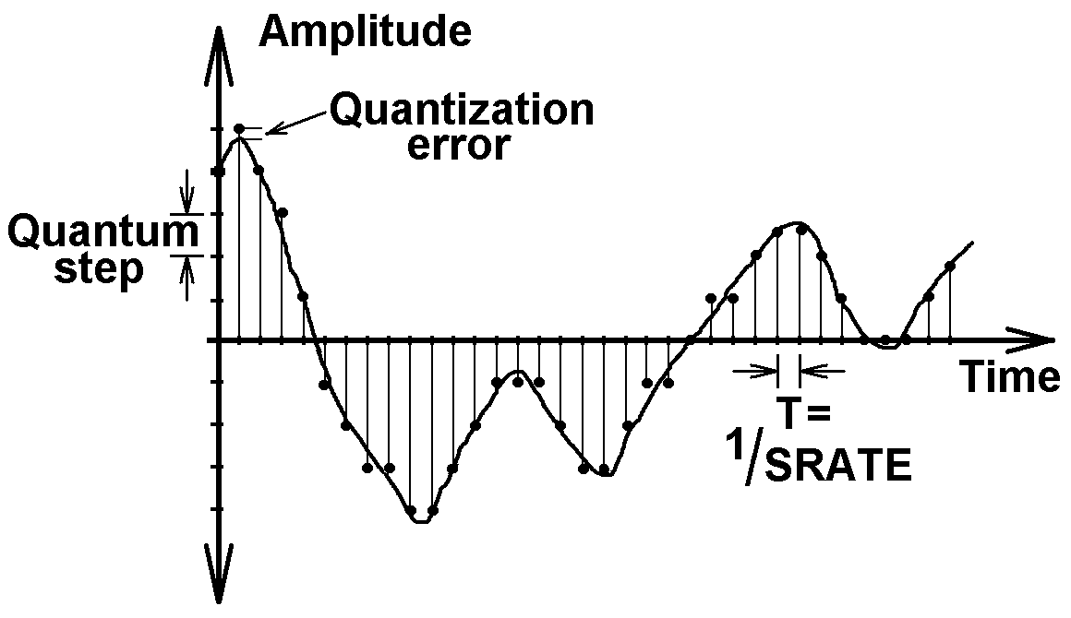
What is an Image?
(digital audio)
Rectangular (2D) array of pixels
A pixel is a sample, not a little square!
Continuous image
Digital image

Slide 12
Sampling and Reconstruction
Sampling
(e.g. digital camera)
Reconstruction
(e.g. CRT)

Slide 13
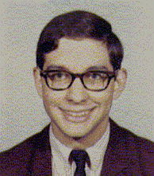
Adjusting Brightness
Simply scale pixel components
  Must clamp to range (e.g., 0 to 1)
Original
Brighter

Slide 14
Adjusting Contrast
Compute average luminance L for all pixels
  L = 0.30*r + 0.59*g + 0.11*b
Scale deviation from L for each pixel
  Must clamp to range (e.g., 0 to 1)
L
Original
More Contrast

Slide 15
Scaling the image
Resample with
fewer or more pixels
(mathy theory…)
Original
1/4X
resolution
4X
resolution

Slide 16
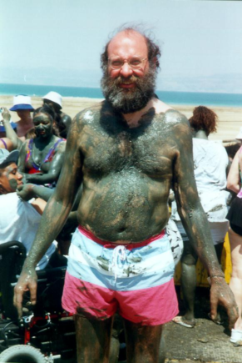
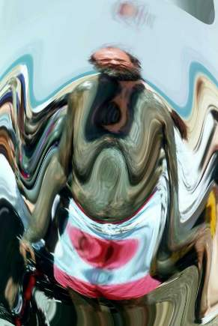
Image Warping
Move pixels of image (resampling)
Warp
Source image
Destination image

Slide 17
Image Morphing
[Beier & Neeley]
Image₀
Warp₀
Result
Image₁
Warp₁

Slide 18
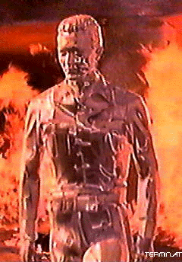
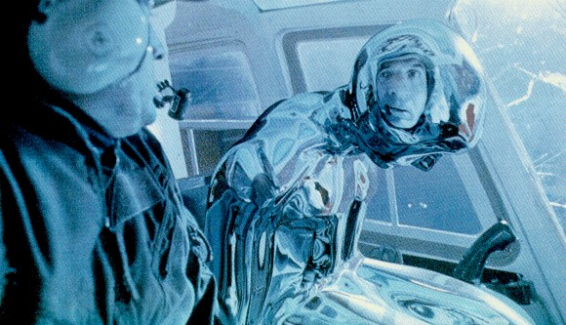
Image Morphing
Another example, T2, uses 3D graphics…

Slide 19
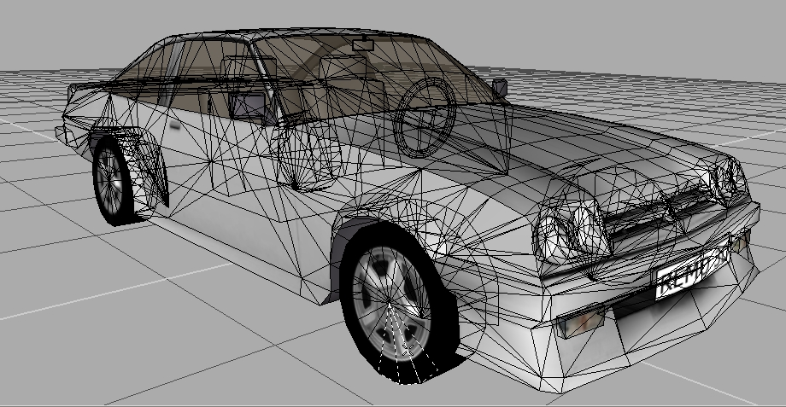
Part II: Modeling
How to construct and represent shapes (in 3D)
(Remo3D)

Slide 20
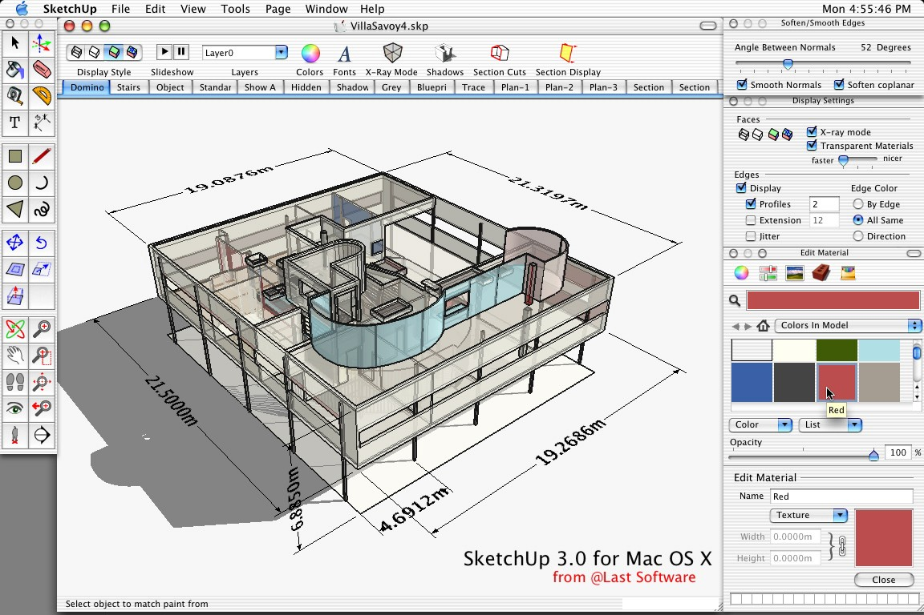
Modeling in SketchUp (demo)

Slide 21
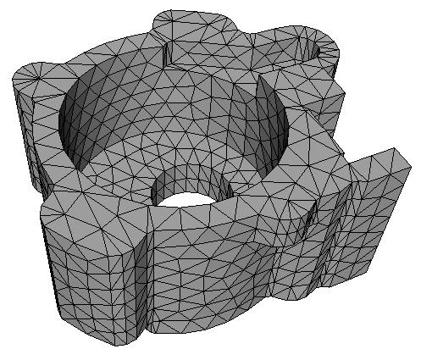
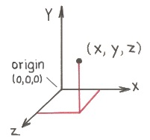
Model representation
Most common: list of triangles
  Three vertices in 3D
  (x₁, y₁, z₁)
  (x₂, y₂, z₂)
  (x₃, y₃, z₃)

Slide 22
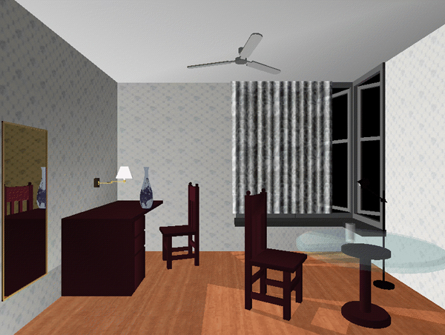
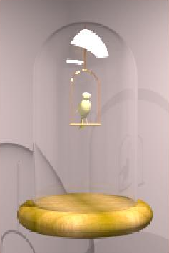
Part III: Rendering
Direct illumination
  One bounce from light to eye
  Implemented in graphics cards
  OpenGL, DirectX, …
Global illumination
  Many bounces
  Ray tracing
Direct Illumination
(Chi Zhang, CS 426, Fall99)
Ray Tracing
(Greg Larson)

Slide 23
Ray Casting
A (slow) method for computing direct illumination
For each sample:
  Construct ray from eye
  through image plane
  Find first surface intersected
  by ray
  Compute color of sample
  based on surface properties
eye

Slide 24
Lighting Simulation
Light
Source
Lighting parameters
  Light source emission
  Surface reflectance
Surface
N
N
eye

Slide 25
Simple Reflectance Model
Simple analytic model:
  diffuse reflection +
  specular reflection +
  ambient lighting
Based on model
proposed by Phong
Surface

Slide 26
Diffuse Reflection
Assume surface reflects equally in all directions
  Examples: chalk, clay
Surface

Slide 27
Specular Reflection
Reflection is strongest near mirror angle
  Examples: mirrors, metals
N
R
θ
θ
L

Slide 28
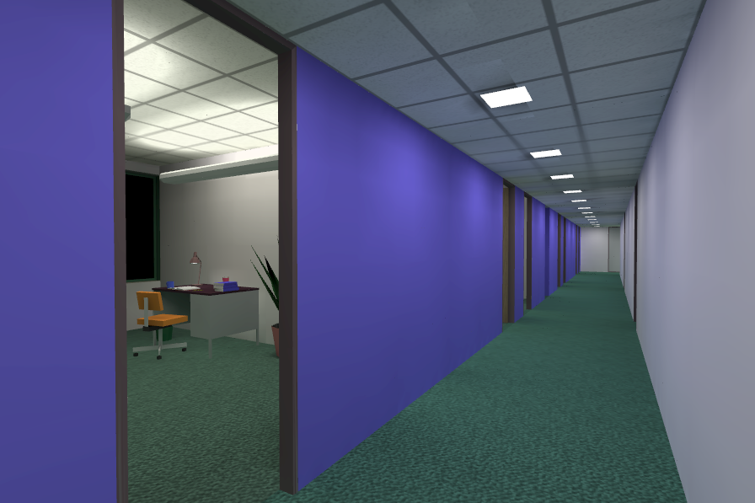
Ambient Lighting
Represents reflection of all indirect illumination
This is a total cheat (avoids complexity of global illumination)!

Slide 29
Combine colors of light & surface
Light color
N
Viewer
L
V
Surface color
(possibly in texture)

Slide 30
Sum For Multiple Lights
N
Viewer
L₁
L₂
V

Slide 31
Lighting Simulation
Light
Source
Direct illumination
  Ray casting
  Other methods
Global illumination
  Ray tracing
  Other methods
N
Surface
N
N
Camera

Slide 32
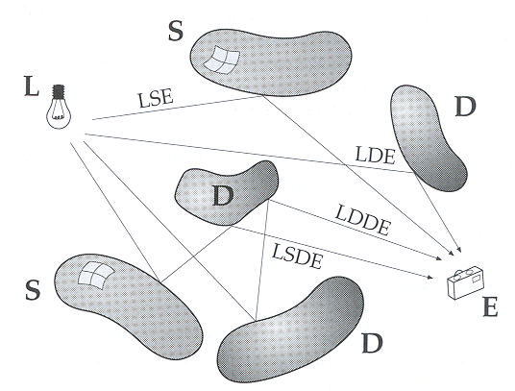
Path Types
L = light
D = diffuse bounce
S = specular bounce
E = eye

Slide 33
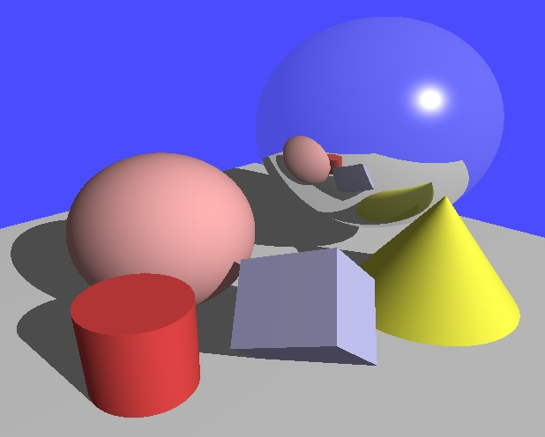
Path Types?
Henrik Wann Jensen

Slide 34
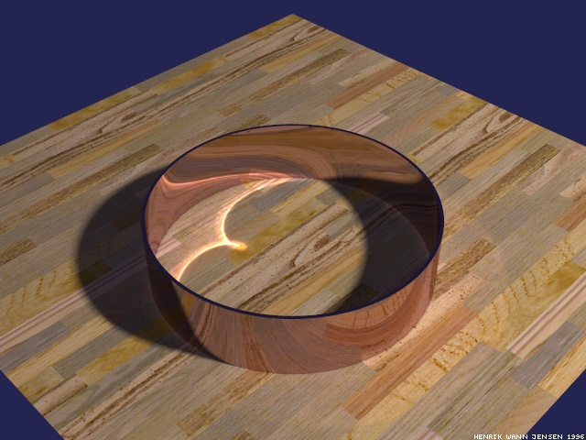
Ray Tracing
(note: texture)
Henrik Wann Jensen

Slide 35
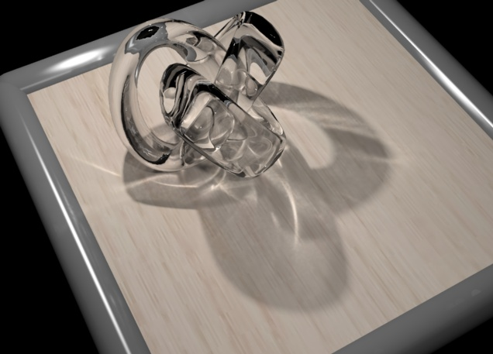
Ray Tracing
RenderPark

Slide 36
Ray Tracing
Terminator 2

Slide 37
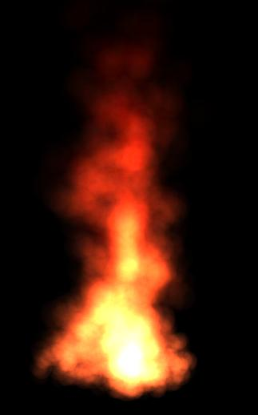
Part IV: Animation
Keyframe animation
  Articulated figures
Simulation
  Particle systems
Animation
(Jon Beyer,
CS426, Spring04)
Simulation

Slide 38
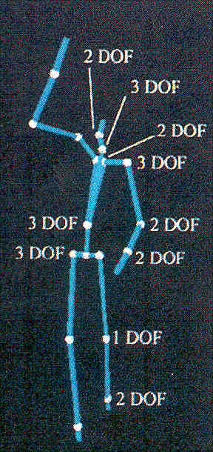
Articulated Figures
Well-suited for humanoid characters
Root
Chest
LHip
RHip
Neck
LCollar
LCollar
LKnee
RKnee
Head
LShld
LShld
LAnkle
RAnkle
LElbow
LElbow
LWrist
LWrist
Rose et al. `96

Slide 39
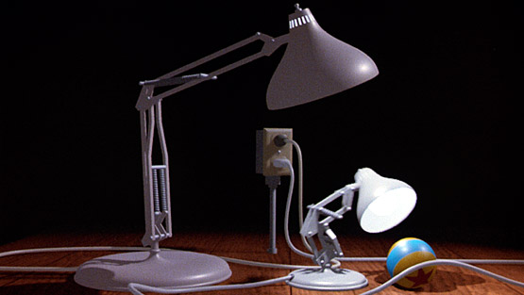
Keyframe Animation: Luxo Jr.
Pixar

Slide 40
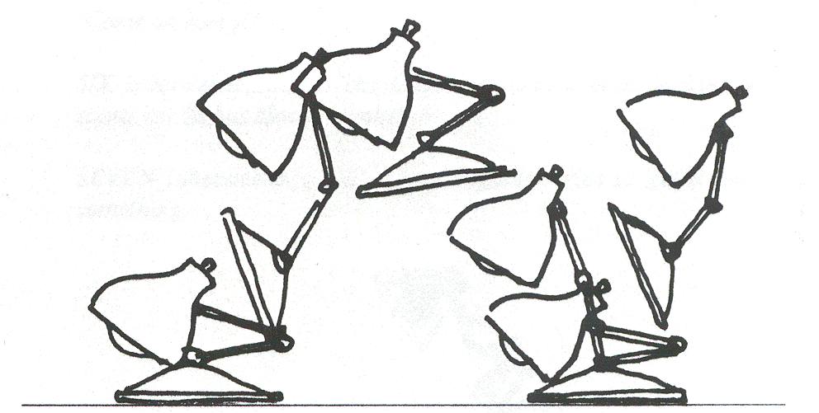
Keyframe Animation
Define character poses at specific times: “keyframes”
“In between” poses found by interpolation
Lasseter `87

Slide 41
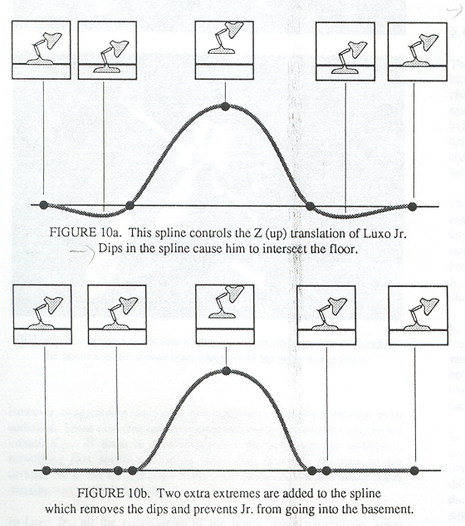
Keyframe Animation
Inbetweening: may not be plausible
Lasseter `87

Slide 42
Keyframe Animation
Solution: add more keyframes
Lasseter `87

Slide 43
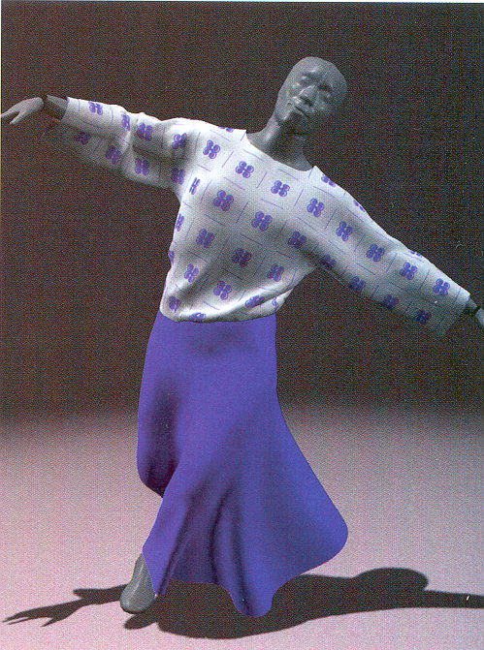
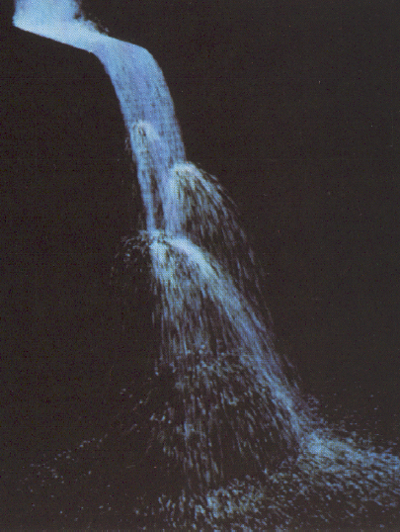
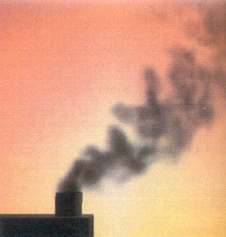
Simulation
Animator cannot specify motion for:
  Smoke, water, cloth, hair, fire
Water
Hot Gases
(Foster & Metaxas `97)
Cloth
(Baraff & Witkin `98)

Slide 44
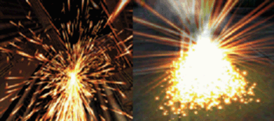
Particle Systems
Recall: “Game of Life”
For each frame (time step):
  Create new particles and assign attributes
  Delete any expired particles
  Update particles based on attributes and physics
  Newton’s Law: f=ma
  Render particles

Slide 45
Particle Systems
A particle is a point mass
  Mass
  Position
  Velocity
  Acceleration
  Color
  Lifetime
Many particles to model complex phenomena
  Keep array of particles
v
p = (x,y,z)

Slide 46
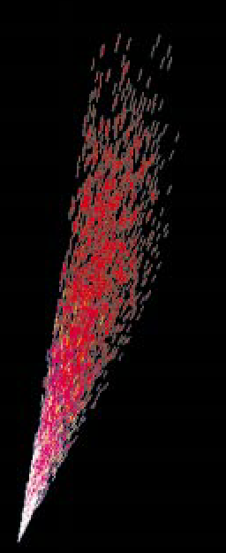
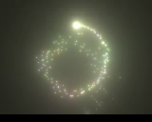
Creating/Deleting Particles
This is where person
controls animation
Where to create particles?
  Around some center
  Along some path
  Surface of shape
  Where particle density is low
When to delete particles?
  Areas of high density
  Life span
  Random

Slide 47
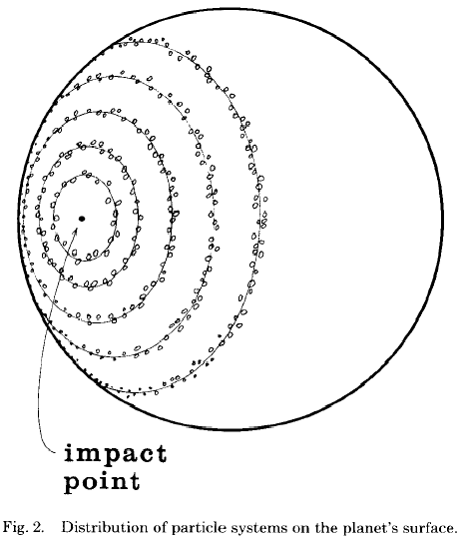
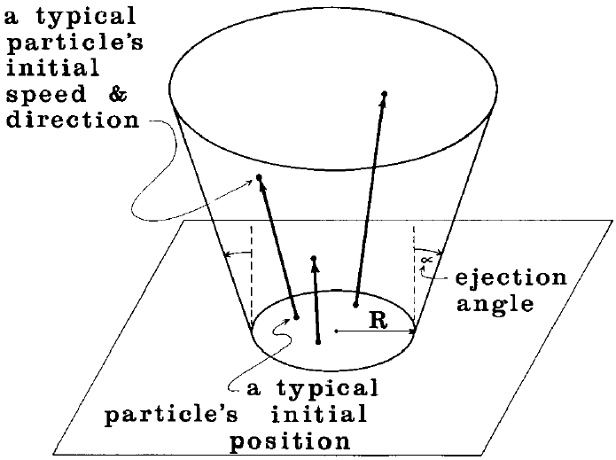
Example: Wrath of Khan
Reeves

Slide 48
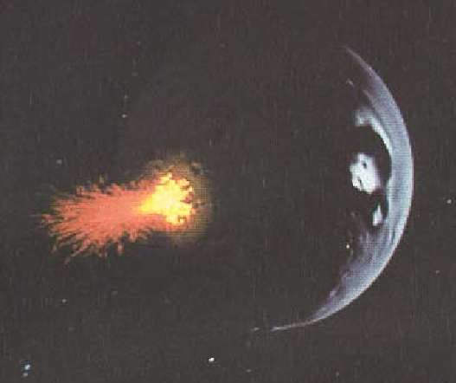
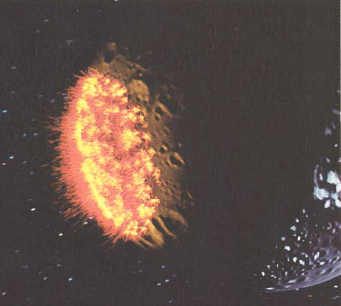
Example: Wrath of Khan
Reeves

Slide 49
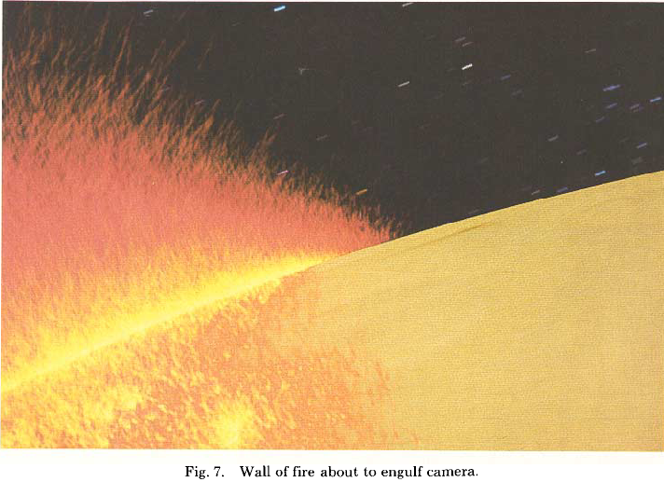
Example: Wrath of Khan
Reeves

Slide 50
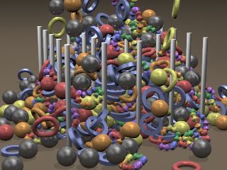
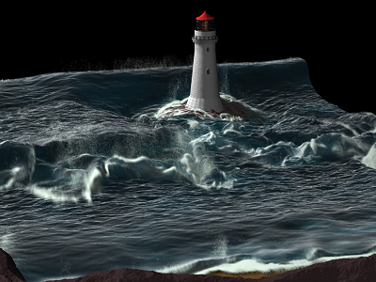
Advances in simulation
Contact
(Fedkiw)
Fluids
(Fedkiw)

Slide 51
