Slide 1
Logic: From Greeks to philosophers to circuits.
COS 116, Spring 2012
Adam Finkelstein

Slide 2
High-level view of self-reproducing program
}
Print 0
Print 1
. Print 0
A
Prints binary code of B
}
. . . . . .
. . . . . .
. . . . . .
Takes binary string on tape, and …
B
SEE HANDOUT ON COURSE WEB

Slide 3
Binary arithmetic
    25
    + 29
    54
    11001
    11101
    110110
Q: How do we add two binary numbers?

Slide 4
Recap: Boolean Logic Example
Ed goes to the party if
Dan does not and Stella does.
Choose “Boolean variables” for 3 events:
{
}
E: Ed goes to party
D: Dan goes to party
S: Stella goes to party
Each is either
TRUE or FALSE
E = S AND (NOT D)
Alternately: E = S AND D

Slide 5


Three Equivalent Representations
Boolean Expression E = S AND D
S
Boolean Circuit
E
D
D
S
E
Truth table:
Value of E for every
possible D, S.
TRUE=1; FALSE= 0.
0
0
0
0
1
1
1
0
0
1
1
0

Slide 6
Boolean “algebra”
A AND B written as A • B A OR B written as A + B
0 • 0 = 0
0 • 1 = 0
1 • 1 = 1
0 + 0 = 0
1 + 0 = 1
1 + 1 = 1
Funny arithmetic
Notes:
This is just notation.

Slide 7
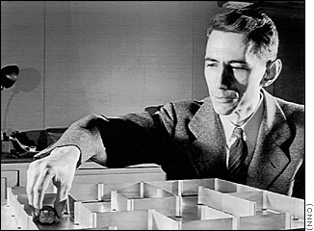
Claude Shannon (1916-2001)
Founder of many fields
(circuits, information theory, artificial intelligence…)
With “Theseus” mouse

Slide 8
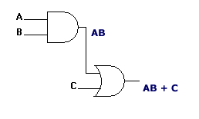

Boolean gates
Shannon (1939)
High voltage = 1
Low voltage = 0
x
Output voltage is high
if both of the input voltages are high;
otherwise output voltage low.
x · y
y
x
Output voltage is high
if either of the input voltages are high;
otherwise output voltage low.
x + y
y
x
x
Output voltage is high
if the input voltage is low;
otherwise output voltage high.
(implicit extra wires for power)

Slide 9
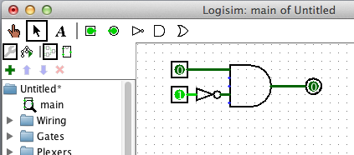
Let’s try it out…
Boolean Expression E = S AND D
S
Boolean Circuit
E
D
D
S
E
Truth table:
Value of E for every
possible D, S.
TRUE=1; FALSE= 0.
0
0
0
0
1
1
1
0
0
1
1
0

Slide 10
Combinational circuit
Boolean gates connected by wires
Important: no cycles allowed
Wires: transmit voltage
(and hence value)

Slide 11
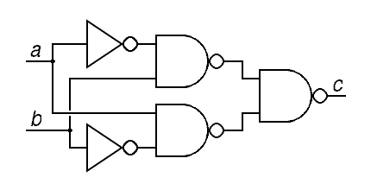
Examples
(Sometimes we use this
for shorthand)
4-way AND
⬅(or this)
More complicated example
← Crossed wires that are not connected
are sometimes drawn like this.
Notes:
Work out truth table for bottom circuit

Slide 12
Combinational circuits and control
“If data has arrived and
packet has not been sent, send a signal”
D
Data arrived?
S
Send signal
P
Packet sent?
S = D AND (NOT P)

Slide 13
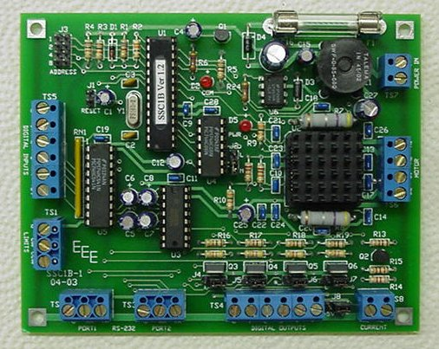
Circuits compute functions
Every combinational circuit computes a Boolean function of its inputs
Inputs
Outputs

Slide 14
Ben Revisited
Ben only rides to class if he overslept,
but even then if it is raining he’ll walk and show up late (he hates to bike in the rain). But if there’s an exam that day he’ll bike if he overslept, even in the rain.
B: Ben Bikes
R: It is raining
E: There is an exam today
O: Ben overslept
How to write a boolean expression for B in terms of R, E, O?
Notes:
Work out truth table

Slide 15
Ben’s truth table
O | R | E | B
0 | 0 | 0 | 0
0 | 0 | 1 | 0
0 | 1 | 0 | 0
0 | 1 | 1 | 0
1 | 0 | 0 | 1
1 | 0 | 1 | 1
1 | 1 | 0 | 0
1 | 1 | 1 | 1

Slide 16
Truth table → Boolean expression
Use OR of all
input combinations
that lead to TRUE (1)
B = O·R·E + O·R·E + O·R·E
O | R | E | B
0 | 0 | 0 | 0
0 | 0 | 1 | 0
0 | 1 | 0 | 0
0 | 1 | 1 | 0
1 | 0 | 0 | 1
1 | 0 | 1 | 1
1 | 1 | 0 | 0
1 | 1 | 1 | 1
Note:
AND, OR, and NOT gates suffice to implement every Boolean function!

Slide 17
Sizes of representations
For k variables:
A | B | … | X
0 | 0 | … | 0
0 | 0 | … | 0
0 | 1 | … | 0
0 | 1 | … | 1
… | … | … | …
… | … | … | …
1 | 1 | … | 1
k | 10 | 20 | 30
2^{k} | 1024 | 1048576 | 1073741824
2^{k}
For an arbitrary function,
expect roughly half of X’s to be 1
(for 30 inputs roughly 1/2 billion!)
Tools for reducing size:
(a) circuit optimization (b) modular design
k + 1

Slide 18
Expression simplification
Some simple rules:
  x + x = 1
  x · 1 = x
  x · 0 = 0
  x + 0 = x
  x + 1 = 1
  x + x = x · x = x
  x · (y + z) = x · y + x · z
  x + (y · z) = (x+y) · (x+z)
x · y + x · y
= x · (y + y)
= x · 1
= x
De Morgan’s Laws:
x · y = x + y
x + y = x · y

Slide 19
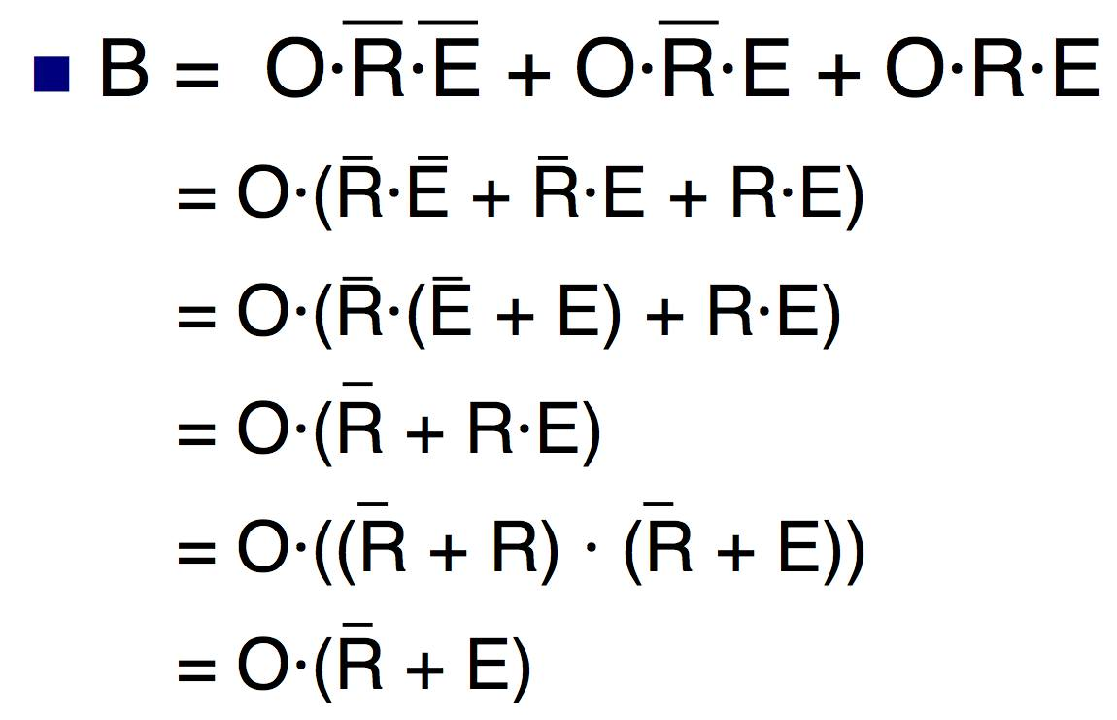
Simplifying Ben’s circuit
…
Notes:
Draw this

Slide 20
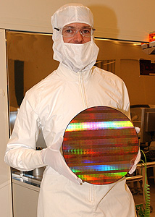
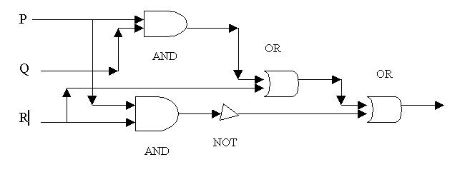
Something to think about:
How hard is Circuit Verification?
Given a circuit, decide if it is “trivial” (no matter the input,
it either always outputs 1 or always outputs 0)
Alternative statement: Decide if there is any setting of the inputs that makes the circuit evaluate to 1.
Time required?

Slide 21
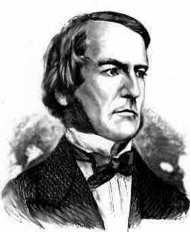
Boole’s reworking of Clarke’s “proof” of existence of God
(see handout – after midterm)
General idea: Try to prove that Boolean expressions
E₁, E₂, …, E_{k} cannot simultaneously be true
Method: Show E₁· E₂ · … · E_{k} = 0
Discussion for after Break: What exactly does Clarke’s “proof” prove? How convincing is such a proof to you?
Also: Do Google search for “Proof of God’s Existence.”

Slide 22



Beyond combinational circuits …
Need 2-way communication (must allow cycles!)
Need memory (scratchpad)
CPU
Ethernet card

Slide 23
Circuit for binary addition?
    25
    + 29
    54
    11001
    11101
    110110
Want to design a circuit to add
any two N-bit integers.
Q: Is the truth table method useful for N=64?

Slide 24
After Break: Modular Design
Design an N-bit adder using N 1-bit adders
After midterm, read:
(a) handout on boolean logic.
(b) Boole’s “proof” of existence of God.

