Slide 1
Digital audio and computer music
COS 116, Spring 2012
Guest lecture: Rebecca Fiebrink

Slide 2
Overview
Physics & perception of sound & music
Representations of music
Analyzing music with computers
Creating music with computers

Slide 3
1. Sound and music

Slide 4
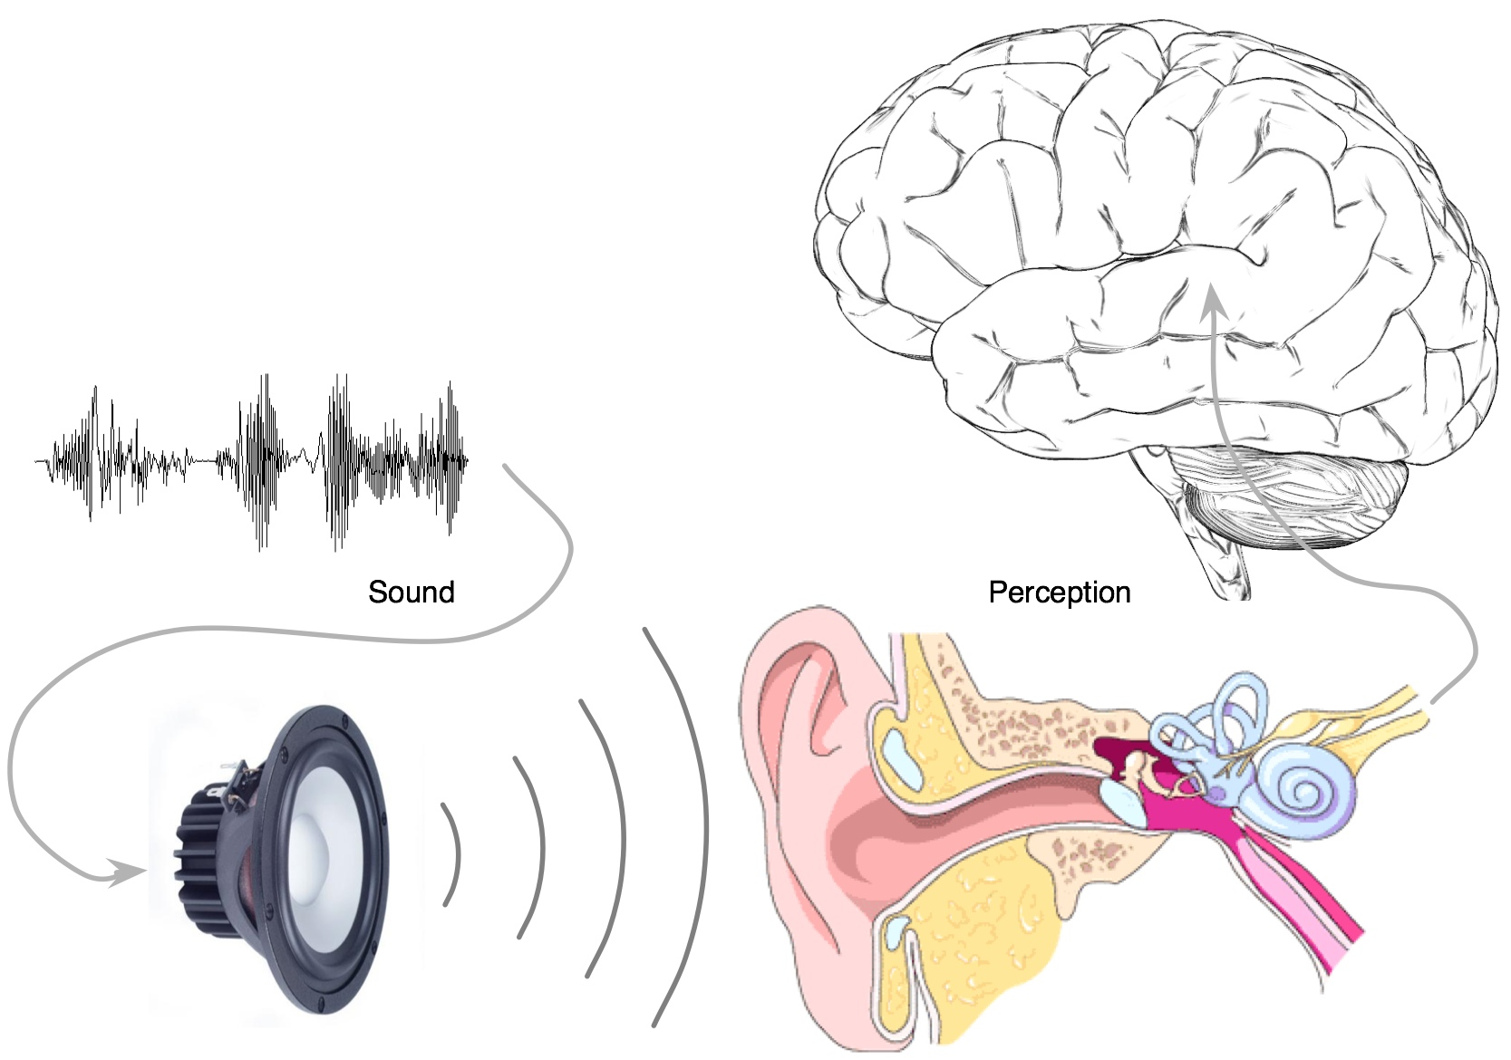
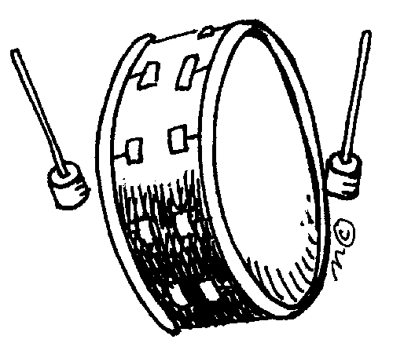
What is sound?
Discussion
Time
“Pressure wave”
Notes:
DEMO: Sndpeek

Slide 5
What do we hear?
http://www.youtube.com/watch?v=EvxS_bJ0yOU
http://www.youtube.com/watch?v=wY1EMwDeaBw
http://www.youtube.com/watch?v=nIt9QF_5C_w
Pitch
Loudness
Timbre
Location
Meter, rhythm, harmony, melody, structure
etc...

Slide 6
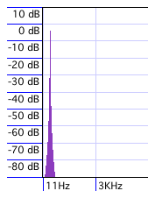
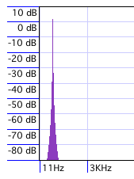
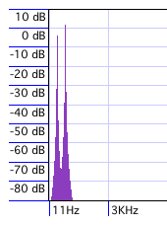
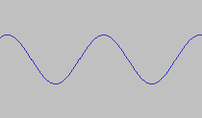
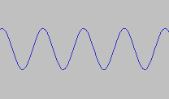
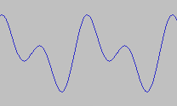
Psychoacoustics
Psychoacoustics: relationships between physical phenomenon and our perception
Frequency: pitch (20-20,000Hz)
Amplitude: loudness
Timbre: Identities and strengths of frequencies present
+
=
Notes:
Show sndpeek again with sounds
Mention that they will explore these issues in the lab.

Slide 7
Discussion
Time
What is music?
“Organized sound”
Psychoacoustics play an important role
Also dependence upon history, culture, experience
Engages listeners’ psychological mechanisms for expectation/reward

Slide 8
2. Representations of sound and music

Slide 9
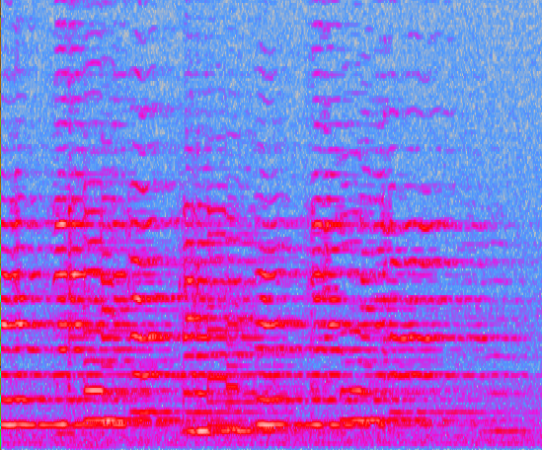
How do you represent music?
Score:
Digital waveform
Spectrogram

Slide 10
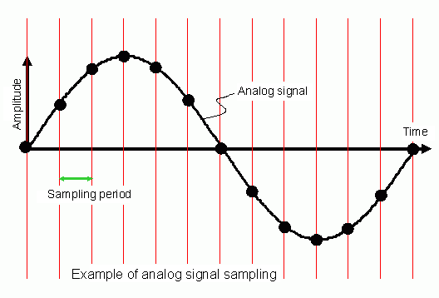
Digital representation of music

Slide 11
Compression
A “better” representation with fewer bits
Why? Security, transmission, storage
How?
Psychoacoustic principles
MP3: Masking
Physical principles of sound production (uses models of sound source)

Slide 12
Choosing a representation
Representations make compromises
Standard representations are somewhat arbitrary
Appropriate choice is task-dependent

Slide 13
3. Using technology to analyze sound and music

Slide 14
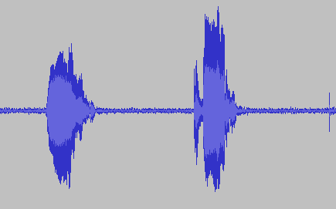
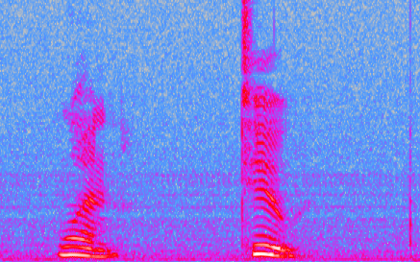
Analyzing speech
Real-life apps:
Customer service phone routing
Voice recognition software

Slide 15
Auditory Scene Analysis
Applications: Archival and retrieval, forensics, AI

Slide 16
Music information retrieval
Analyzing musical data
Query, recommend, visualize, transcribe, detect plagiarism, follow along score
Sites/apps you can try
midomi
Themefinder.com
Pandora.com (includes “human-powered” algorithms)
Shazaam

Slide 17
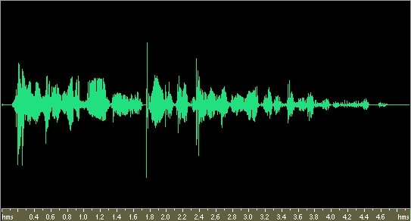
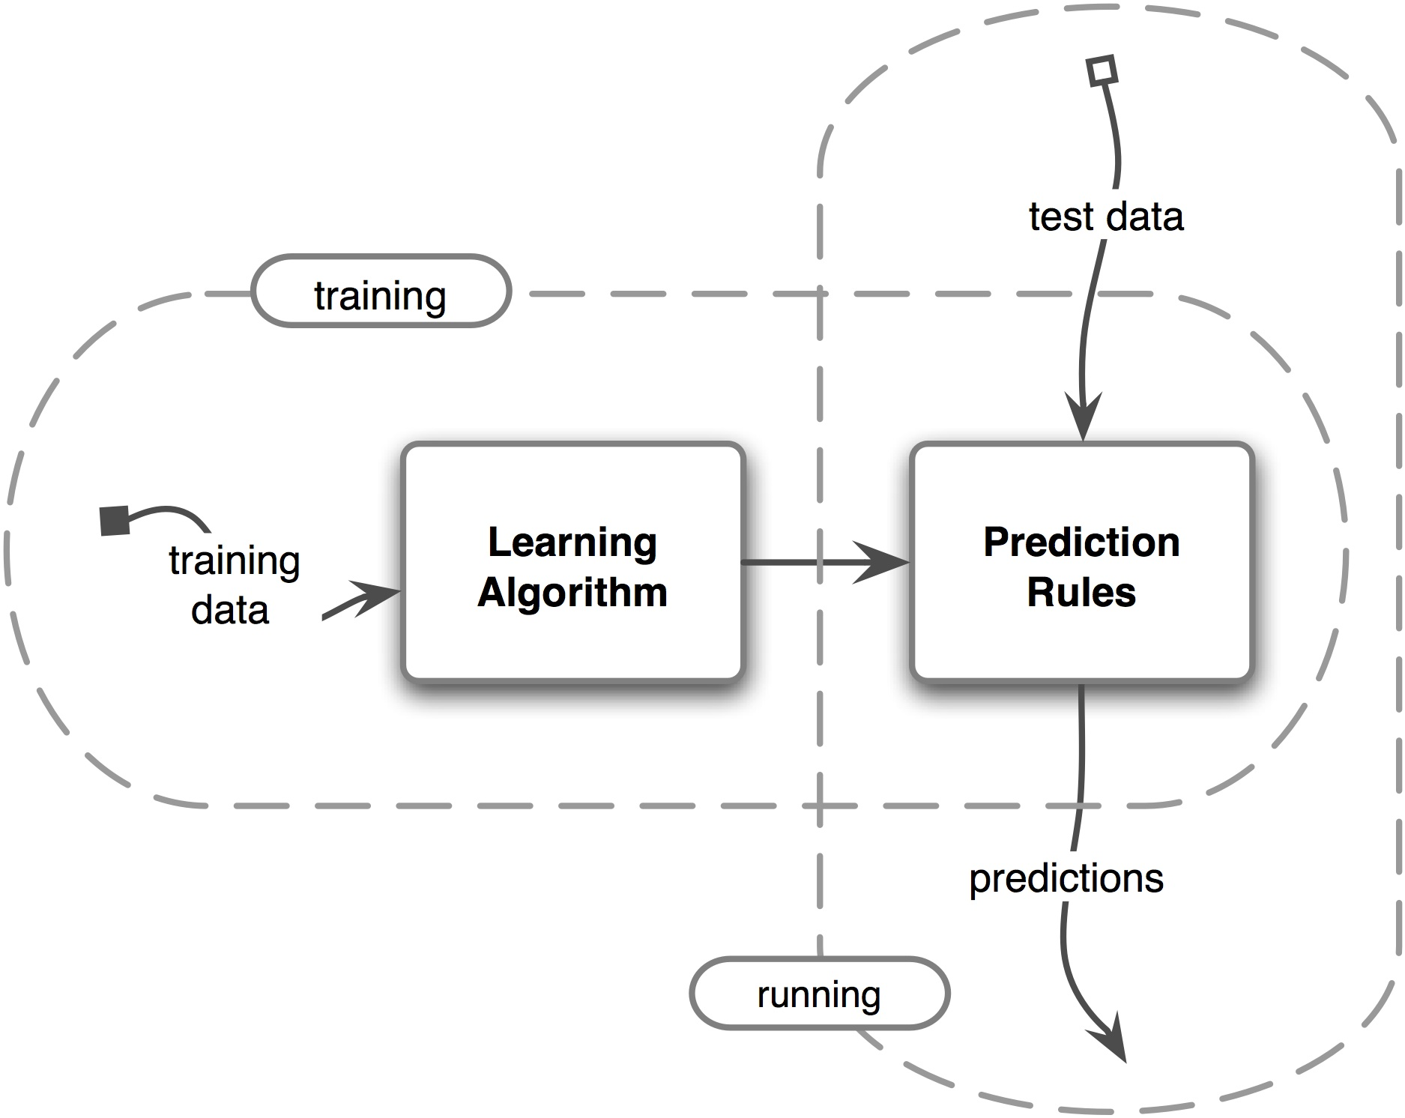
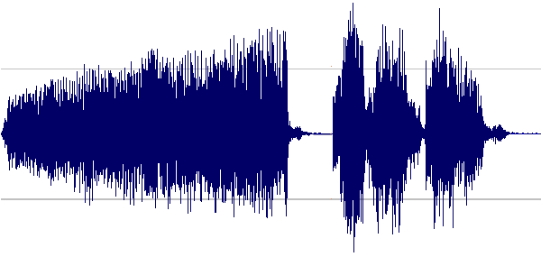
Machine learning for analysis

Slide 18
4. Using technology to create music and sound

Slide 19
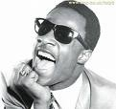
Creating music: Synthesis

Slide 20
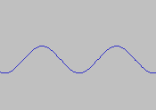
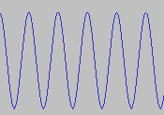
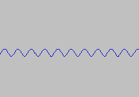
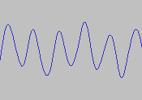
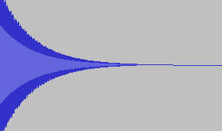
Four approaches to synthesis
1. Additive synthesis
Figure out proportions of various frequencies
Synthesize waves and superimpose them
Modify amplitude using an “envelope”:
+
+
…=

Slide 21
2. FM Synthesis
Modulate the frequency of one sine oscillator using the output of another oscillator
Notes:
DEMO: FM in ChucK

Slide 22
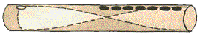
3. Physical Models
Start with knowledge of physical systems
Simulate oscillation (Recall Lecture 4)

Slide 23
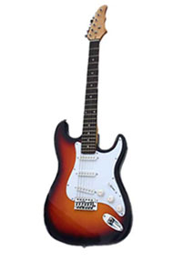
4. Cross-synthesis
Choose filter for speech (vowel)
Choose source to be another sound

Slide 24
How can computers be used in making music?
Synthesizing new sounds
Processing and transforming sound
Demo: T-Pain
Accompanying human performers
Demo: Raphael
Composing new music
Demo: Copin
As new musical instruments
And many other ways, too…

Slide 25
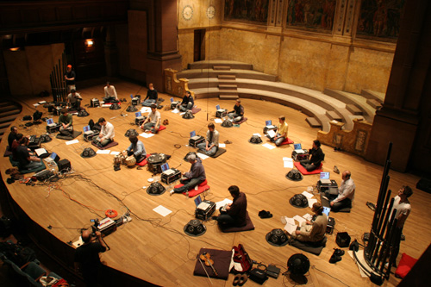
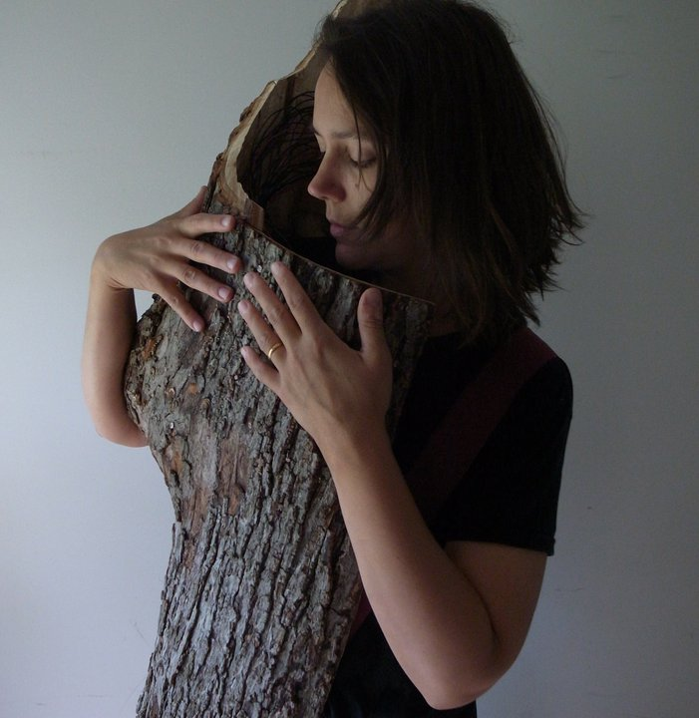
Computer as Instrument
Demo: SMELT keyboard, motion
Video: Clix
Demo: Wekinator
Video: CMMV, Blinky
Demo: Live coding

Slide 26
Questions: How can we….
develop new ways to synthesize sound?
give a user control over synthesis parameters?
make machines interactive in a musical way?
augment human capabilities?
design new instruments that are easy to play? allow expert musicality?
create music that is emotionally and aesthetically compelling?

Slide 27
Final remarks
Distinctions in this presentation are superficial
Analysis, representation, and creation interact
Technology draws on and contributes to our understanding of the physics and psychophysics of sound
Computer music is interdisciplinary
HCI, AI, programming languages, algorithms, systems building
Also psychology, music theory, acoustics, signal processing, engineering, physics, performance practice, library science, applied math & statistics, …
Technology is constantly complicating and changing the landscape of our musical experiences as creators, participants, listeners, and consumers.

Slide 28
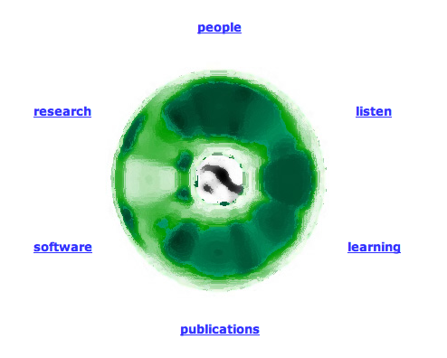
http://soundlab.cs.princeton.edu/

