Slide 1
What computers just cannot do.
COS 116, Spring 2012
Adam Finkelstein

Slide 2
“Prof, what’s with all the negative thinking?!?”
“What computers can’t do.”
An obvious motivation: Understand the limits of technology

Slide 3
The power of negative thinking….

Slide 4
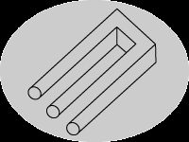
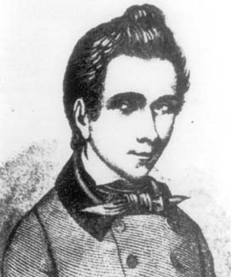
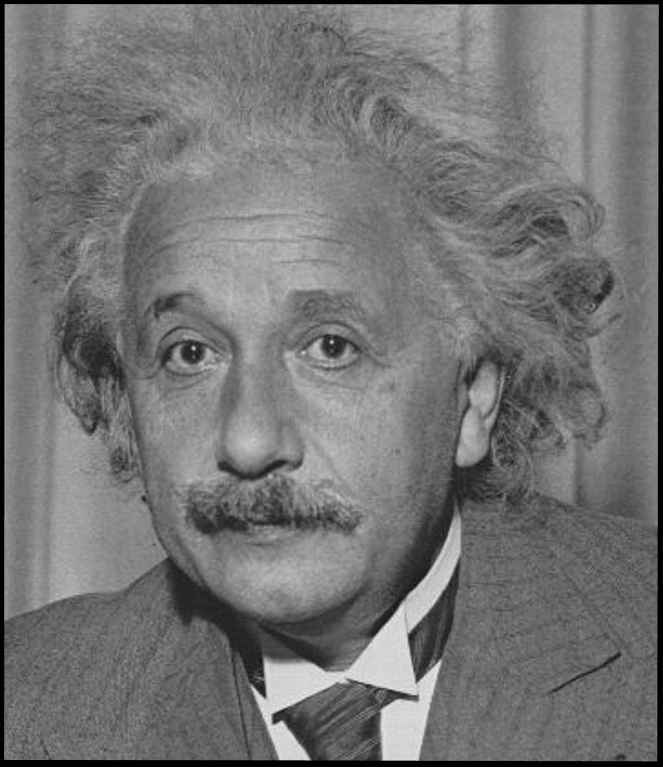
In Science….
Often, impossibility result
deep insight
Examples
Impossibility of trisecting angle with ruler and compass (Galois)
Group Theory and much of modern math
Relativity and modern physics
Nothing travels faster than light

Slide 5
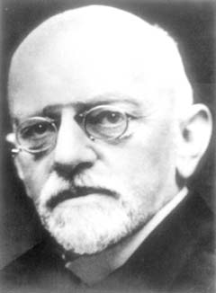
In Mathematics….. “Can mathematicians be replaced by machines?”
[Hilbert, 1900]
Math is axiomatic
Axioms – Set of statements
Derivation rules – finite set of rules for deriving new statements from axioms
Theorems – Statements that can be derived from axioms in a finite number of steps
Mathematician – Person who tries to determine whether or not a statement is a theorem.

Slide 6
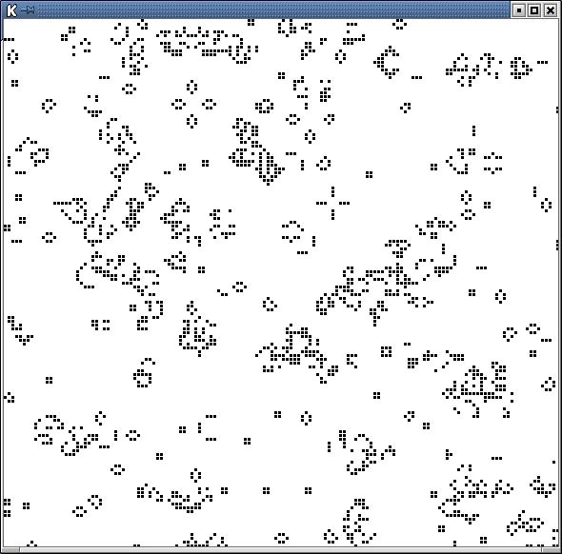
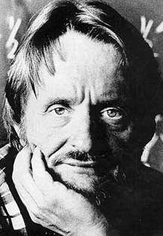
Understanding complex systems (or even simple systems)….
Can a simple set of mathematical equations “solve” problems like:
“Given starting configuration for the game of life, determine whether or not cell (100,100) is ever occupied by a critter.”
John Conway

Slide 7
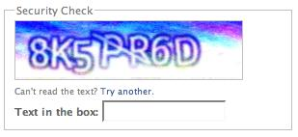
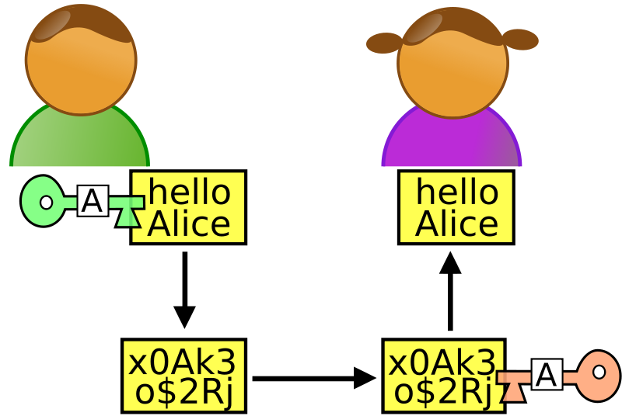
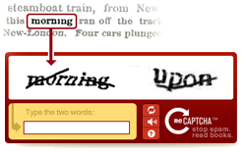
In computer science……
CAPTCHA
Cryptography

Slide 8
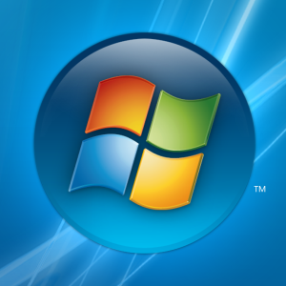
More Computer Science… Automated Software Checking?
Windows Vista:
50-million line program
Can computers check whether or not it will ever crash?
Notes:
Printout is 20 stories high

Slide 9
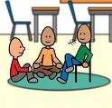
Discussion
Time
What is a computation?
(need to know this to know what can/cannot be computed)
Next:
How did Turing set about formalizing this age-old notion and what were the features of his model?

Slide 10
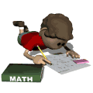
What is a computation?
(see reading by Davis)
Basic Elements
Scratch Pad
Step-by-step description of what to do (“program”); should be finite!
At each step:
Can only scan a fixed number of symbols
Can only write a fixed number of symbols

Slide 11
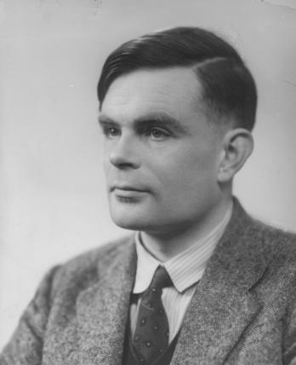
Turing’s model
1 dimensional unlimited scratchpad (“infinite tape”)
Only symbols are 0 or 1 (tape has a finite number of 1s)
Can only scan/write one symbol per step
Program looks like
1. PRINT 0 2. GO LEFT 3. GO TO STEP 1 IF 1 SCANNED 4. PRINT 1 5. GO RIGHT 6. GO TO STEP 5 IF 1 SCANNED 7. PRINT 1 8. GO RIGHT 9. GO TO STEP 1 IF 1 SCANNED 10. STOP
The Doubling Program

Slide 12
Example: What does this program do?
1. PRINT 0 2. GO RIGHT 3. GO TO STEP 1 if 1 SCANNED 4. GO TO STEP 2 if 0 SCANNED

Slide 13
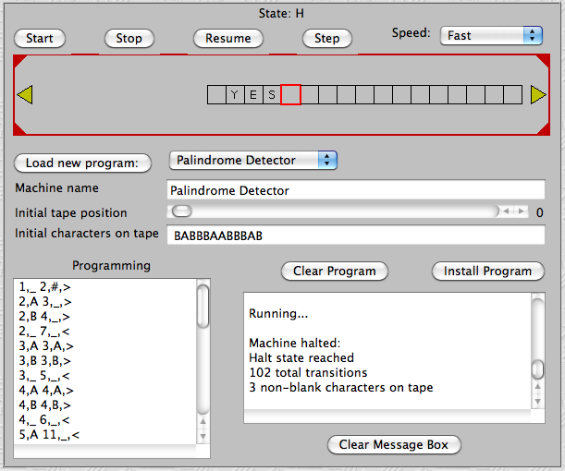
Let’s try another…
http://ironphoenix.org/tril/tm/

Slide 14
Discussion
Time
Can this computational model do every computation that pseudocode can?
How do we implement arithmetic instructions, arrays, loops?

Slide 15
Surprising facts about this simple model
It can do everything that pseudocode can do
Hence it can “simulate” any other physical
system, and in particular simulate any other physically realizable “computer.”
[CHURCH-TURING THESIS”]
THIS MODEL CAPTURES THE NOTION OF “COMPUTATION” ----TURING

Slide 16
Recall: Numbers and letters can be written in binary.
A program can also be represented by a string of bits!

Slide 17
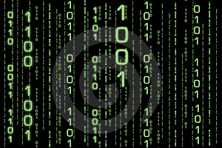
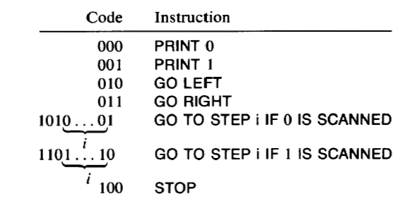
“Code” for a program
= Binary Representation
Many conventions possible (e.g., ASCII)
Davis’ convention:
P Code (P)

Slide 18
Programs and Data
A False Dichotomy!
Program
Usual viewpoint -
Data
Program
But can have -
Code of Program

Slide 19
Universal Program U
U
Program P
Data
U “simulates” what P would do on that data
(Sometimes also known as “interpreter”)
Notes:
Example: billing system, my mac running old powerpoint.

Slide 20
Automated Bug Checking Revisited
Halting Problem
Let P = program such that code(P) = V. Does P halt on data D?
V
D
IDEAS???
Trivial Idea: Simulate P using universal program U. If P halts, will eventually detect.
Problem: But if P never halts, neither does the simulation.

Slide 21
Next Week: Halting Problem is unsolvable by another program
Read this proof in the Davis article, and try to understand.
Ponder the meaning of “Proof by contradiction.” How convincing is such a proof?
“When something’s not right, it’s wrong…” -Bob Dylan
Homework for next week will be posted this afternoon. Includes: Write a Turing-Post program that prints the bit sequence 101 infinitely often,
as well as its binary code
Thurs: Digital audio (guest: Prof. Fiebrink)

