Slide 1
Creating new worlds inside the computer
COS 116, Spring 2012
Adam Finkelstein

Slide 2
A couple tips….
Use Piazza! (Even for private questions.)
Send lab reports and homeworks to pu.cos116@gmail.com

Slide 3
Pseudocode
Simple instructions: involve +, −, ×, ÷
Compound instructions
Conditionals
Loops
No need to sweat over exact wording during exams (unless it changes meaning!)
See pseudocode handout on course web page

Slide 4
“Algorithm” - definition revisited
“Pseudocode for turning a set of inputs into outputs in a finite amount of time”
Questions to think about:
What group of computational tasks can be solved by algorithms?
How dependent is this group on the exact definition of pseudocode?

Slide 5
Today’s topic: Creating new worlds inside the computer.
“simulation”

Slide 6
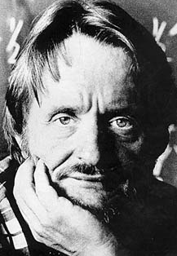
Conway’s Game of life
Rules: At each step, in each cell:
Survival: Critter survives if it has: 2 or 3 neighbors.
Death: Critter dies if it has: 1 or fewer neighbors, or more than 3.
Birth: New critter is born if cell is currently empty and 3 neighboring cells have critters.
Example

Slide 7
Discussion
Time
How would you write pseudocode that simulates
Game of Life?
Should use: n x n array A (for desired n)
A[i, j] = 1 means critter in square A[i, j] = 0 means empty square
Q: How do we “traverse” such an array using the “loop” construct?
Q: How do we update such an array for the next time step?

Slide 8
Pseudocode for each step
Do for i = 1 to n
{
Do for j = 1 to n
{
neighbors ← A[i – 1, j - 1] + A[i – 1, j] + A[i – 1,j + 1] + A[i, j – 1] + A[i, j + 1] + A[i + 1, j – 1] + A[i + 1, j] + A[i + 1, j + 1]
if ( A[I,j] = 1 AND neighbors = 2 ) then
{ B[i, j] ← 1 }
else if (…)
…etc. //see handout; Example 3//
}
}
Do for i = 1 to n
{
Do for j = 1 to n
{ A[i,j] ←B[i,j] }
}

Slide 9
Lesson from the Game of Life?
Simple local behavior can lead to complex global behavior
(See Brian Hayes article in readings.)

Slide 10
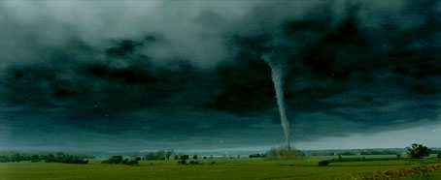
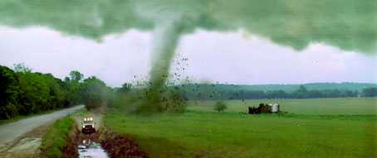
Next..

Slide 11
What does this pseudocode do? Write on a piece of paper and hand it in.
n items, stored in array A
Variables are i, S.
S← 0
Do for i = 1 to [n/2]
{
S ← S + A[2*i]; }

Slide 12
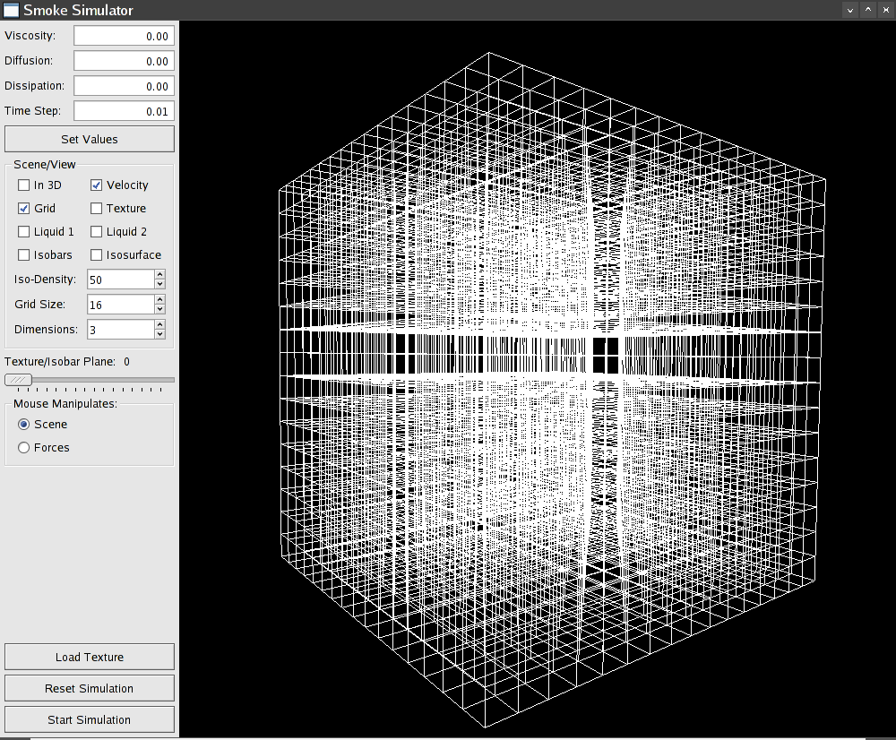
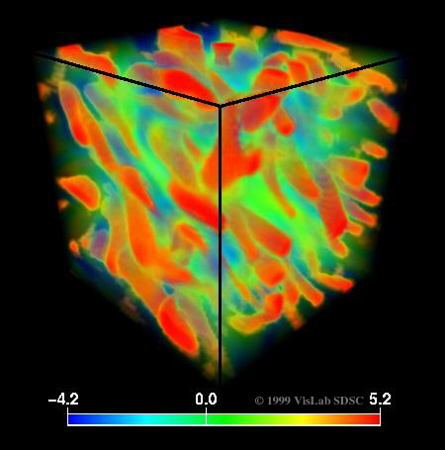
Twister simulation
Divide region into 3D array
Identify laws of physics for air
Navier Stokes equations:
How does a block of air move, given pressure, temperature and velocity differentials on boundary?
(“differentials” = difference from neighbors)

Slide 13
Simulator pseudocode
Initialize Grid using data from observations: surface and aircraft measurements, radar (NEXRAD) readings, etc.
Do for i = 1 to n
{
Do for j = 1 to n
{
Do for k = 1 to n
{ Update state of Grid[i, j, k] }
}
}
10ºC, 15 psi, 20% humidity
11ºC, 15 psi, 23% humidity
etc.

Slide 14
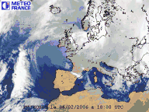
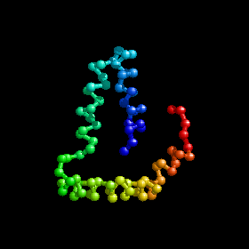
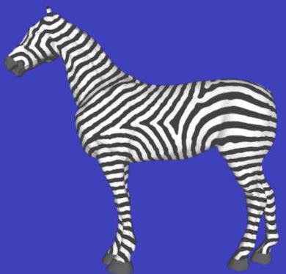
Other examples of simulation
[Turk 91] following:
How patterns arise in plants and animals
Weather forecasting
Protein folding
Animation

Slide 15
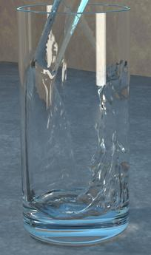
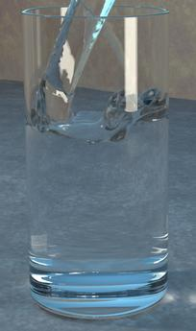
Display
Q: How to display result of simulation?
A: Computer graphics (later in course)
[Enright and Fedkiw 02]

Slide 16
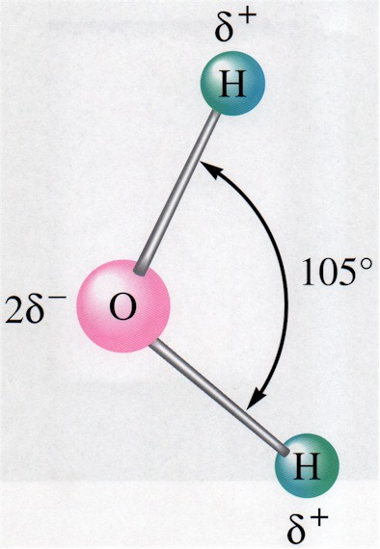
Physics of snow crystals
“Cooling” – reduce amount of molecular motion
Crystal growth: capture of nearby floating molecules
cooling
further cooling
Snow crystals
Water vapor
Water

Slide 17
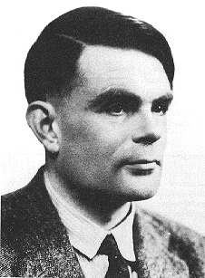
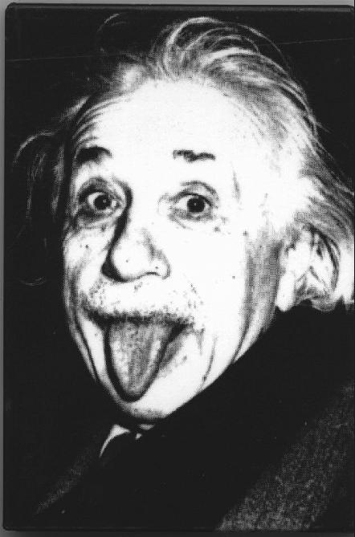
Bigger questions
Alan Turing
Albert Einstein
Can computer simulation be replaced by a “theory of weather”? A “theory of tornadoes”?
Is there a “theory” that answers this type of problem:
Given: A starting configuration in the game of life
Output: “Yes” if the cell at position (100, 100) is ever occupied, “No” otherwise

Slide 18
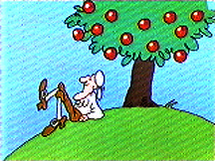
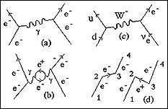
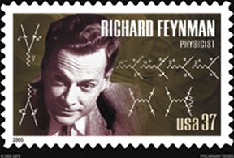
Actually, reverse trend: “theory of matter” (particle physics) is becoming computational.
1670 F = ma
Today
Hayes (reading this week): The universe as a “cellular automaton”

Slide 19
Peeking ahead:
A computer can simulate another computer (e.g., a Classic Mac simulator on a PC). Will explore the implications of this in a future lecture.
Game of life is actually a “computer.”
Readings for this week: (i) Brian Hayes article; first 5 pages
(ii) Brooks 99-126
HW 2 Due next Thurs.

