Slide 1
Telling a robot how to behave
Adam Finkelstein COS 116: Spring 2012

Slide 2
Today: Understanding a simple robot
Why?
Larger goal: seek an answer to “What is Computation?”
Acquire insight into technology that will become pervasive within the next decade.
First encounter with many themes of the course.

Slide 3
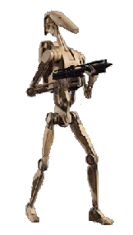
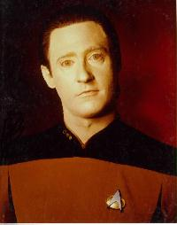
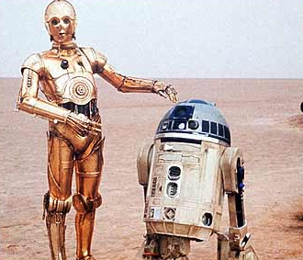
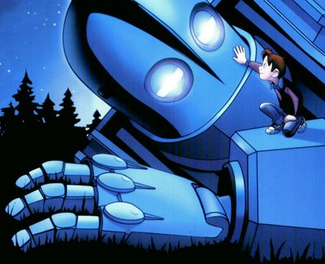
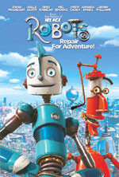
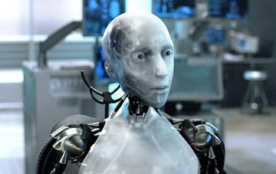
Robots in pop culture

Slide 4
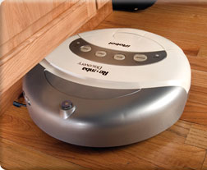
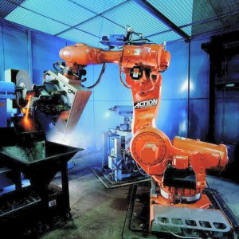
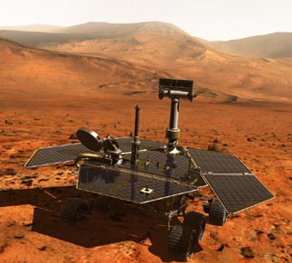
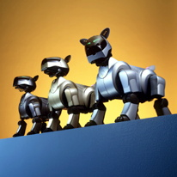
Real robots

Slide 5
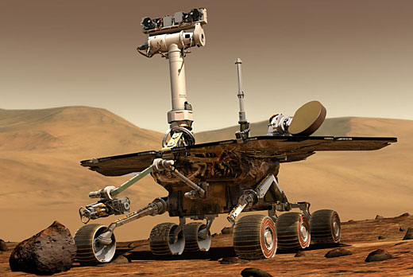
Discussion…
Mars rover: what are the design principles?

Slide 6
Definition of “Robot”:
A machine that can be programmed to interact with the physical environment in a desired way
Key word: programmed
As opposed to cars, televisions, which are operated by people

Slide 7
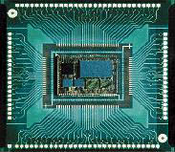
Components of a robot
Three stages:
1. Sensors/Inputs: light, sound, motion...
2. Computing Hardware
3. Outputs/Actions: motors, lights, speakers…

Slide 8
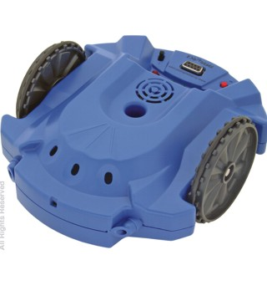
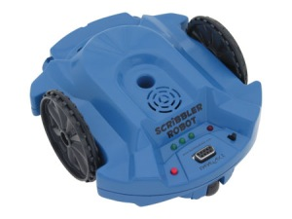
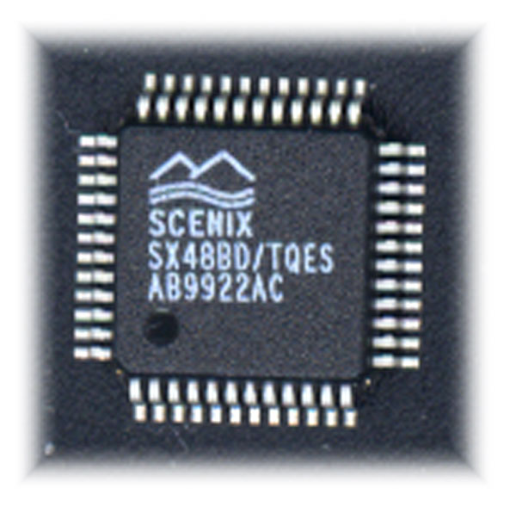
Our robot: Scribbler
Stall sensor
Speaker
Inputs
Outputs
button
Motor/wheels
Line sensor (underneath)
Light outputs
Light sensors
Obstacle sensor emitter
Obstacle sensor detector

Slide 9
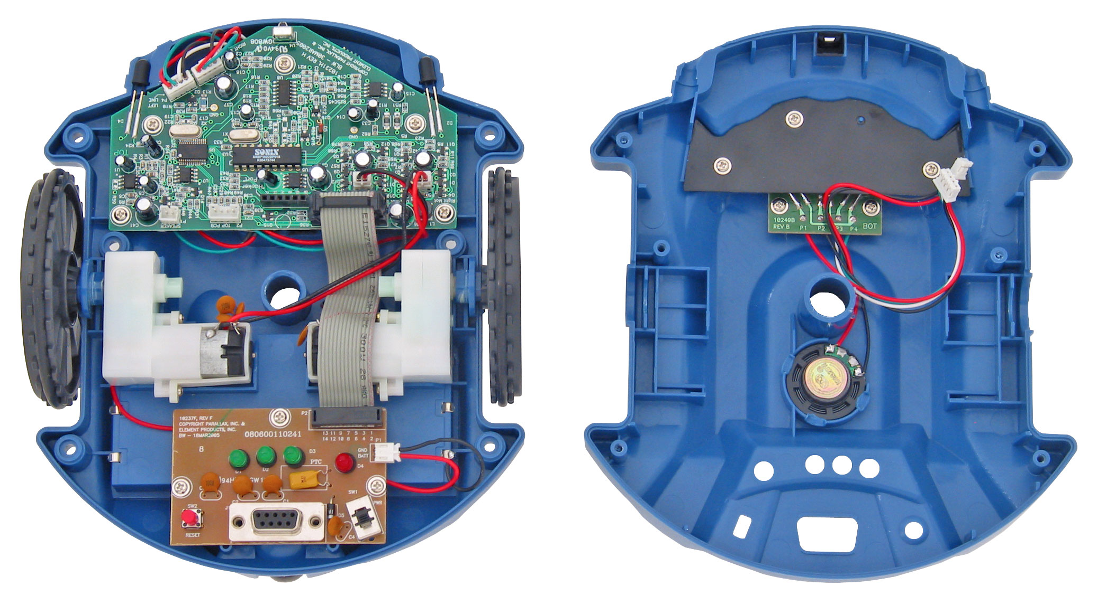
Scribbler inside

Slide 10
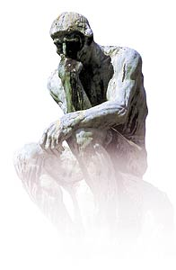
Formal specification of actions
Fact of life in computing: hardware is “dumb”
Forces us to make nebulous concepts precise
What is language? Music? Intelligence?
Running themes:
What is machine “intelligence”?
Are there limits?

Slide 11
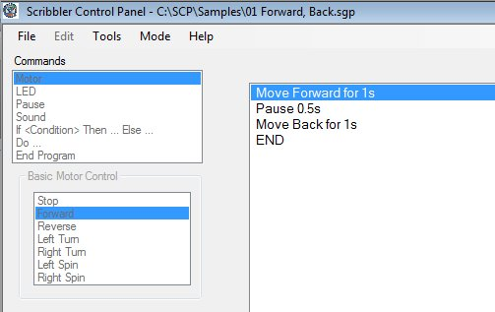
Controlling Scribbler

Slide 12
Remember (esp. for Scribbler labs):
Microprocessor can do one thing at a time
Very fast -- 20 million operations per second!
Compound instructions: sequence within {…}

Slide 13
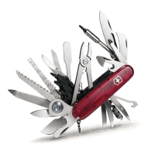
Why programmable?
Benefits of a programmable device:
Flexible
Multi-use
Universal
Main difference between computers and other technologies

Slide 14
Our robot: Scribbler
Stall sensor
Speaker
Inputs
Outputs
button
Motor/wheels
Line sensor (underneath)
Light outputs
Light sensors
Obstacle sensor emitter
Obstacle sensor detector

Slide 15
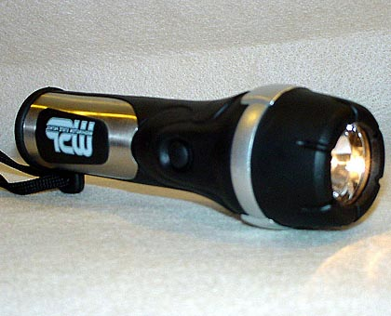
Example 1: As a burglar alarm
Beep!
If beam interrupted…

Slide 16
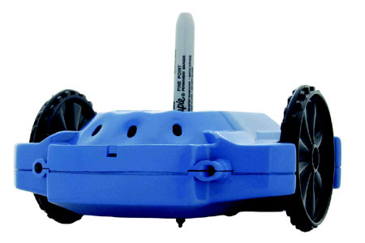
Example 2: As an artiste

Slide 17
Interesting note: Scribbler is more stupid than you think
3 pages of stuff like
Do forever
{
Move Forward for 1s
Move back for 1s
}
END
GOTO Main
SenseObs:
FREQOUT ObsTxLeft, 1, 38500
IF (ObsRx = 0) THEN object_left = 1 ELSE
object_left = 0
LOW ObsTxLeft
FREQOUT ObsTxRight, 1, 38500
IF (ObsRx = 0) THEN object_right = 1 ELSE object_right = 0
LOW ObsTxRight
RETURN
SenseLine:
HIGH LineEnable
line_right = LineRight
line_left = LineLeft
LOW LineEnable
=
“Translator” written by
Rajesh Poddar ‘08

Slide 18
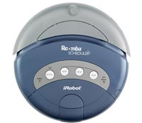
Where are things going?
“Small cleaning agents” – Brooks

Slide 19
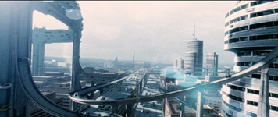
Where are things going?
Automated highways
Being actively researched
(From Minority Report)

Slide 20
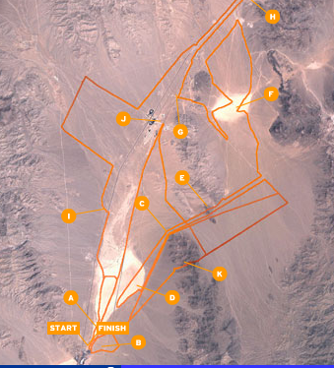
Where are things going?
DARPA Grand Challenge ($2 M prize):
132 mile race in the desert
No human control!
5 teams, Stanford won in ~7 hours

Slide 21
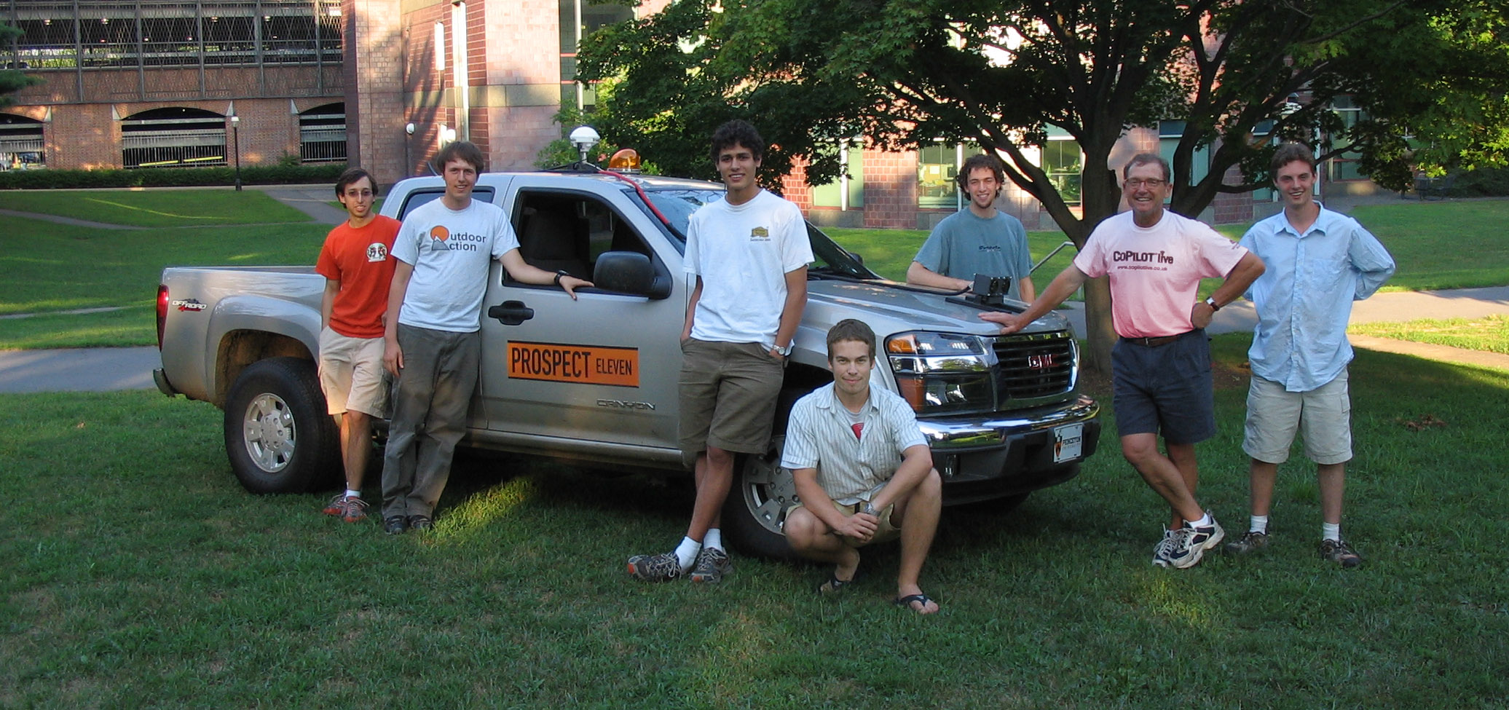
The Princeton Entry
Undergraduate Project; reached the finals

Slide 22
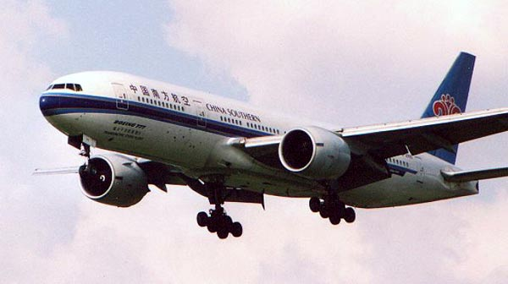
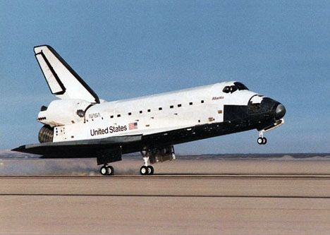
Where are we going?

Slide 23
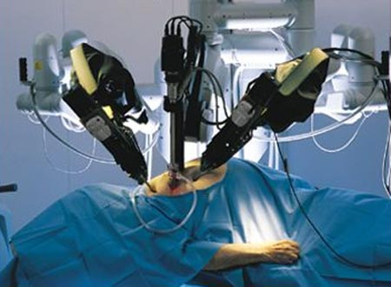
What is going inside us?
“Da Vinci” Robotic surgery system
More precise, though often still controlled by human

Slide 24
Why are multi-purpose robots so hard to build?
Need precise instruments that act like: eyes, ears, hands, fingers, …
Need smart ways to use sensor data (ex: human eyesight vs. high-res camera)

Slide 25
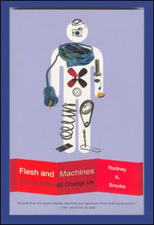
1. Reading: Brooks pp 12-21, pp 32-51 2. Lab: Web 2.0 3. Homework 1: Survey
TO DO’s
(All posted on course web page.)

