Slide 1
Concurrency and Clocks
COS 316 Precept #8

Slide 2
Staying Synchronized
On a single machine, its wall clock is sufficient
Matches intuition
In a distributed setting, each machine’s clock may differ from the other machines
There is no longer an objective time
Need some other mechanism to order events
Notes:
A single machine has a single clock
When an event occurs, that machine can check its clock and apply a timestamp to that event
And the clock will function as an objective source of time
If you want to know the order two events happened in, check their timestamps!
But when we introduce concurrency and distributed systems, that intuition falls apart
In a distributed setting, there’s a lack of inherent synchrony
The clock on one machine may be different from the clock on another machine
All kinds of strange things can happen, so the clocks of different machines can’t be relied upon

Slide 3
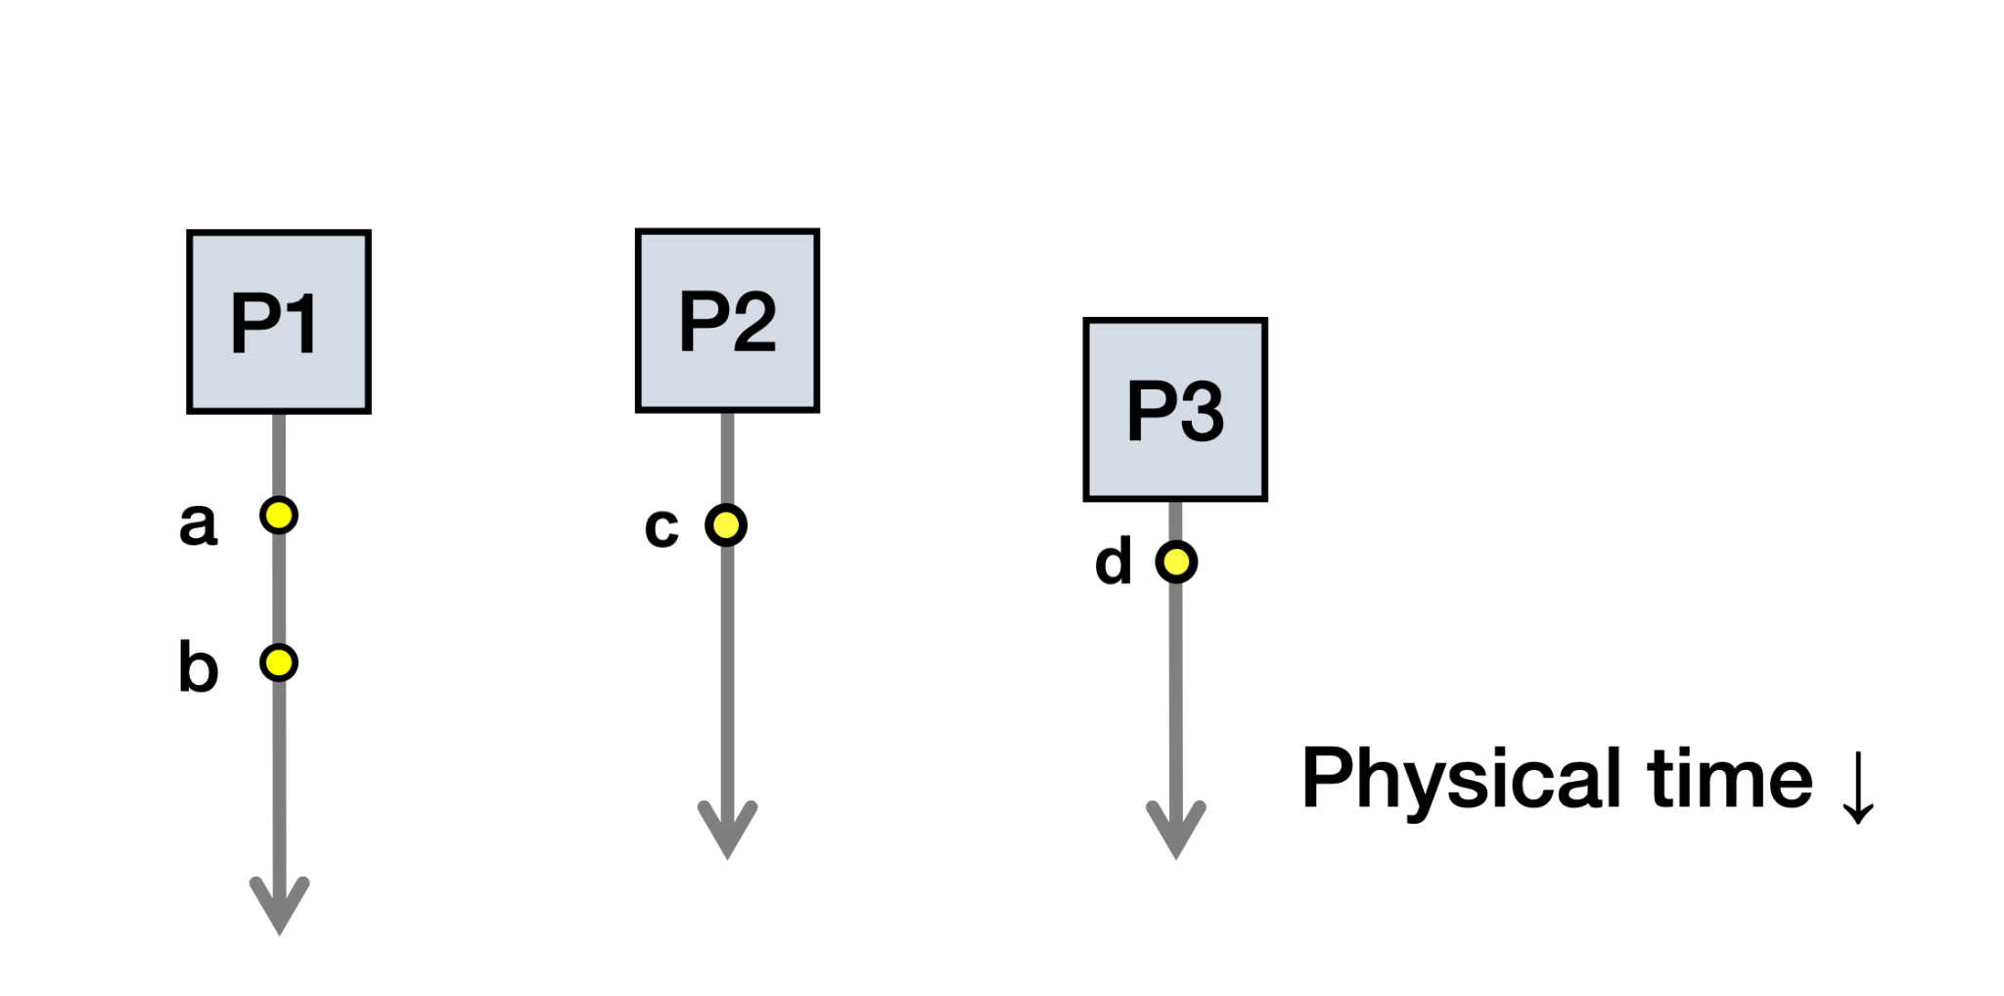
Causality and Happens-Before
Notes:
Let’s talk about causal relationships
For two events, we assume a causal relationship between them if one event could’ve affected the other
We say that the first event “happens before” the second event
For a single process, we assume that events happen before all events that occur afterward in that process
But what if two events occur on different processes?
If there’s no communication between those processes, then the events on one process could not have affected the other process
We call these events concurrent
Looking at the figure on the slide: There can be no causal relationship between C and D because those processes never communicate
There IS a causal relationship between C and B because B is the receipt of a message and C is the sending of that message.
And there is another causal relationship between A and B because A has a causal relationship with all events that happen after it in the same process
For pairs of events where there is a causal relationship between them, we want to be able to communicate that, because in the total order of events, they need to appear in the correct order

Slide 4
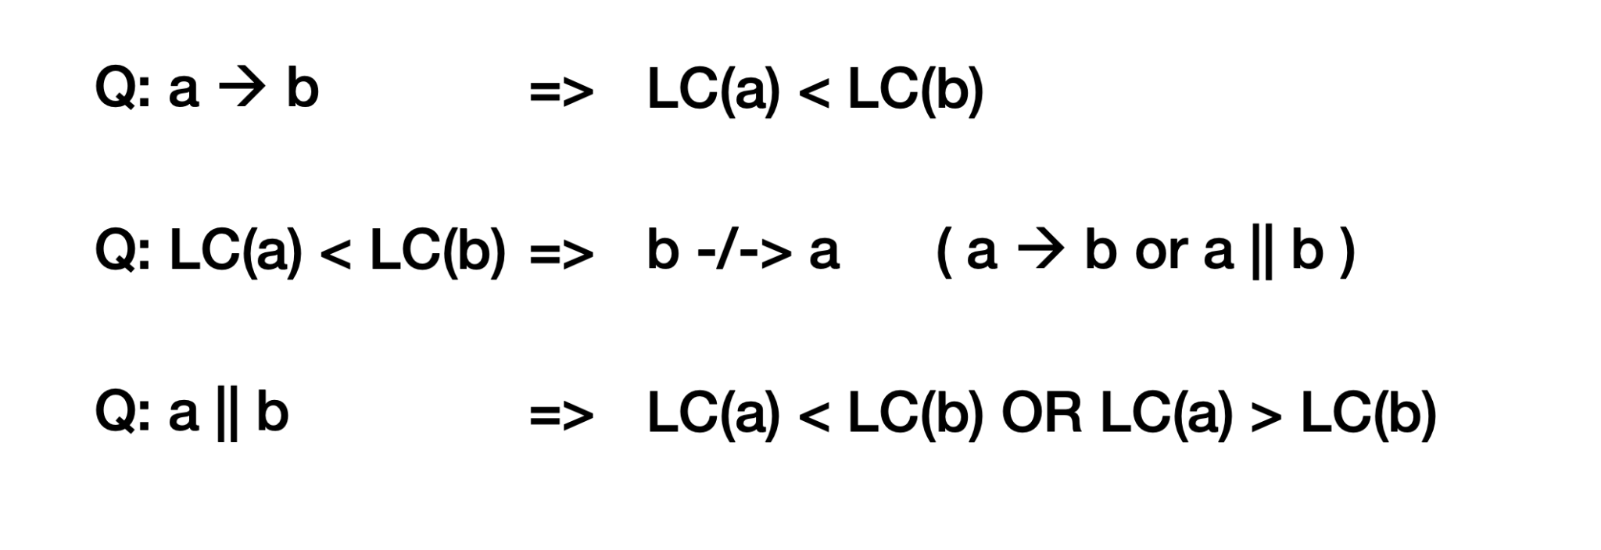
Lamport Clocks
Provide a way to totally order events (when used with some tie-breaking mechanism)
LC(A) < LC(B) => B -/-> A
Notes:
In lecture, you were introduced to lamport clocks
Lamport clocks provide a way to totally order events in a distributed system, when used with some tie-breaking criterion
The actual criterion that’s used isn’t important. It just needs to be deterministic. The one that you learned in class is to use process ID. That’s both arbitrary and completely fine.
Each event that occurs will be assigned a timestamp that can be used to sort them
After the tie-breaking criterion has been applied, there should be no ties: every event should be sortable by their lamport timestamp
For any two events, A, and B, if A happens before B, A’s lamport timestamp is guaranteed to be lower than B’s lamport timestamp

Slide 5
Lamport Clock Algorithm
Before executing an event b, Ci = Ci + 1:
Set event time C(b) ← Ci
Send the local clock in the message m
On process Pj receiving a message m:
Set Cj and receive event time C(c) ← 1 + max{ Cj, C(m) }
Notes:
The algorithm for computing lamport clocks is simple
Each process keeps a local clock
Note that this is not an actual clock. Each process doesn’t care about the actual time that things happen, it cares about the order of events
There are two types of events that would trigger an update of a process’s lamport clock
The first is an event that the process is responsible for. This could be sending a message to another process or some entirely local event that doesn’t involve communication.
In this scenario, before the event is labeled with a timestamp, the process increments its lamport clock by 1 and applies this new clock value as the timestamp. If the event is the sending of a message to another process, the timestamp is included with the message
The other type of event is the receipt of a message. This time, a comparison needs to be made. The receiving process will look at its own lamport clock and the timestamp that was included in the message it received
It will take the max of these values and set its own clock to that value. It will then increment its new clock value before applying the timestamp to the “receive message” event.

Slide 6
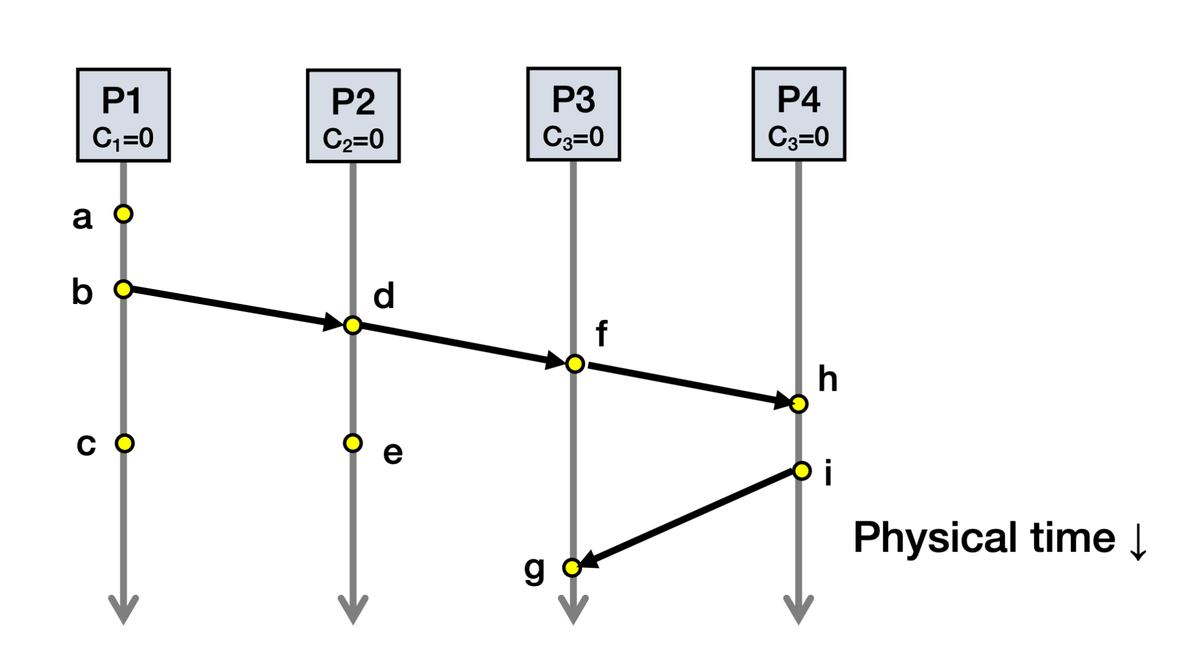
Lamport Clock Example
Notes:
Let’s solidify our understanding of the algorithm with an example
We want to assign a lamport timestamp to each of these events
A = 1.1
B = 2.1
C = 3.1
D = 3.2
E = 4.2
F = 4.3
H = 5.4
I = 6.4
G = 7.3

Slide 7
Totally-Ordered Multicast
Goal: All sites apply updates in (same) Lamport clock order
Client sends update to one replica site j
Replica assigns it Lamport timestamp Cj . j
Key idea: Place events into a sorted local queue
Sorted by increasing Lamport timestamps
Notes:
Totally-ordered multicast is an application of lamport clocks
Its goal is to have a set of distributed processes apply updates in the same global order
The protocol uses lamport clocks to define that global order
Each process keeps a sorted queue of events that have yet to be executed
The queue is always kept sorted by lamport timestamp
And the events in every queue should execute in the order of their lamport timestamps

Slide 8
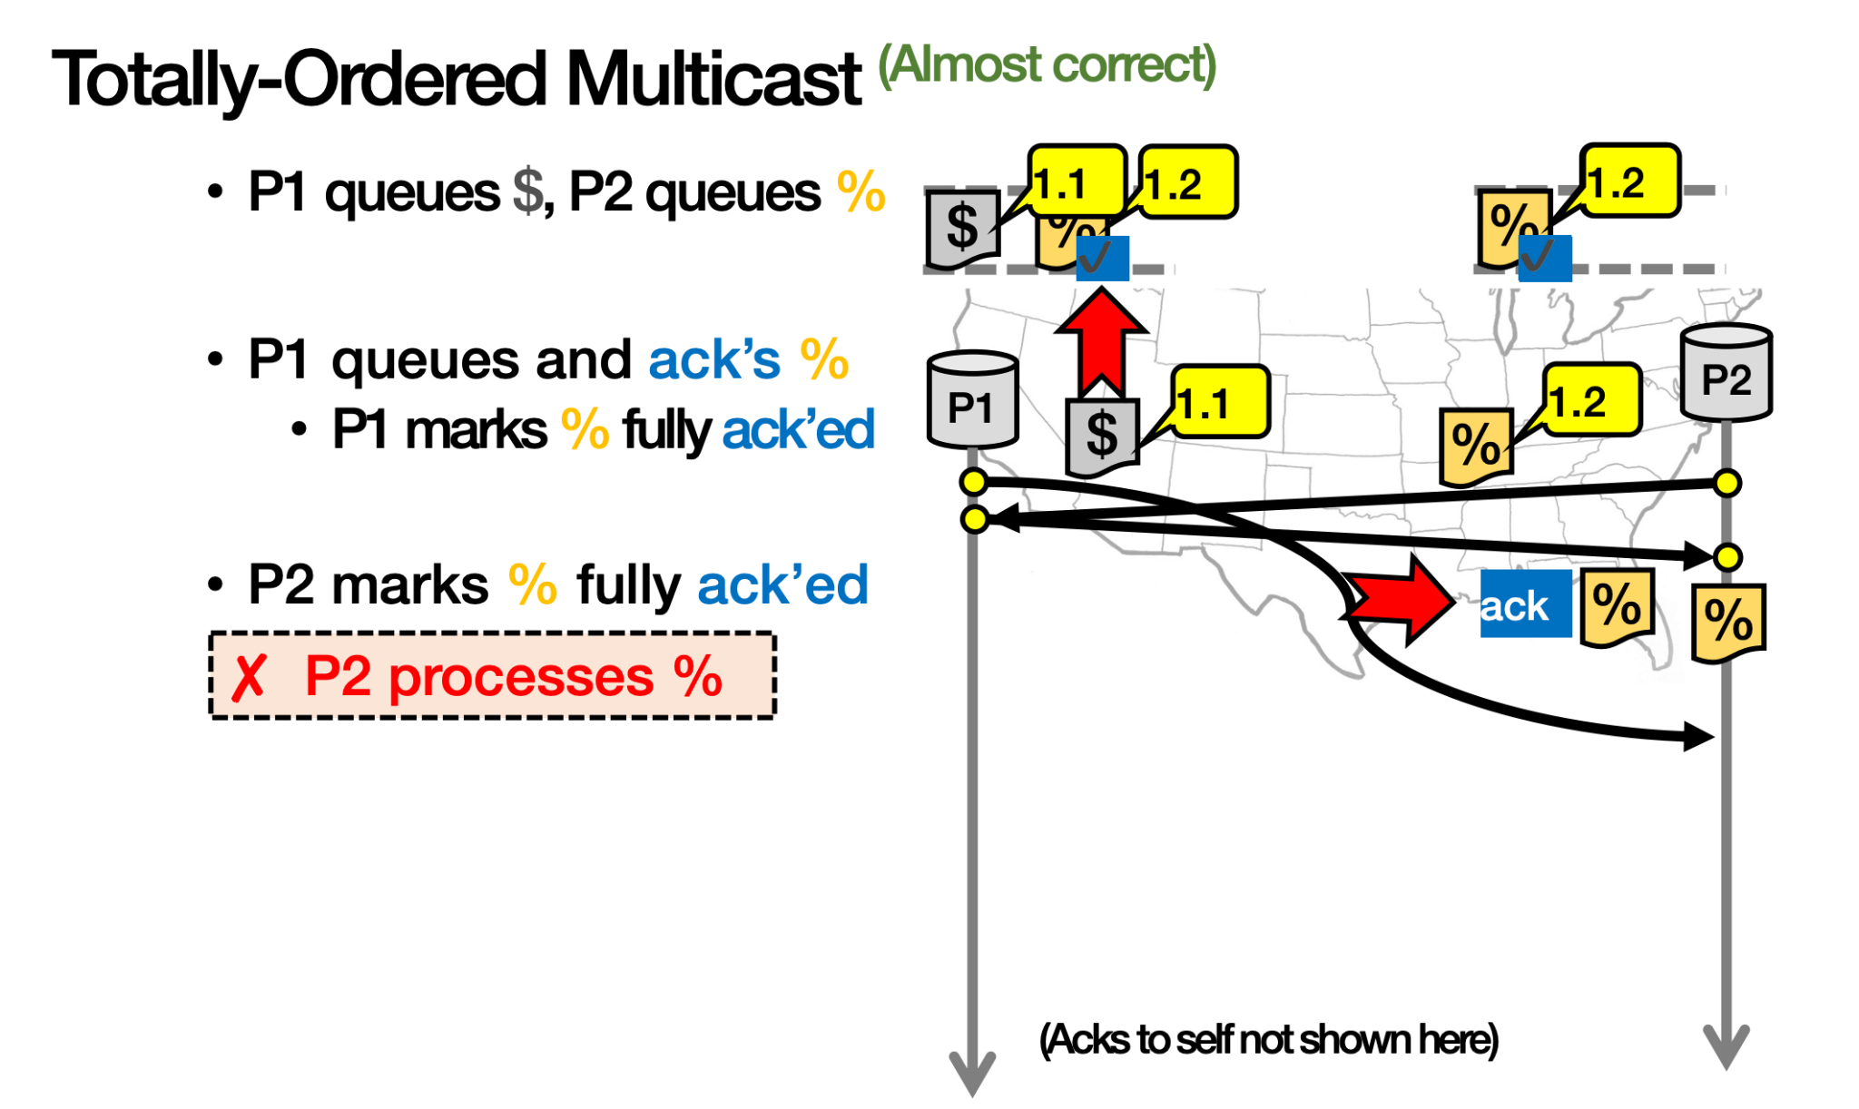
Totally-Ordered Multicast (Incorrect)
On receiving an update from client, broadcast to others (including yourself)
On receiving an update from replica:
Add it to your local queue
Broadcast an acknowledgement message to every replica (including yourself)
On receiving an acknowledgement:
Mark corresponding update acknowledged in your queue
Remove and process updates everyone has ack’ed from head of queue
Notes:
This is the incorrect version of totally-ordered multicast that was shown in class
It’s because updates can be applied out of order!
In the example above, P2 processes event % before it processes $, even though $ has a lower lamport clock

Slide 9
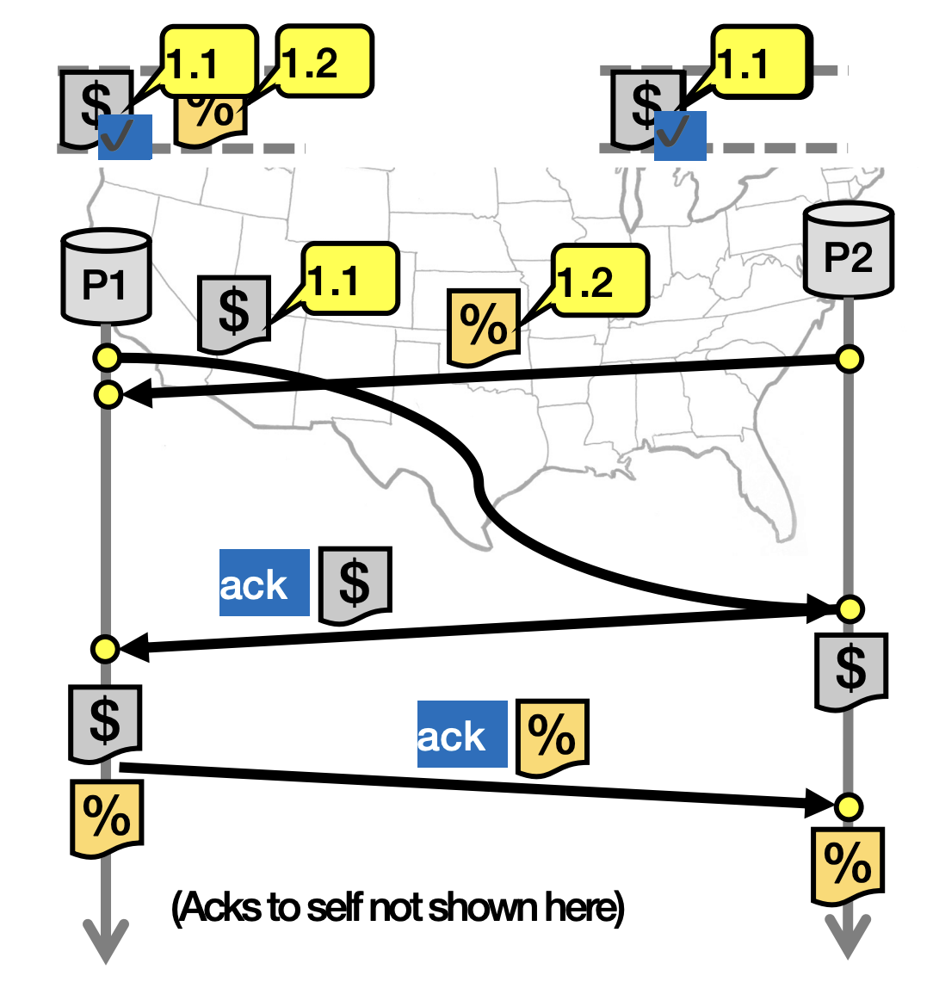
Totally-Ordered Multicast (Correct)
On receiving an update from client, broadcast to others (including yourself)
On receiving an update from replica:
Add it to your local queue
Broadcast an acknowledgement message to every replica (including yourself) only from the head of the queue
On receiving an acknowledgement:
Mark corresponding update acknowledged in your queue
Remove and process updates everyone has ack’ed from head of queue
Notes:
This is the correct version of totally-ordered multicast that was shown in class
Notice that step 2 has changed so that acknowledgements are only sent for the event at the head of the queue, which should have the smallest lamport timestamp
The difference is that P1 doesn’t send an ack immediately after receiving the % operation anymore since not everything in front of the % operation in P1’s queue is ready to be executed (the $ operation)

Slide 10
Lamport Clock Weaknesses
Notes:
Let’s take a closer look at the guarantees provided by Lamport clocks
If there is a causal relationship between two events, meaning A happens before B, then the lamport clock for A is guaranteed to be lower than that of B
But what if only have the lamport clocks and not visibility into the ground truth of a situation?
Given the lamport clocks for A and B, if LC(A) is lower than LC(B), we can conclude that B did NOT happen before A
Which is equivalent to saying that A happened before B OR A and B are concurrent, which is ambiguous
What if we need to know for sure whether two things are causally related?
Then lamport clocks fall short!

Slide 11
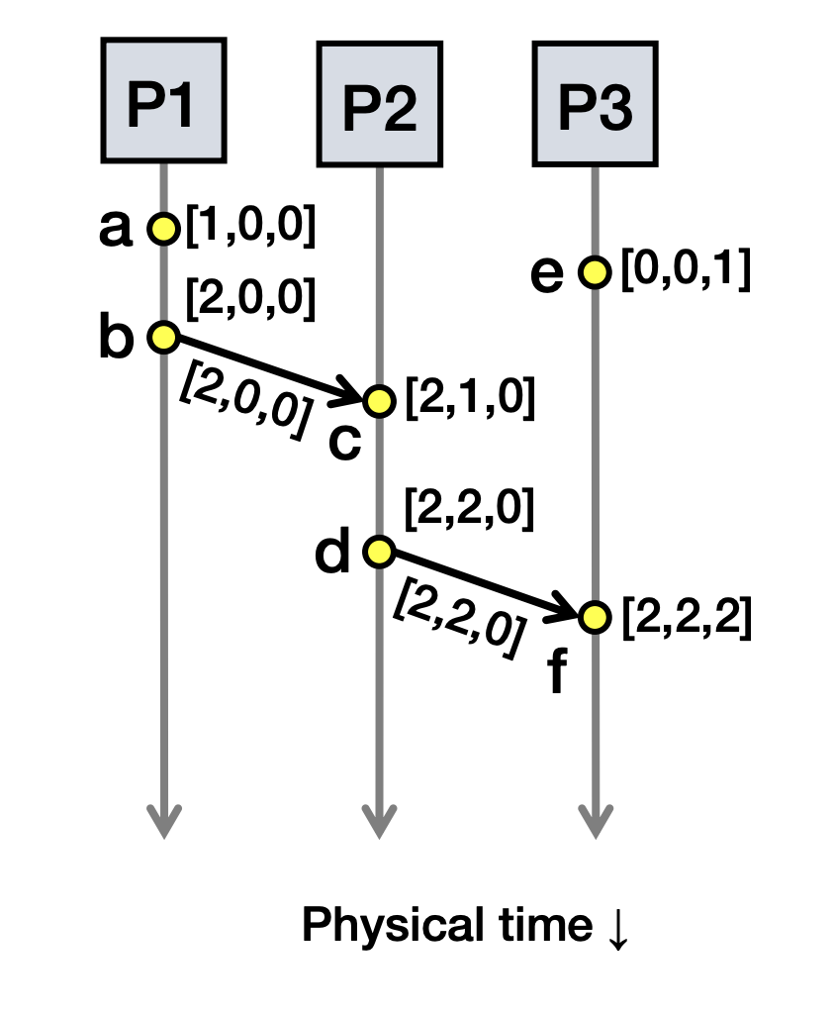
Vector Clocks
Notes:
Vector clocks are an improvement over lamport clocks in that they allow us to differentiate between a causal relationship and concurrency
With this mechanism, each process keeps a vector clock of length N, where each element of the vector corresponds to a process in the system
Now, when an event occurs that a process is solely responsible for (some calculation or sending a message), it increments the element of the vector that corresponds to it
Similar to before, when a message is sent, the ENTIRE vector clock is included in the message
When a process receives a message, it iterates through the elements of the received clock and its own clock pairwise, taking the max of each element
It then increments the element of its vector that corresponds to it

Slide 12
Comparing Vector Timestamps
Notes:
With vector clocks, there are now explicit cases for when there is a happens-before relationship between two events and when those two events are concurrent!
This removes ambiguity!

Slide 13
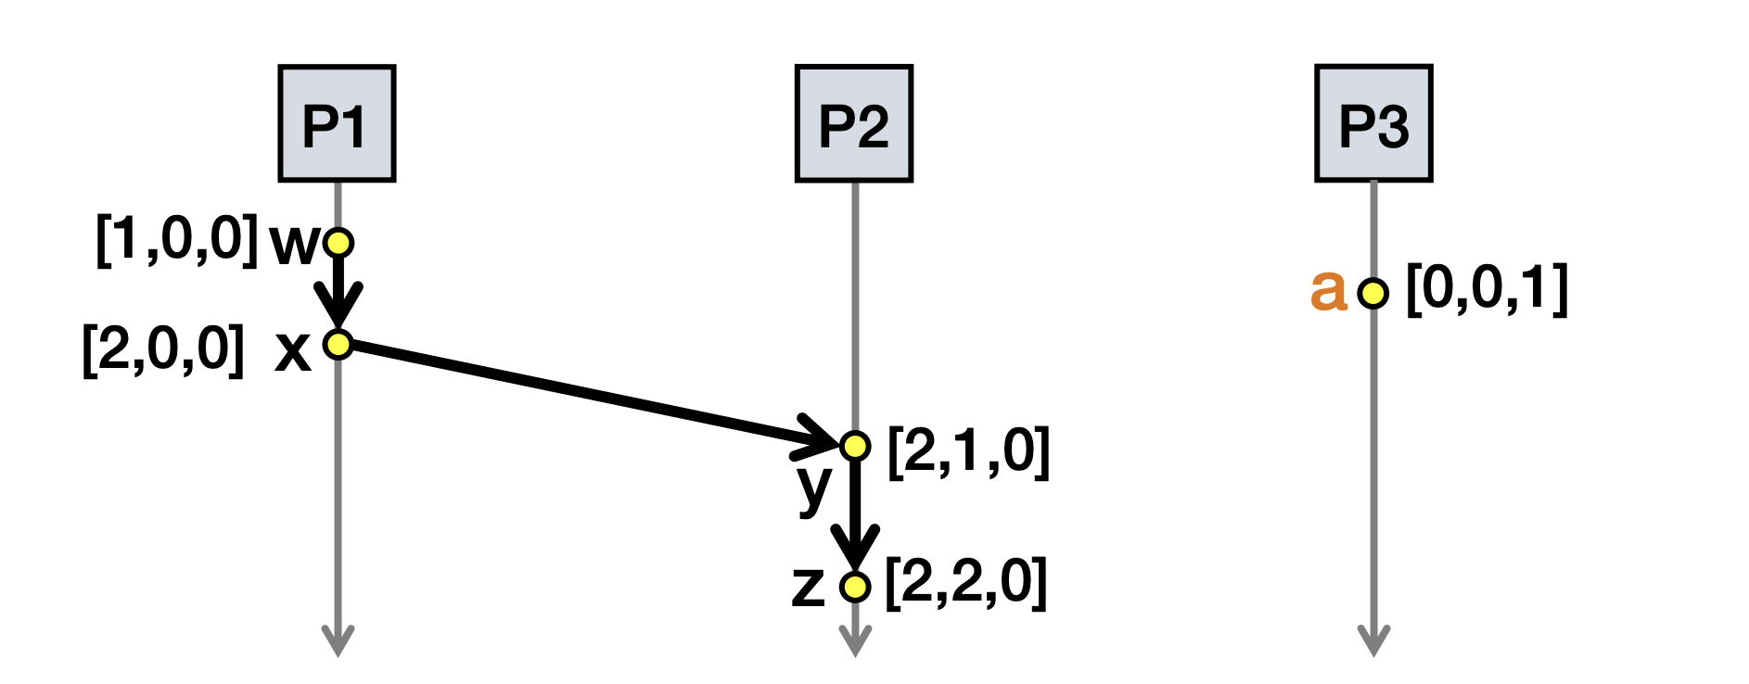
Vector Clock Weaknesses
Notes:
A vector clock’s weaknesses comes down to its size. Vector clocks are larger than lamport clocks and their size scales with the number of processes in the system
For a large number of processes, vector clocks can get pretty long

Slide 14
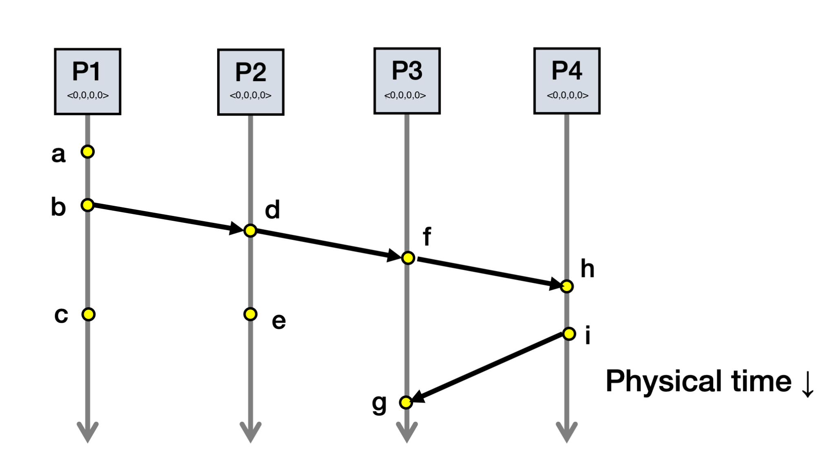
Vector Clock Example
Notes:
A: <1, 0, 0, 0>
B: <2, 0, 0, 0>
C: <3, 0, 0, 0>
D: <2, 1, 0, 0>
E: <2, 2, 0, 0>
F: <2, 1, 1, 0>
G: <2, 1, 2, 2>
H: <2, 1, 1, 1>
I: <2, 1, 1, 2>

