Slide 1
Network Communication and Remote Procedure Calls (RPCs)
COS 418/518: Distributed Systems
Lecture 3
Wyatt Lloyd

Slide 2
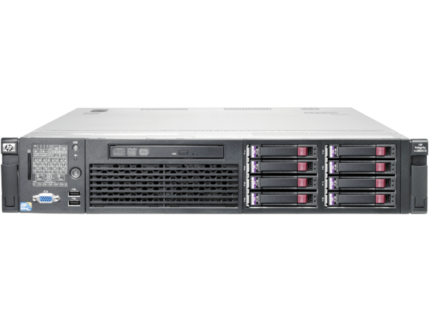
Distributed Systems, What?
Multiple computers
Connected by a network
Doing something together

Slide 3
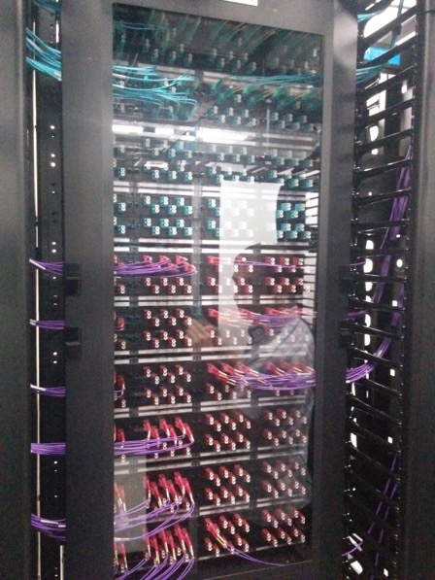
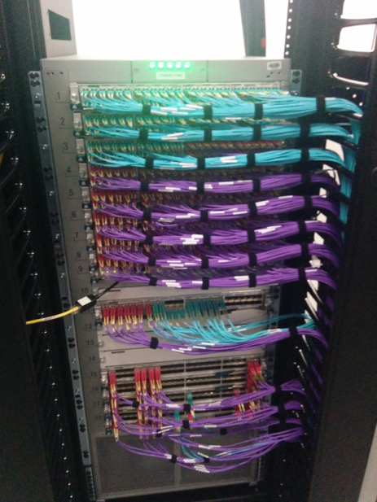

Slide 4
Today’s outline
How can processes on different cooperating computers communicate with each other over the network?
Network Communication
Remote Procedure Call (RPC)

Slide 5
The problem of communication
Process on Host A wants to talk to process on Host B
A and B must agree on the meaning of the bits being sent and received at many different levels, including:
How many volts is a 0 bit, a 1 bit?
How does receiver know which is the last bit?
How many bits long is a number?

Slide 6
The problem of communication
Applications
HTTP
Skype
SSH
FTP
Transmission
media
Coaxial cable
Fiber optic
Wi-Fi
Re-implement every application for every new underlying transmission medium?
Change every application on any change to an underlying transmission medium?
No! But how does the Internet design avoid this?

Slide 7
Solution: Layering
Applications
HTTP
Skype
SSH
FTP
Intermediate layers
Transmission
media
Coaxial cable
Fiber optic
Wi-Fi
Intermediate layers provide a set of abstractions for applications and media
New applications or media need only implement for intermediate layer’s interface

Slide 8
Layering in the Internet
Transport: Provide end-to-end communication between processes on different hosts
Network: Deliver packets to destinations on other (heterogeneous) networks
Link: Enables end hosts to exchange atomic messages with each other
Physical: Moves bits between two hosts connected by a physical link
Host
Applications
Transport layer
Network layer
Link layer
Physical layer

Slide 9
Logical communication between layers
How to forge agreement on the meaning of the bits exchanged between two hosts?
Protocol: Rules that govern the format, contents, and meaning of messages
Each layer on a host interacts with its peer host’s corresponding layer via the protocol interface
Application
Application
Transport
Transport
Network
Network
Network
Link
Link
Link
Physical
Physical
Physical
Host A
Router
Host B

Slide 10
Physical communication
Communication goes down to the physical network
Then from network peer to peer
Then up to the relevant application
Application
Application
Transport
Transport
Network
Network
Network
Link
Link
Link
Physical
Physical
Physical
Host A
Router
Host B

Slide 11
Communication between peers
How do peer protocols coordinate with each other?
Layer attaches its own header (H) to communicate with peer
Higher layers’ headers, data encapsulated inside message
Lower layers don’t generally inspect higher layers’ headers
Application
Application message
Transport-layer message body
Transport
H
Network-layer datagram body
Network
H

Slide 12
Network socket-based communication
Socket: The interface the OS provides to the network
Provides inter-process explicit message exchange
Can build distributed systems atop sockets: send(), recv()
e.g.: put(key,value) → message
Host A
Host B
Application layer
Application layer
Process
Process
Socket
Socket
Transport layer
Transport layer
Network layer
Network layer
Link layer
Link layer
Physical layer
Physical layer
Notes:
Q: Who has done socket programming? How did you like it?

Slide 13
// Create a socket for the client if ((sockfd = socket (AF_INET, SOCK_STREAM, 0)) < 0) { perror(”Socket creation"); exit(2); } // Set server address and port memset(&servaddr, 0, sizeof(servaddr)); servaddr.sin_family = AF_INET; servaddr.sin_addr.s_addr = inet_addr(argv[1]); servaddr.sin_port = htons(SERV_PORT); // to big-endian // Establish TCP connection if (connect(sockfd, (struct sockaddr *) &servaddr,
sizeof(servaddr)) < 0) { perror(”Connect to server"); exit(3); }
// Transmit the data over the TCP connection send(sockfd, buf, strlen(buf), 0);

Slide 14
Socket programming: still not great
Lots for the programmer to deal with every time
How to separate different requests on the same connection?
How to write bytes to the network / read bytes from the network?
What if Host A’s process is written in Go and Host B’s process is in C++?
What to do with those bytes?
Still pretty painful… have to worry a lot about the network
Notes:
Q: How do we make this better?

Slide 15
Solution: Another layer!
Host A
Host B
Application layer
Application layer
Process
Process
RPC Layer
RPC Layer
Socket
Socket
Transport layer
Transport layer
Network layer
Network layer
Link layer
Link layer
Physical layer
Physical layer

Slide 16
Today’s outline
Network Communication
Remote Procedure Call

Slide 17
Why RPC?
The typical programmer is trained to write single-threaded code that runs in one place
Goal: Easy-to-program network communication that makes client-server communication transparent
Retains the “feel” of writing centralized code
Programmer needn’t think about the network

Slide 18
Everyone uses RPCs
COS 418 programming assignments use RPC
Google gRPC
Facebook/Apache Thrift
Twitter Finagle
…

Slide 19
What’s the goal of RPC?
Within a single program, running in a single process, recall the well-known notion of a procedure call:
Caller pushes arguments onto stack,
jumps to address of callee function
Callee reads arguments from stack,
executes, puts return value in register,
returns to next instruction in caller
RPC’s Goal: make communication appear like a local procedure call: way less painful than sockets…

Slide 20
RPC issues
Heterogeneity
Client needs to rendezvous with the server
Server must dispatch to the required function
What if server is different type of machine?
Failure
What if messages get dropped?
What if client, server, or network fails?
Performance
Procedure call takes ≈ 10 cycles ≈ 3 ns
RPC in a data center takes ≈ 10 μs (10³× slower)
In the wide area, typically 10⁶× slower

Slide 21
Problem: Differences in data representation
Not an issue for local procedure calls
For a remote procedure call, a remote machine may:
Run process written in a different language
Represent data types using different sizes
Use a different byte ordering (endianness)
Represent floating point numbers differently
Have different data alignment requirements
e.g., 4-byte type begins only on 4-byte memory boundary

Slide 22
Solution: Interface Description Language
Mechanism to pass procedure parameters and return values in a machine-independent way
Programmer may write an interface description in the IDL
Defines API for procedure calls: names, parameter/return types
Then runs an IDL compiler which generates:
Code to marshal (convert) native data types into machine-independent byte streams
And vice-versa, called unmarshaling
Client stub: Forwards local procedure call as a request to server
Server stub: Dispatches RPC to its implementation
Notes:
xdr 87 sun rock introduced idls

Slide 23
A day in the life of an RPC
Client calls stub function (pushes parameters onto stack)
Client machine
Client process
k = add(3, 5)
Client stub (RPC library)

Slide 24
A day in the life of an RPC
Client calls stub function (pushes parameters onto stack)
Stub marshals parameters to a network message
Client machine
Client process
k = add(3, 5)
Client stub (RPC library)
proc: add | int: 3 | int: 5
Client OS

Slide 25
A day in the life of an RPC
Stub marshals parameters to a network message
OS sends a network message to the server
Client machine
Server machine
Client process
k = add(3, 5)
Client stub (RPC library)
Client OS
Server OS
proc: add | int: 3 | int: 5

Slide 26
A day in the life of an RPC
OS sends a network message to the server
Server OS receives message, sends it up to stub
Client machine
Server machine
Client process
k = add(3, 5)
Client stub (RPC library)
Server stub (RPC library)
Client OS
Server OS
proc: add | int: 3 | int: 5

Slide 27
A day in the life of an RPC
Server OS receives message, sends it up to stub
Server stub unmarshals params, calls server function
Client machine
Server machine
Client process
k = add(3, 5)
Server process
Implementation of add
Client stub (RPC library)
Server stub (RPC library)
proc: add | int: 3 | int: 5
Client OS
Server OS

Slide 28
A day in the life of an RPC
Server stub unmarshals params, calls server function
Server function runs, returns a value
Client machine
Server machine
Client process
k = add(3, 5)
Server process
8 ← add(3, 5)
Client stub (RPC library)
Server stub (RPC library)
Client OS
Server OS

Slide 29
A day in the life of an RPC
Server function runs, returns a value
Server stub marshals the return value, sends message
Client machine
Server machine
Client process
k = add(3, 5)
Server process
8 ← add(3, 5)
Client stub (RPC library)
Server stub (RPC library)
Result | int: 8
Client OS
Server OS

Slide 30
A day in the life of an RPC
Server stub marshals the return value, sends message
Server OS sends the reply back across the network
Client machine
Server machine
Client process
k = add(3, 5)
Server process
8 ← add(3, 5)
Client stub (RPC library)
Server stub (RPC library)
Client OS
Server OS
Result | int: 8

Slide 31
A day in the life of an RPC
Server OS sends the reply back across the network
Client OS receives the reply and passes up to stub
Client machine
Server machine
Client process
k = add(3, 5)
Server process
8 ← add(3, 5)
Client stub (RPC library)
Server stub (RPC library)
Client OS
Server OS
Result | int: 8

Slide 32
A day in the life of an RPC
Client OS receives the reply and passes up to stub
Client stub unmarshals return value, returns to client
Client machine
Server machine
Client process
k ← 8
Server process
8 ← add(3, 5)
Client stub (RPC library)
Server stub (RPC library)
Result | int: 8
Client OS
Server OS

Slide 33
Today’s outline
Network Communication
Remote Procedure Call
Heterogeneity – use IDL w/ compiler
Failure

Slide 34
What could possibly go wrong?
Client may crash and reboot
Packets may be dropped
Some individual packet loss in the Internet
Broken routing results in many lost packets
Server may crash and reboot
Network or server might just be very slow
All of these may look the same to the client…

Slide 35
Summary: RPCs and Network Comm.
Layers are our friends!
RPCs are everywhere
Necessary issues surrounding machine heterogeneity
Subtle issues around failures
… Next time!!!
Host A
Host B
Application layer
Application layer
Process
Process
RPC Layer
RPC Layer
Socket
Socket
Transport layer
Transport layer
Network layer
Network layer
Link layer
Link layer
Physical layer
Physical layer

